Slide 1
The American Voter
Heuristics and Cognitive Biases Among The American Electorate.

Slide 2
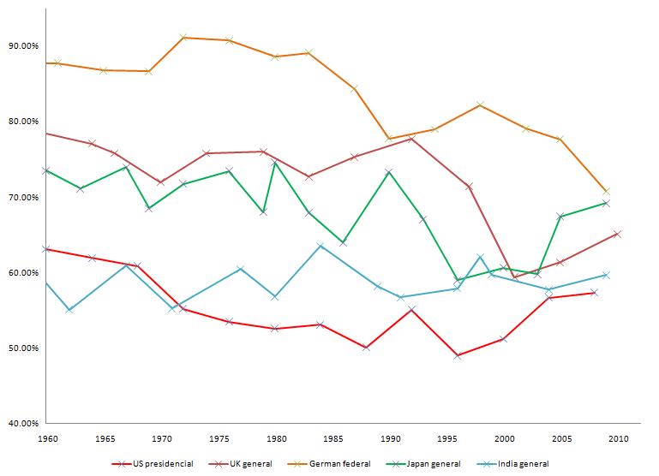
Comparative Voter Turnout 1960-2010

Slide 3
Early Research
The American Voter -1960, Campbell, Converse Miller and Stokes.
“The act of voting requires the citizen to make not a single choice but two. He must choose between rival parties or candidates. He must also decide whether to vote at all” – (pg. 89)
The American Electorate is to uniformed and uninterested in politics to bother to vote.

Slide 4
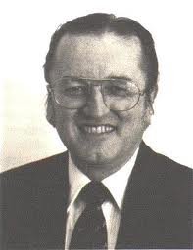
Rational Choice
People don’t vote because they are stupid, People don’t vote because voting is stupid. (to costly)
V=PB – C + D
V = Whether A person Will Turnout to Vote
PB = Probability the Casters Vote Will Matter
C = The Cost of Voting
D = a sense of Duty that benefits the voter.
V = PB – C
An Economic Theory of Democracy

Slide 5
Evolution of Rational Choice
Pocketbook Voting
Running Tally

Slide 6
But What About That D Term?

Slide 7
The Decline of Rational Choice
Cognitive Revolution
Behavioralism
Advances in Technology Allow social scientists to study the brain in ways that Downs and other Rational Choice Theorists never could.
Political scholars begin to doubt the concept that voters develop in isolation.
Effect of Parenting.

Slide 8
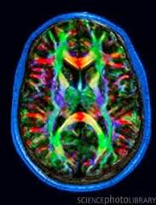
The Role of Affect
Disposition System
Surveillance System
Heuristics
Cognitive Biases

Slide 9
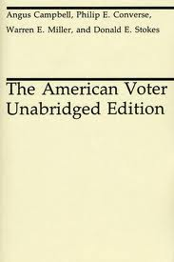
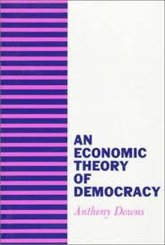
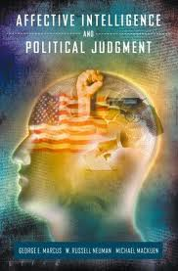
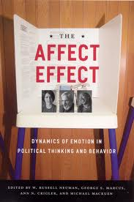
Works Cited

