Slide 1
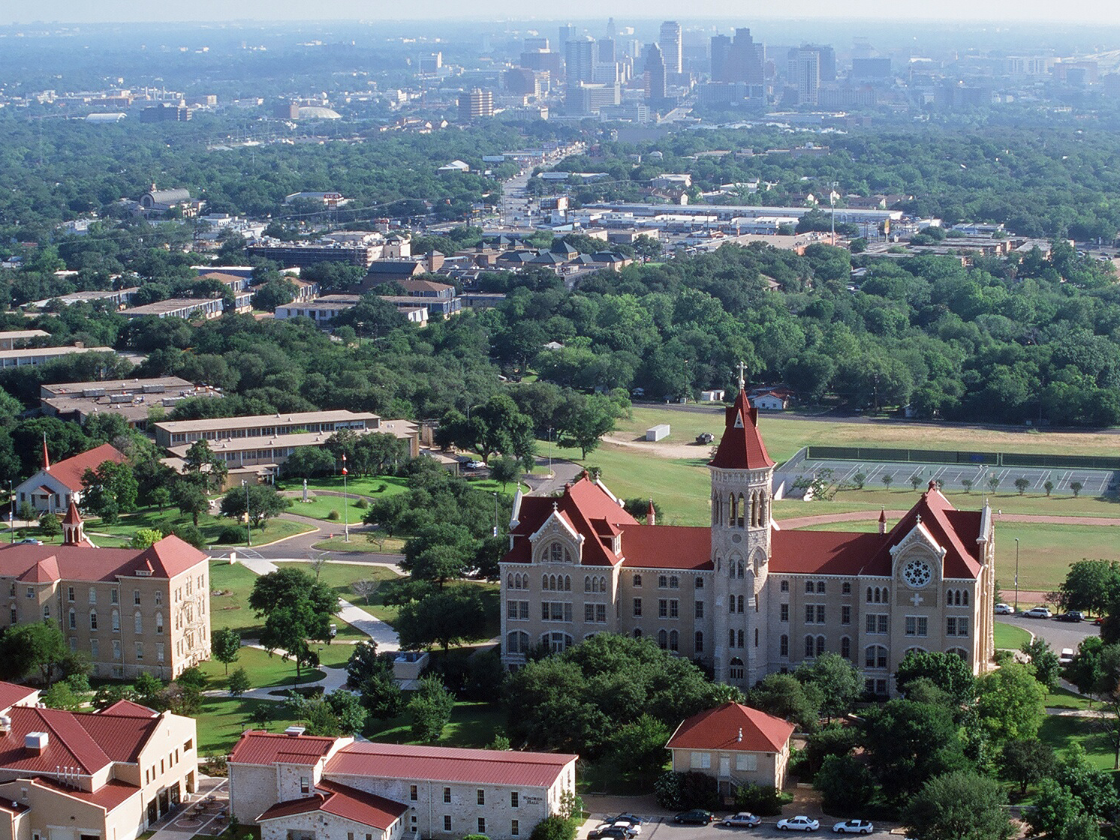
Bookstore

Slide 3
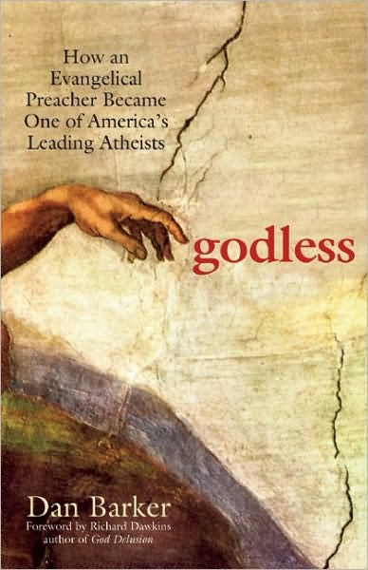
What’s Wrong With the Bible?

Slide 5
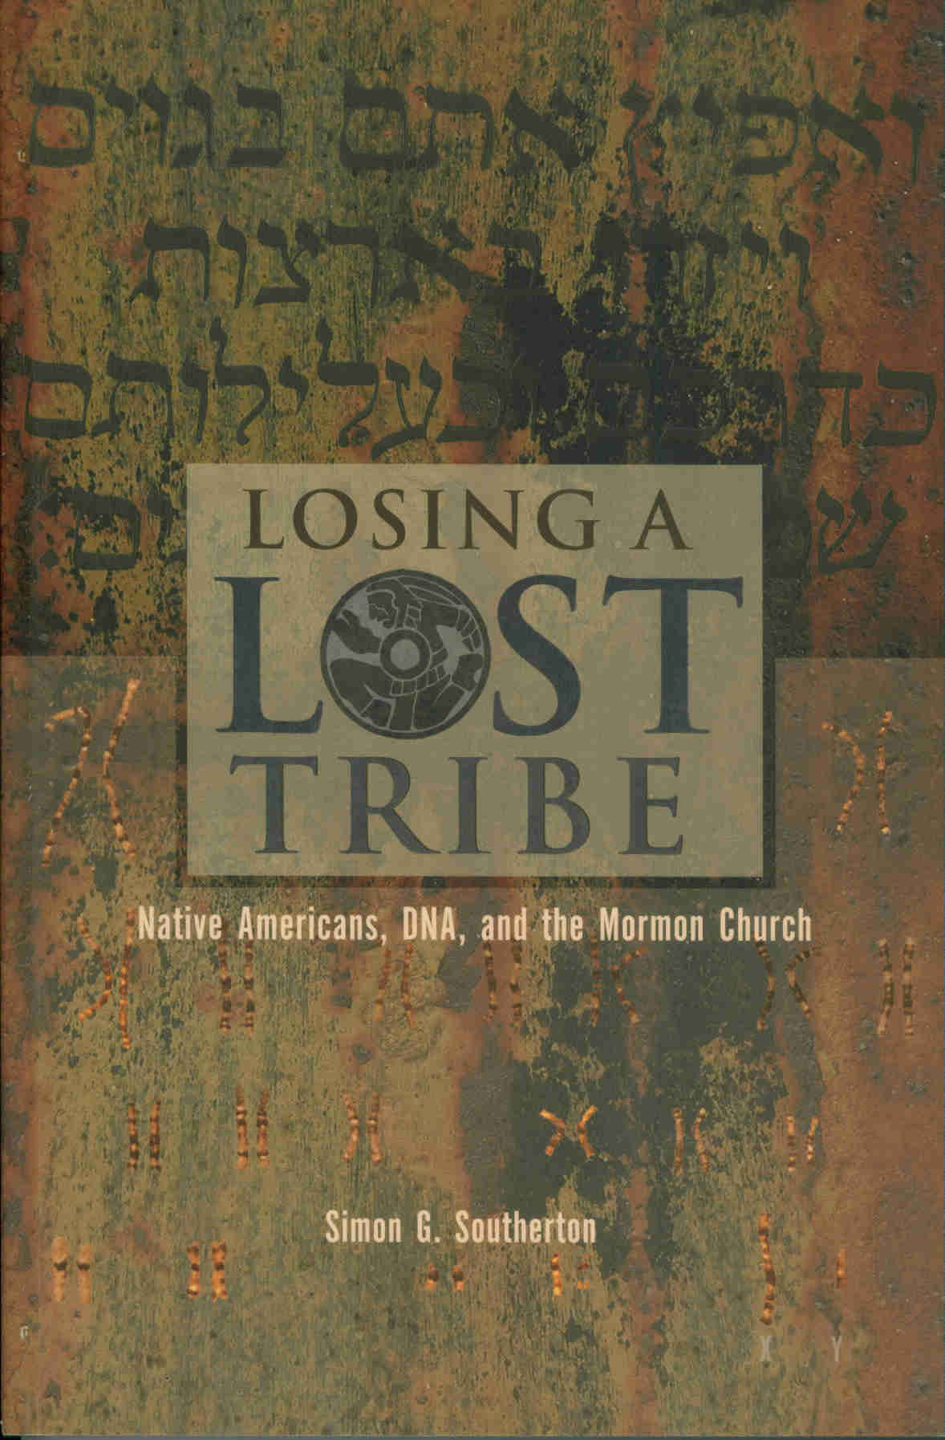
Group B

Slide 6
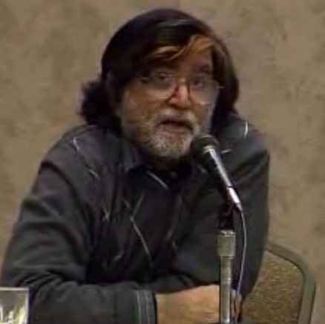
Group C

Slide 7
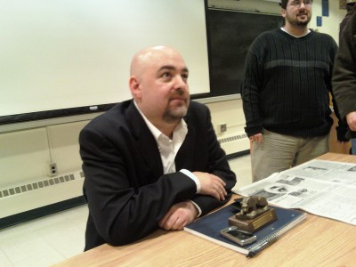

Slide 9
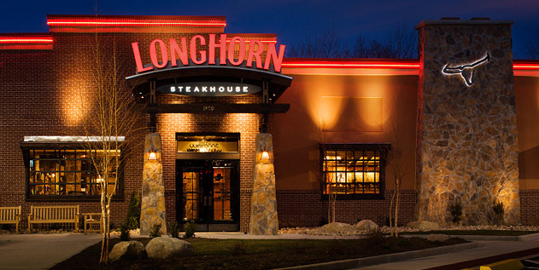
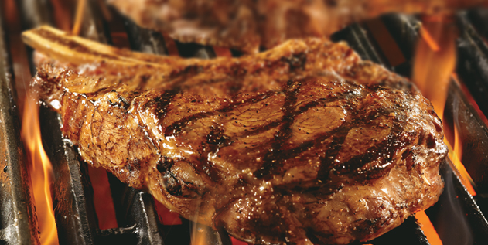
Craving

Slide 11
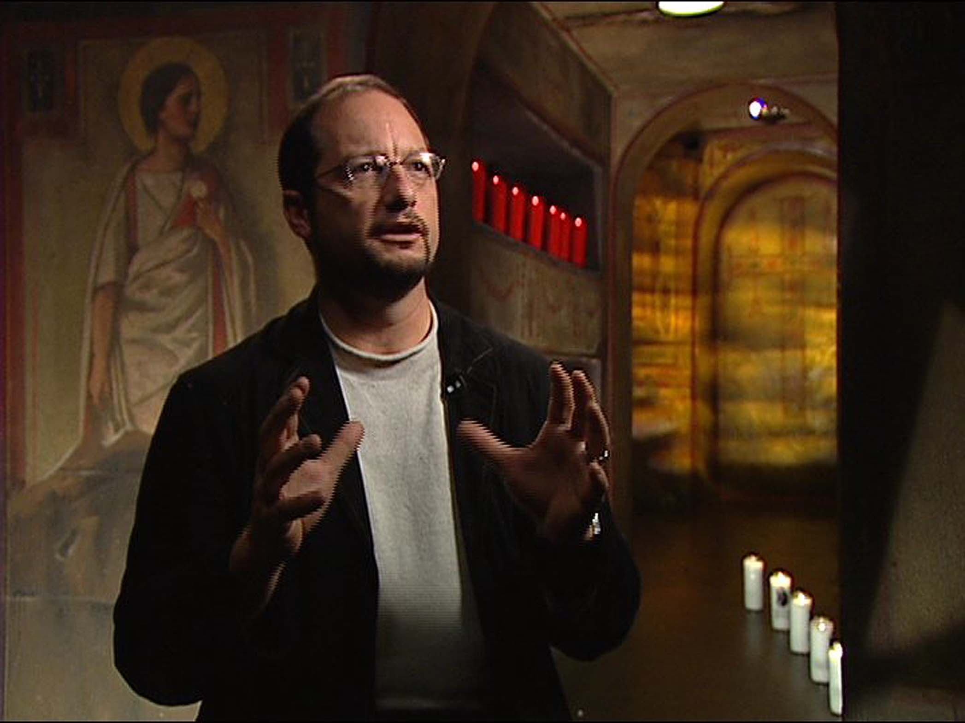
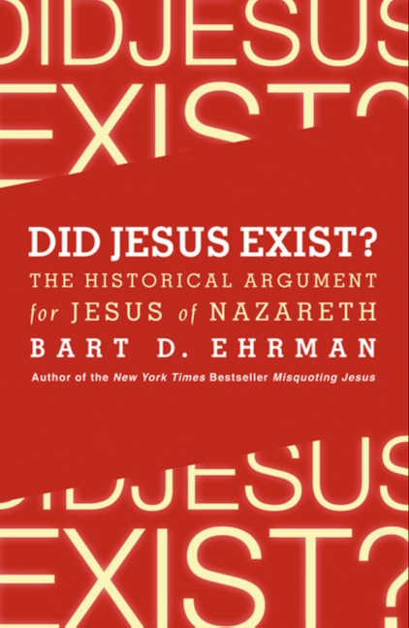
Ridiculous
Absurd

Slide 12
Didn’t there have to have been a Jesus?
No direct evidence for anything Jesus said or did

Slide 13
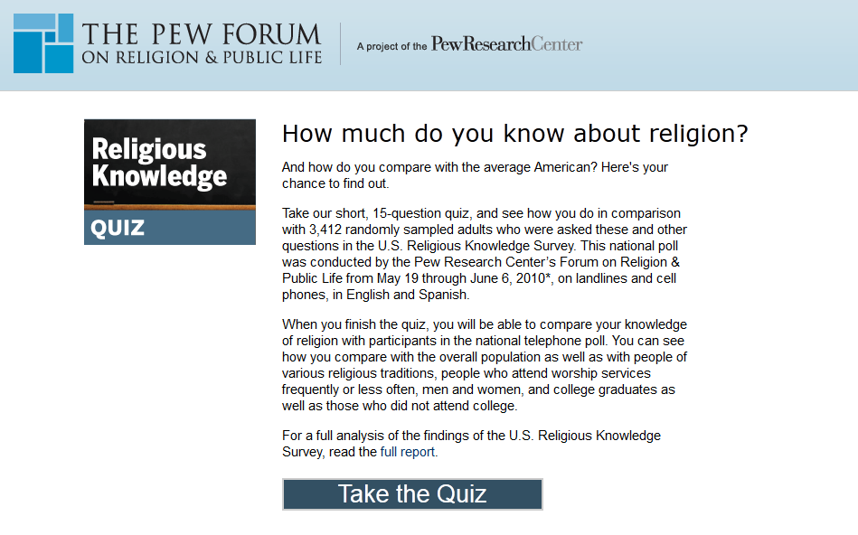
CNN

Slide 14
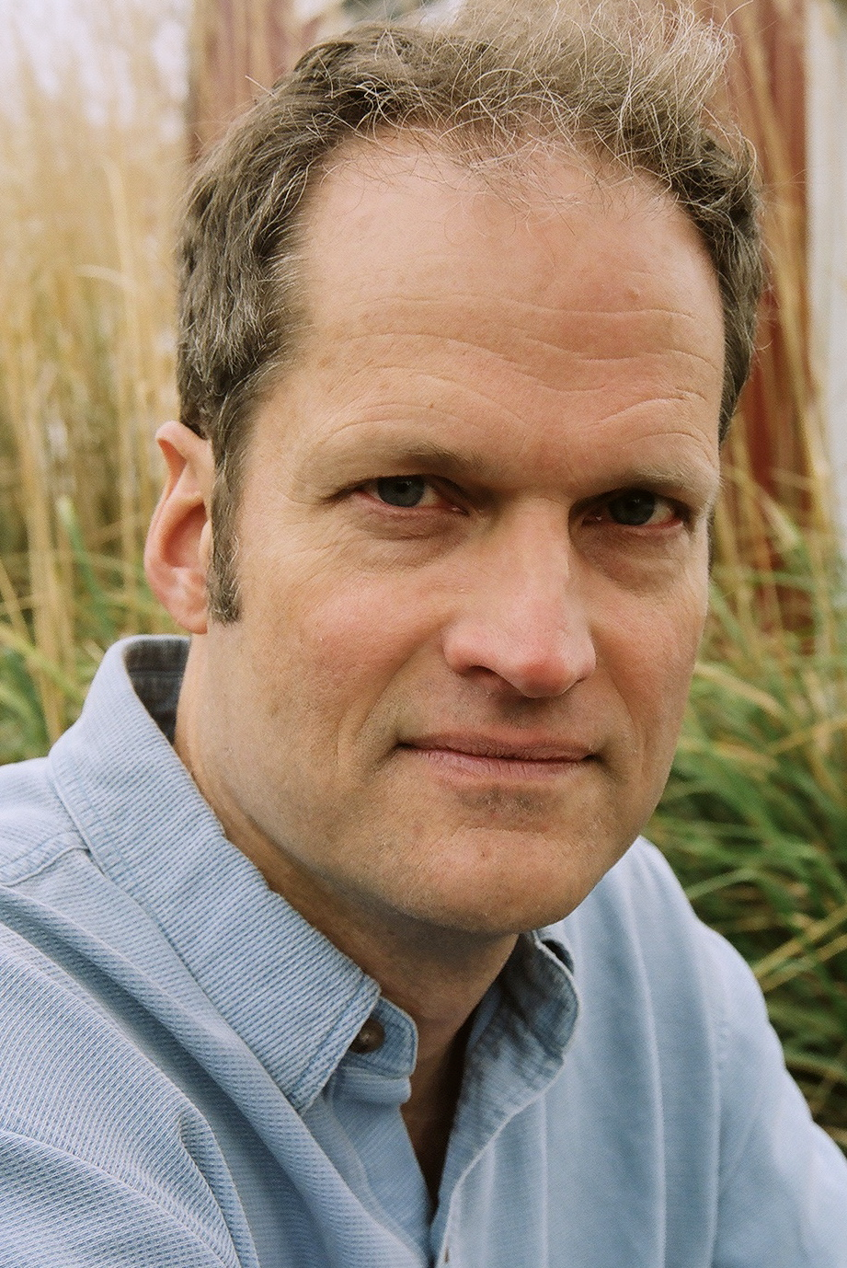

Slide 15
Greatest Story Never Read
Religion of the heart “Feelings”
Vs.
Critical Knowledge
Experiential Faith

Slide 16
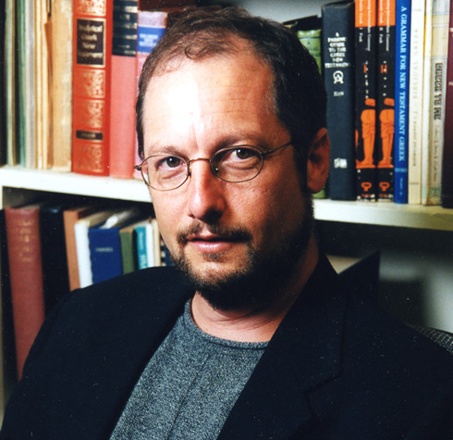
Seminarians learn the historical-critical method in their Bible classes
Forget all about it when it comes time for them to be pastors
Approach the Bible devotionally

Slide 17
Religious Education = Repetition
Rote Memorization
Great for memorizing dogma, awful for critical understanding

Slide 18
Without applying critical historical method to studying Bible, doctrine/dogma confirms prejudices
Confirmation Bias

Slide 19
Jeff Bethke

Slide 20
My generation wants authenticity
My whole point in writing the poem is to separate the two, to help people get the blurriness out of their eyes so they can see Jesus for who he really is

Slide 21
Dispassionate Objective Critical

Slide 22
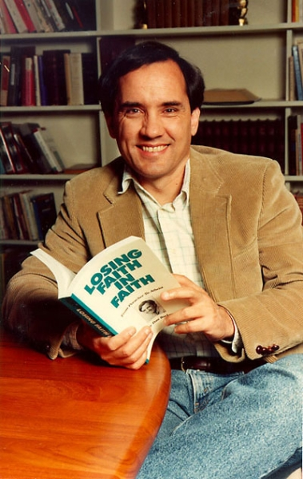
Reasonable Propositions
Verification (what evidence or observations confirm it?)
Repeatability (can anyone replicate the results?)
Falsifiability (what would disprove it?)
Parsimony (simplest explanation)
Logic (free of contradictions)

Slide 23
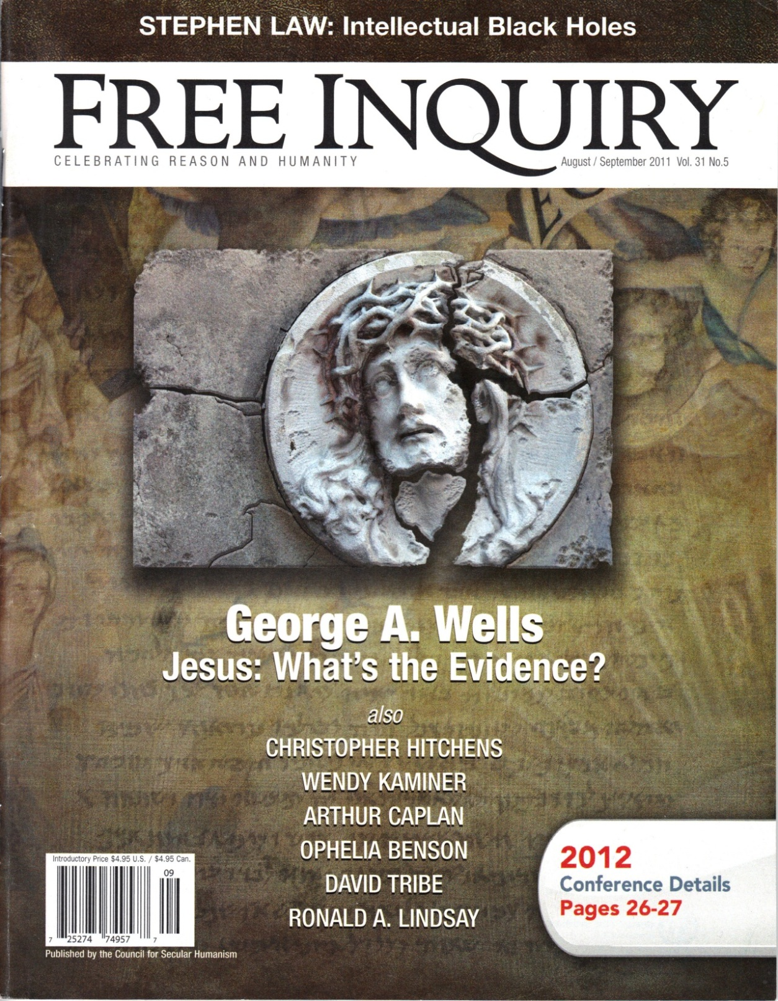

Slide 24
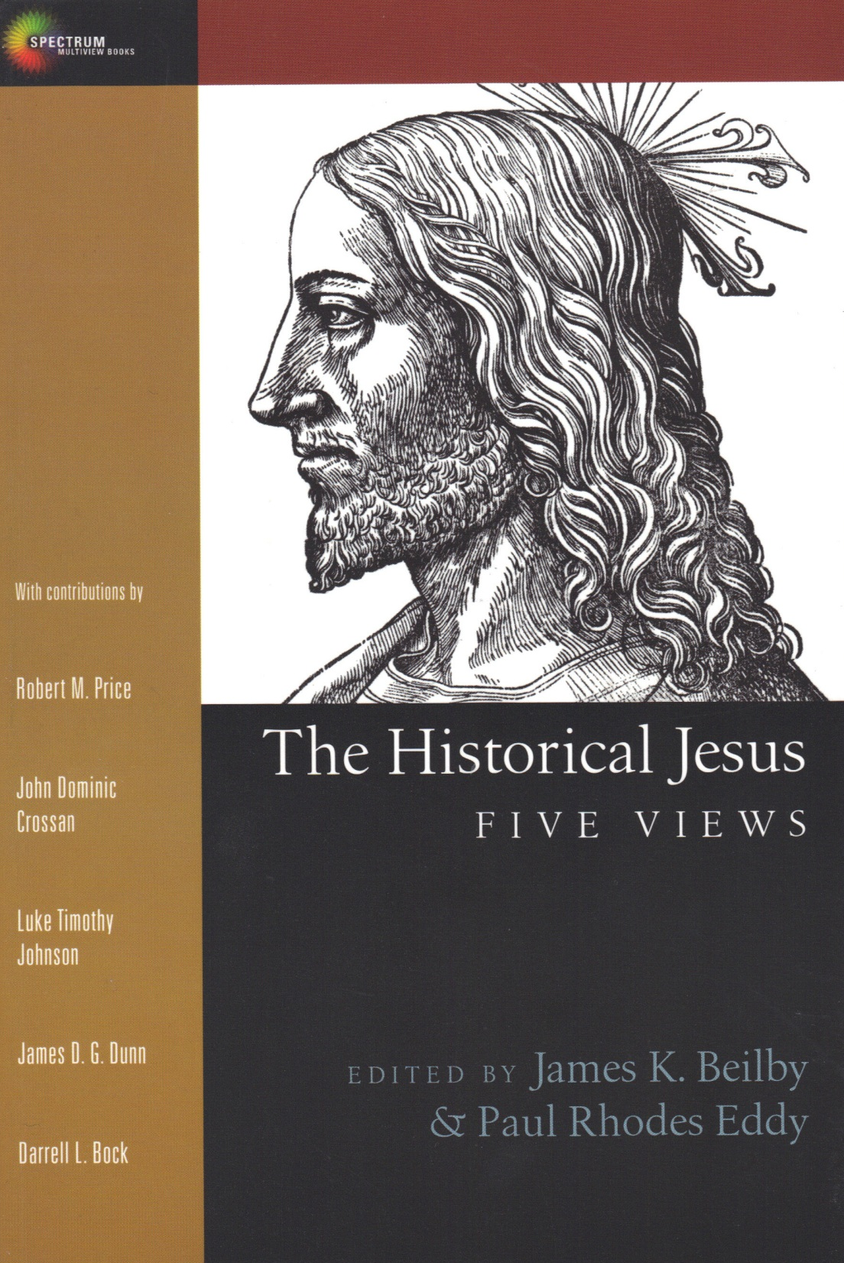
Three Schools Thought:
Christ-Myth Theory
Criteria of Double Dissimilarity (CDD)
Christian Apologetics

Slide 25
Christian Apologetics:
Tradition populated mostly by Christian preachers or theologians
Primary mission = defend a priori belief in historical truth of New Testament Messiah

Slide 26
Criteria Double Dissimilarity:
Historical methodology first developed by Rudolf Bultmann now adopted by a majority of Biblical historians
No saying ascribed to Jesus may be counted as authentic if it has parallels in Jewish or early Christian sayings

Slide 27
Criteria Double Dissimilarity:
Also requires ignoring the mythological and pagan elements in the gospels, hence the “double” dissimilarity
Scholars focus on what Jesus, as a hypothesized historical figure, must have been

Slide 28
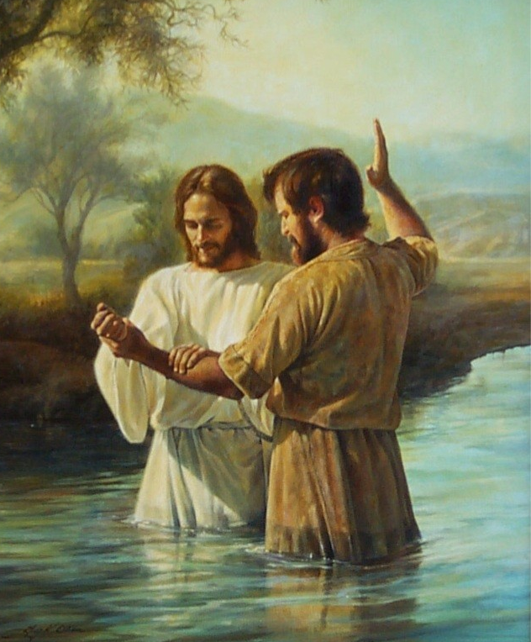
Does not support Christian agenda
Jesus subordinate to John

Slide 29
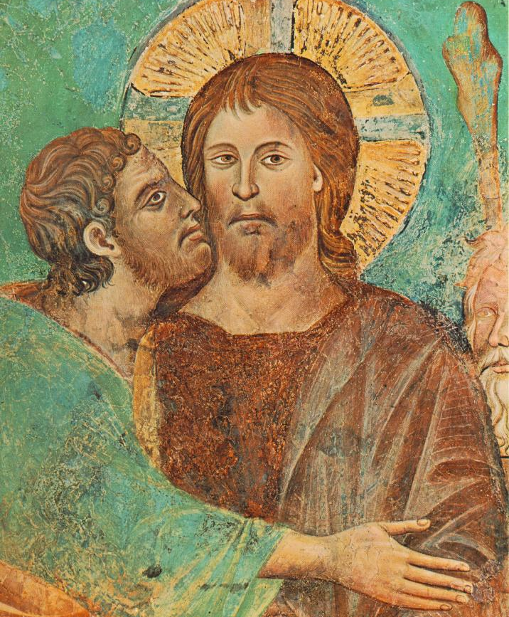
Does not support Christian agenda
Jesus turned in by close ally?

Slide 30
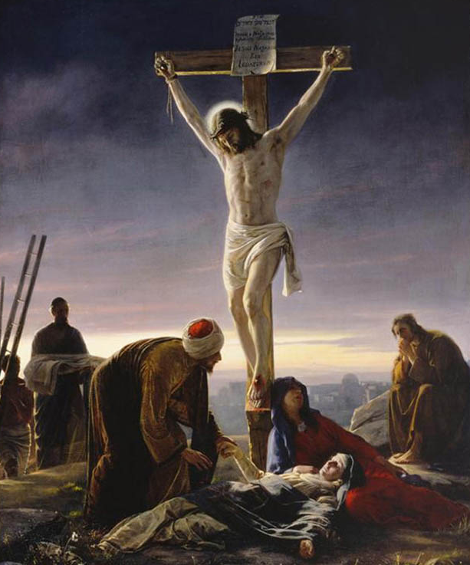
Does not support Christian agenda
Messiah/Savior Crucified?

Slide 31
Criteria Double Dissimilarity:
Since many of the elements in the Bible came from pre-Christian Jewish movements or post-Jesus Christian apologetics, Jesus (according to CDD) is to be found somewhere between the two

Slide 32
Criteria Double Dissimilarity:
The “historical Jesus” remains only an unproven theory
Jesus the historical figure is the binding element given to any untraceable idea, phrase, philosophy or theology from a specific time period

Slide 33
Criteria Double Dissimilarity:
Only way to talk about historical Jesus = talk about type of person could have been
Either a historical Jew transformed into something very different by his followers, or …
Nothing at all

Slide 34
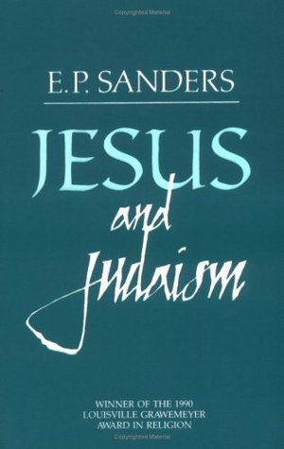
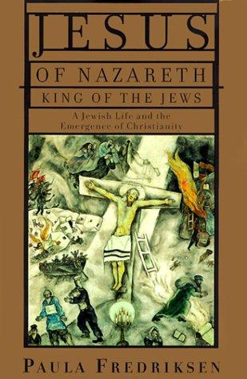
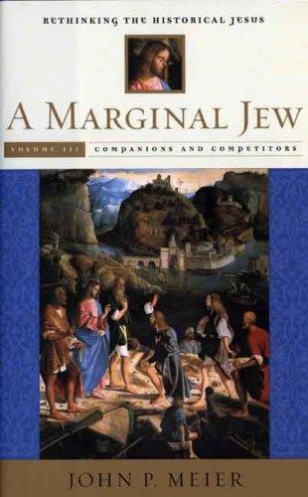
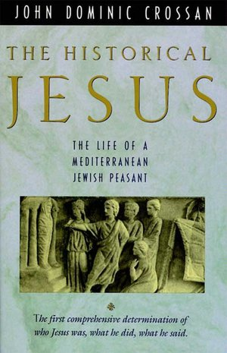

Slide 35
Jesus & Judaism

Slide 36
Criteria Double Dissimilarity:
The problem with this line of reasoning …
Close examination of Jewish sources finds very little in Gospels that cannot be traced to earlier movements within Judaism

Slide 37
Criteria Double Dissimilarity:
The main problem with the human, Jewish Jesus at the center of modern research into biblical history is that nobody really believes in him
He is necessary hypothesis to preserve possibility of Christian faith …

Slide 38
Criteria Double Dissimilarity:
But he is nobody’s hero or savior; only a historical premise
In proving the historical Christ, they are also, albeit indirectly, disproving the Jesus of faith

Slide 39
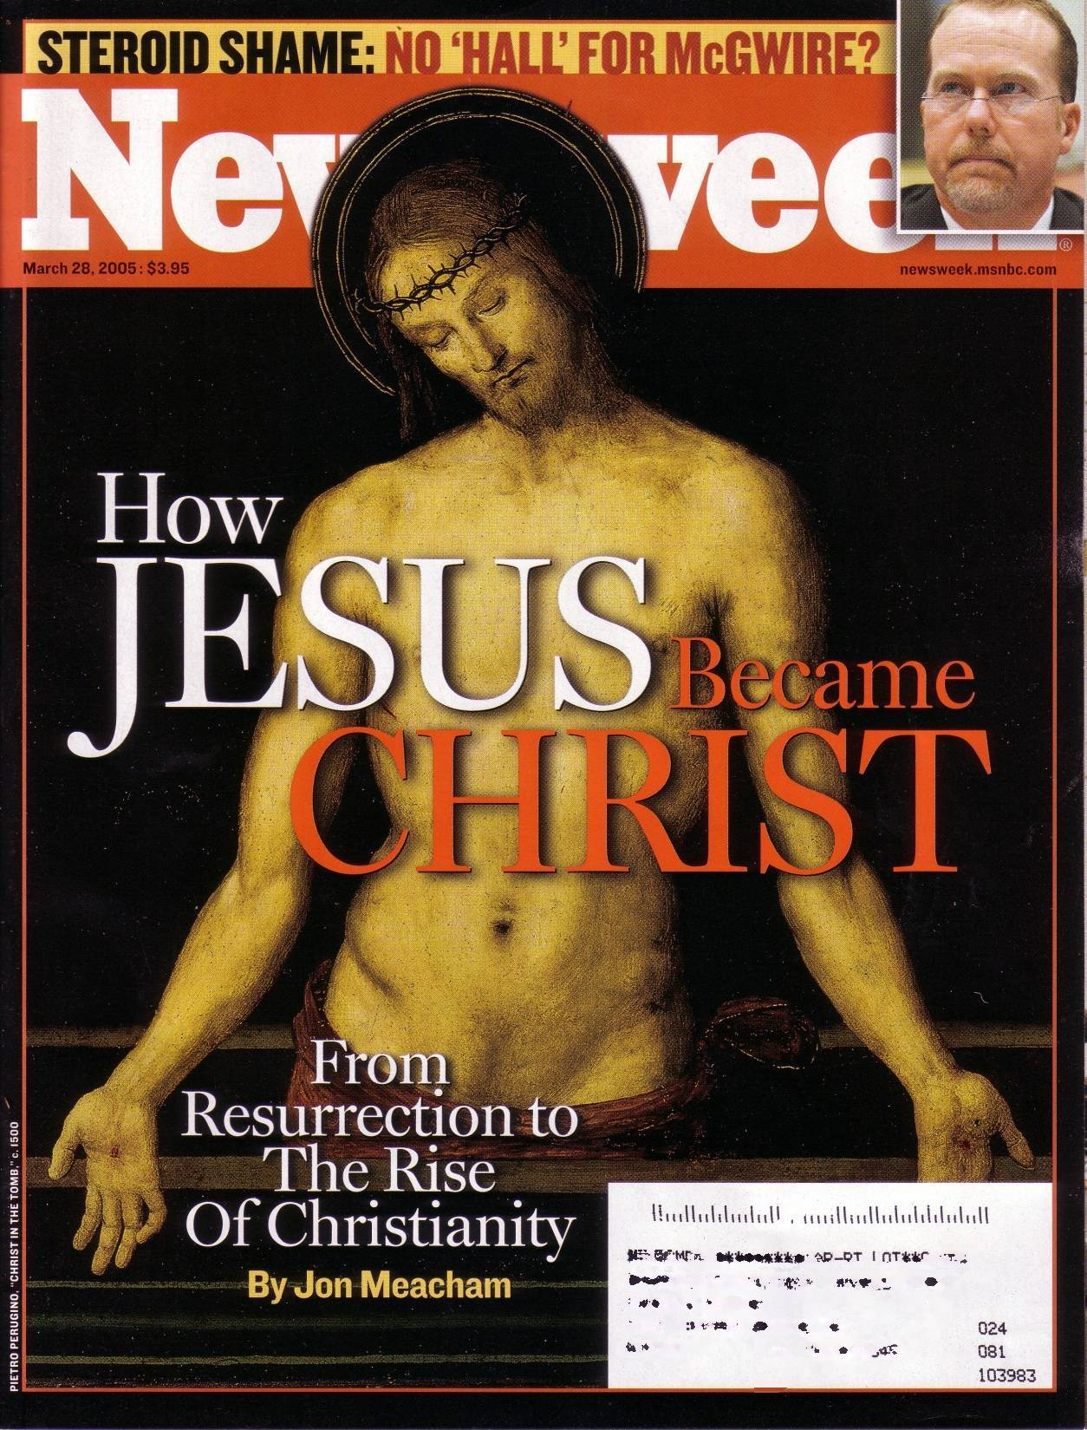
In the long publishing history of the “Lives of Jesus” books he is an exorcist, healer, prophet, sage, rabbi, demigod, messianic king, progressive Pharisee, Galilean shaman, magus, or a Hellenistic sage

Slide 40
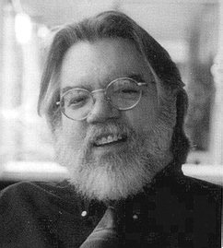
The “historical Jesus” emerged from every one of these historical plastic surgeries looking like the surgeon who operated on him

Slide 41
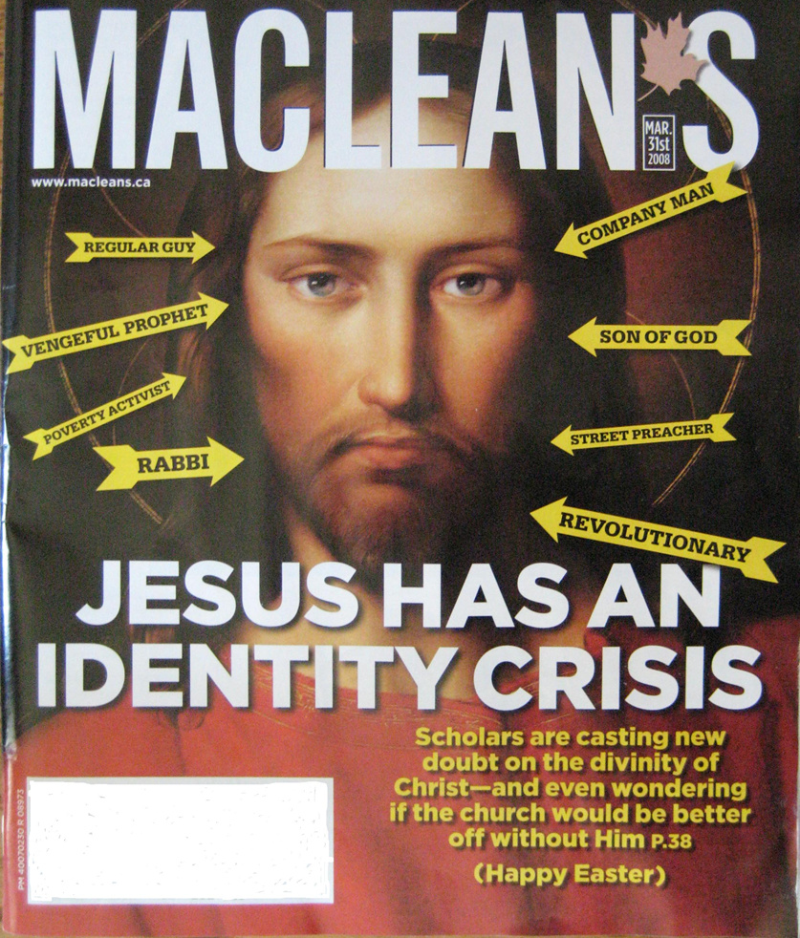

Slide 43
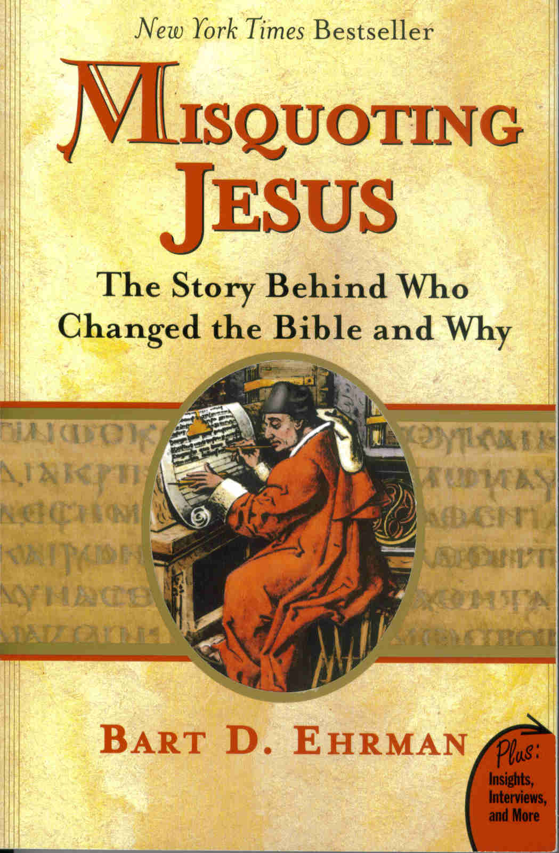

Slide 44
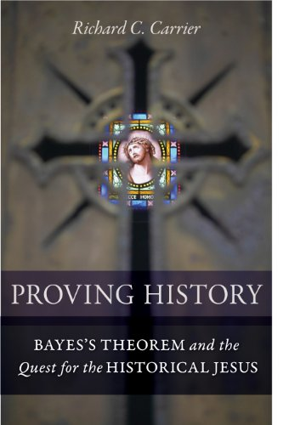

Slide 45
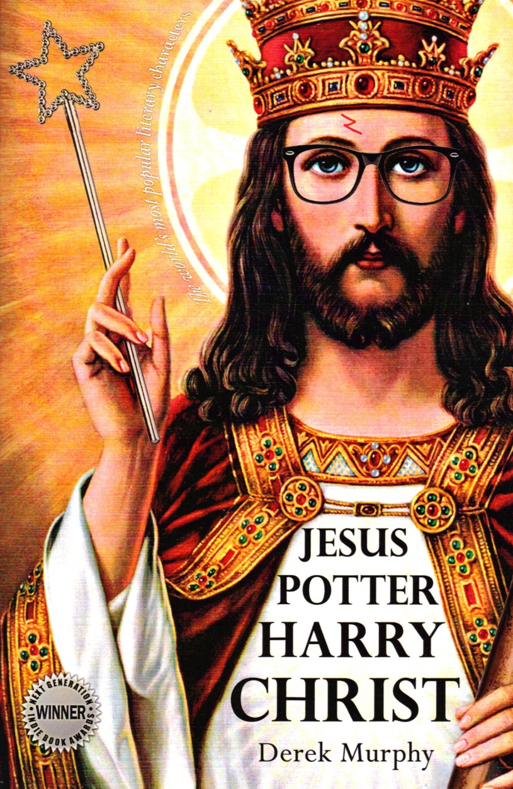
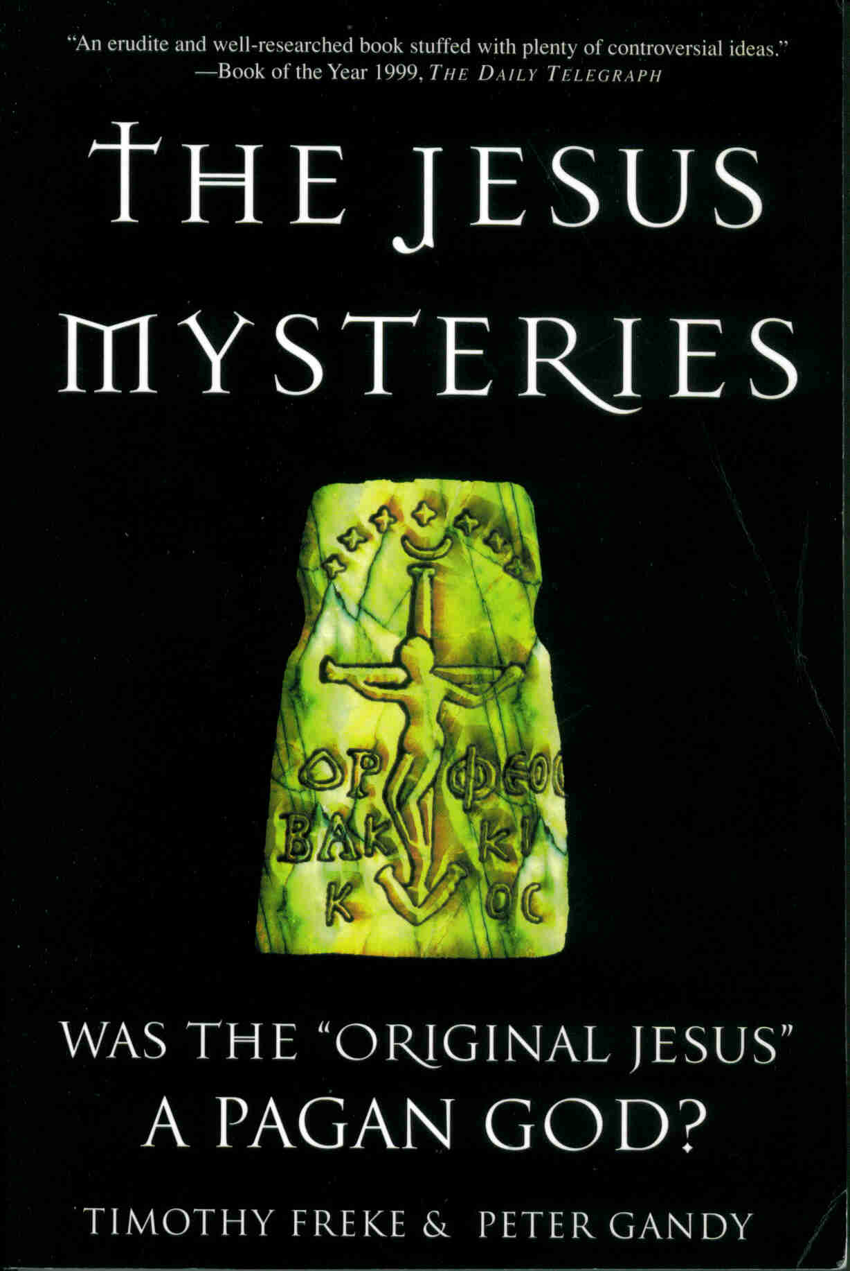

Slide 46
Did Jesus Exist?
No external historical confirmation for New Testament stories
New Testament stories internally contradictory
Natural explanations for origin of Jesus legend
Miracle reports make Jesus story unhistorical
Most Convincing?

Slide 47
Jesus was wildly famous – but there was no reason for contemporary historians to notice him …

Slide 48
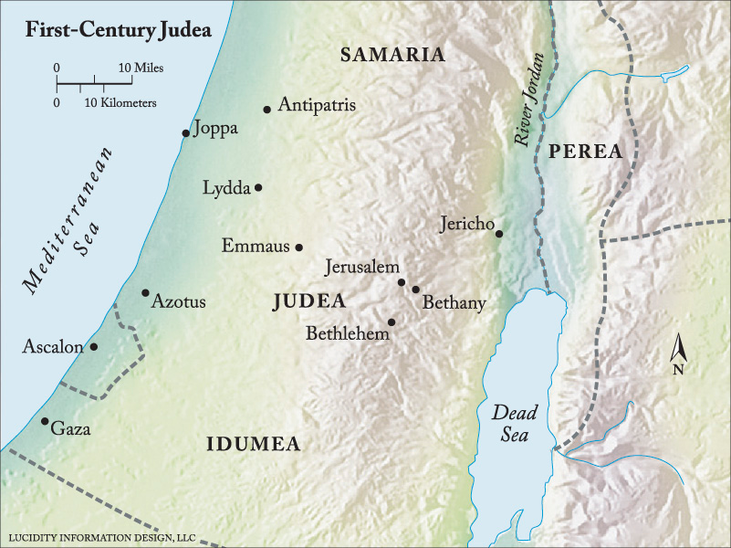
Judea turbulent province of vital strategic importance to Rome

Slide 49
First century considered one of the best-documented periods in history

Slide 50
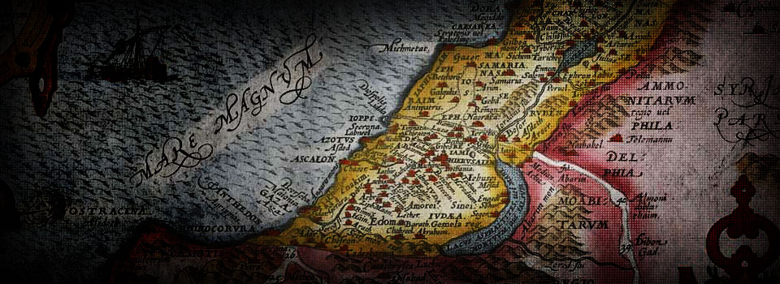
There were many first century writers, philosophers, historians, and other commentators who had good reason to notice Jesus and a wealth of their writings still exist today

Slide 51
Important figures like Epictetus, Pomponius Mela, Martial, Juvenal, Seneca the Younger, Gallio, Seneca the Elder, Piny the Elder, Plutarch, Justus of Tiberias, Philo of Alexandria, Nicolaus of Damascus and more

Slide 52
And these are just the contemporaries; there are still later commentators who we would expect to have mentioned Christ, but did not

Slide 53
According to the Gospels, Jesus was the rock star of first century Judea
Renown not just throughout all Jerusalem but entire region of Palestine, the Decapolis and Syria
Book of Acts—Jesus’ fame quickly spreads to Asia Minor, Egypt, Greece, Rome and throughout the Mediterranean world

Slide 54
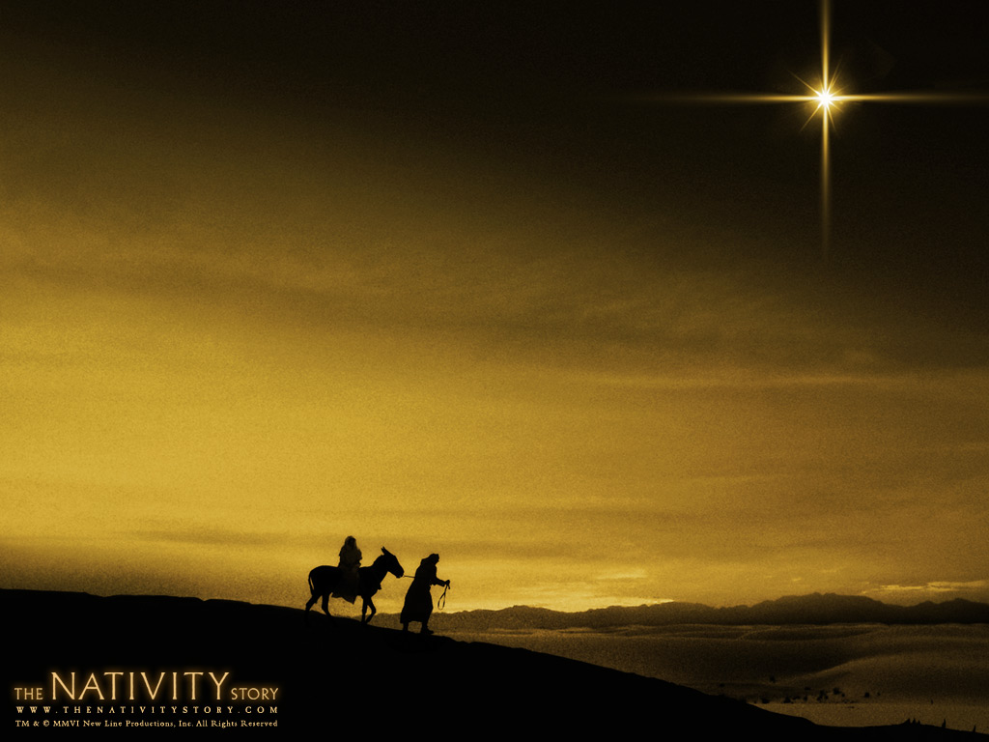
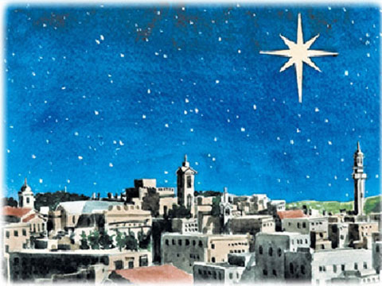
Unrecorded Miracles

Slide 55
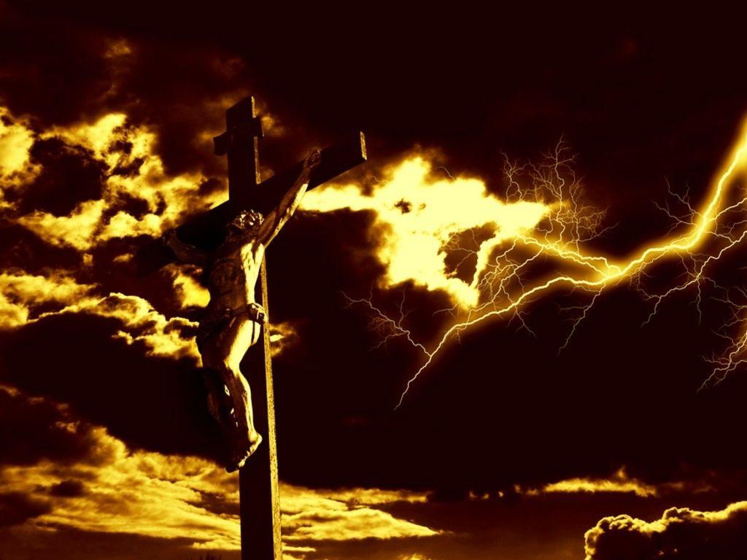
3-hour Supernatural Darkness over “all the land”
Two Major Earthquakes
Mass Resurrection of Many Jewish Saints

Slide 56
Outside New Testament Gospels there is no mention of Jesus whatsoever for nearly a century after Jesus’ alleged death

Slide 57
Christians themselves were responsible for the lion’s share of all ancient writings that survived

Slide 58
Silence surrounding historical Jesus that lasted for centuries occurs even in an environment where the odds were stacked completely in favor of the Christian scribes and copyists

Slide 59
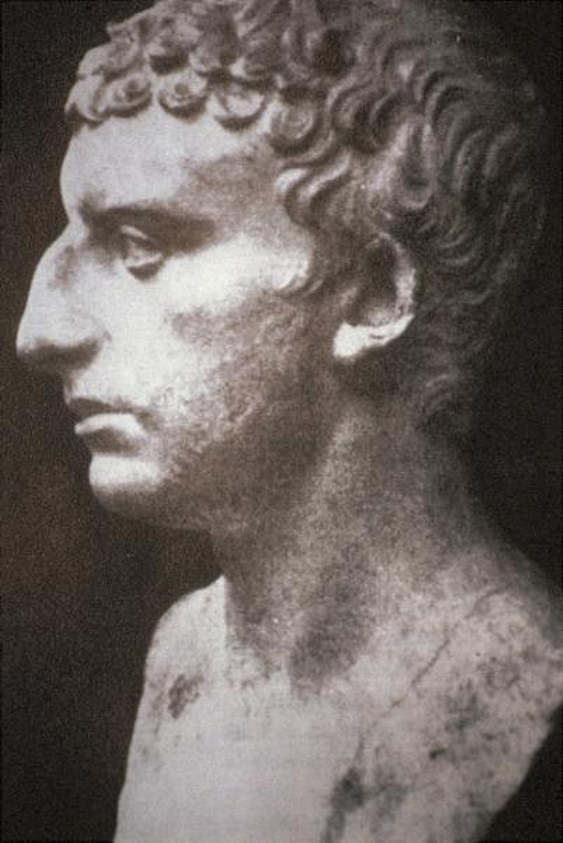
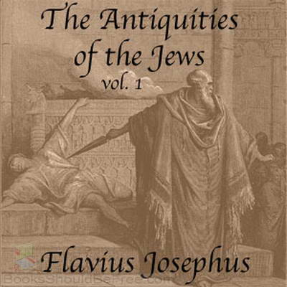
Written 93 or 94 CE

Slide 60
Now there was about this time Jesus, a wise man, if it be lawful to call him a man; for he was a doer of wonderful works, a teacher of such men as receive the truth with pleasure. He drew over to him both many of the Jews and many of the Gentiles. He was (the) Christ. And when Pilate, at the suggestion of the principal men amongst us, has condemned him to the cross, those that loved him at the first did not forsake him; for he appeared to them alive again the third day; as the divine prophets had foretold these and ten thousand other wonderful things concerning him

Slide 61
Absent from earlier copies (4th CE addition)
Not used “the Christ” or “the truth”
Passage out of context
No “tribe of Christians” during Josephus’ time
No reference to Christianity outside passage
Exaggerated language unlike Josephus

Slide 62
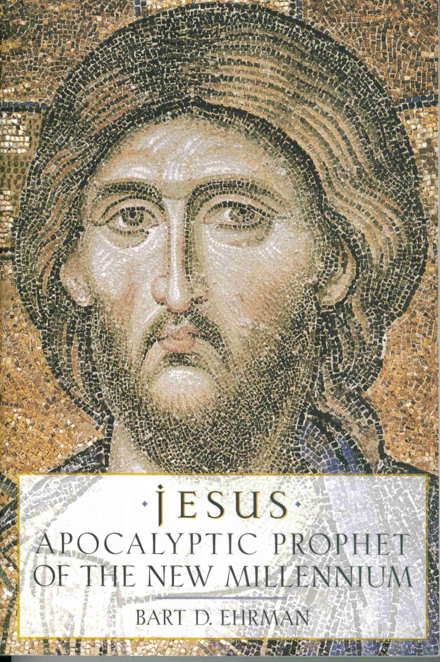
Not much information about historical Jesus outside New Testament canon
A judgment that anyone who looks carefully at the historical record would have to draw, whether Christian, Jewish, Muslim, Buddhist, Hindu, agnostic, or atheist

Slide 63
Even although there are lots of other gospels out there, they are almost entirely late or legendary
No matter how you slice it, you have to rely on the New Testament if you want to know about the life of the historical Jesus

Slide 64
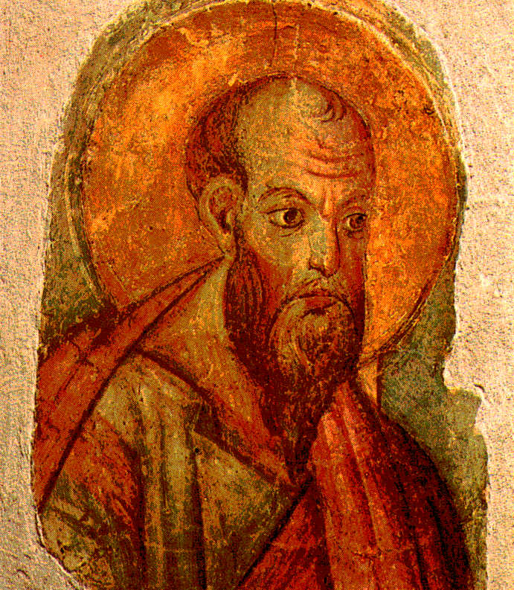
Earliest Writings
Mid-50s CE
Paul of Tarsus

Slide 65
Can you assume that Christ and the historical Jesus are one in the same?

Slide 66
Paul writes of disembodied spiritual Christ
No parents, virgin birth, baptism, miracles, historical activities, sermons, healings, arrest

Slide 67
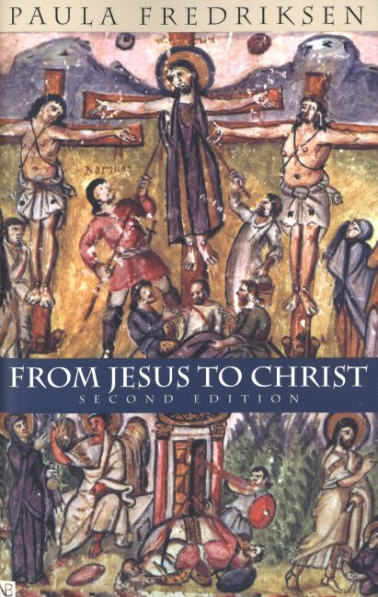
Did Paul even know there was supposed to be a real person named Jesus?
If you look for biographical info on the late Jesus of Nazareth from Paul or from any non-gospel Christian writer in the entire first century, you are out of luck—
No one has anything to say about Jesus the Human Being

Slide 68
The Christ in Paul’s writings is a different character from the Jesus of the Gospels

Slide 69
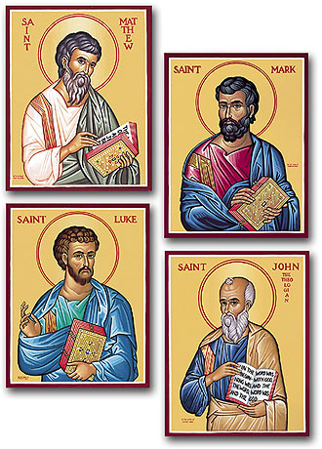
Gospels—Written by Eyewitnesses?
Written no earlier 70 CE
90s CE & later more likely
Don’t know who wrote them, or when, or where
Pretend to be biographies of Jesus
Names added late 2nd C.

Slide 70
Independent Eyewitnesses?
Luke & Matthew copied extensively from Mark
Luke 50%
Matthew 90%
Of the 661 verses in Mark’s Gospel …
Luke uses 360
Matthew 607
“Synoptic Gospels”

Slide 71
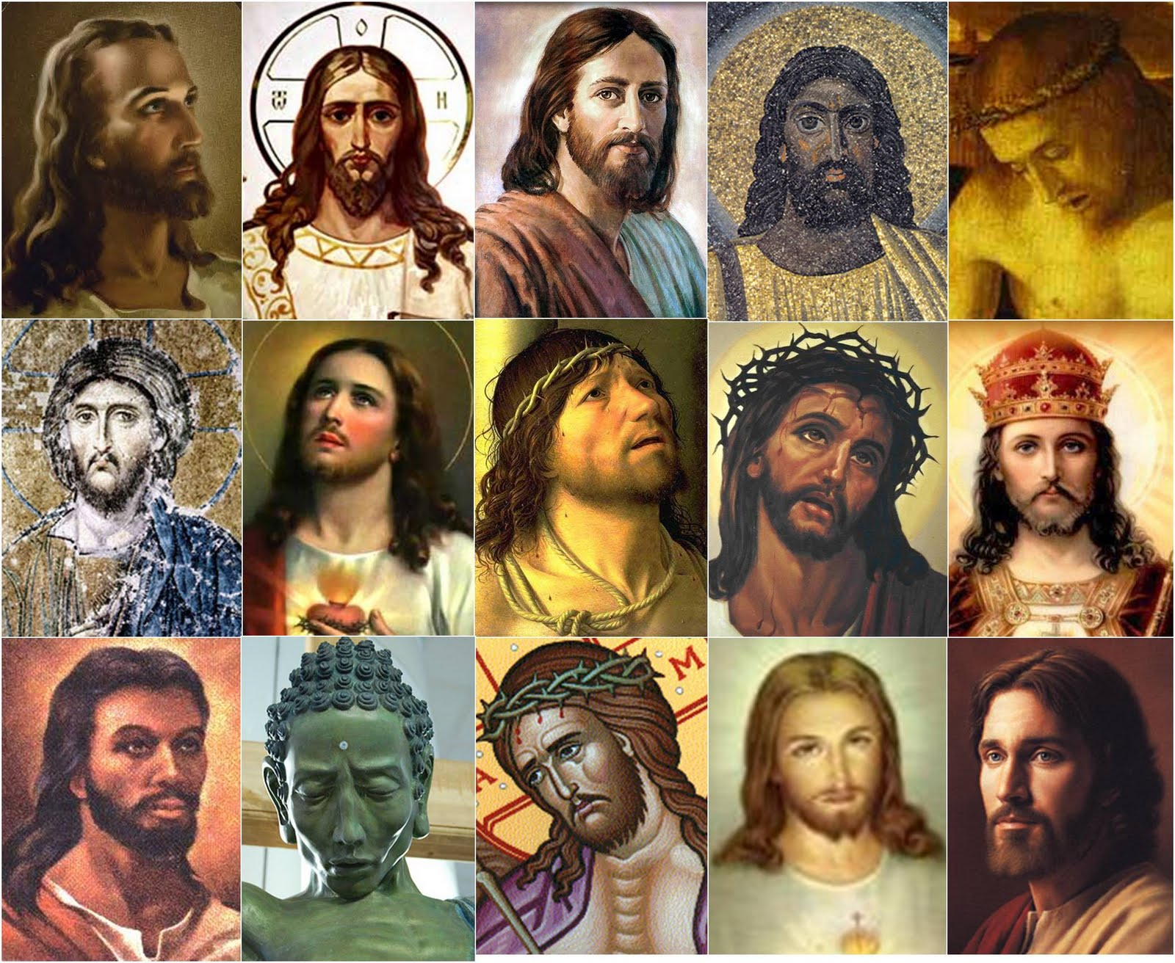
Gospels give us a consistent picture
of Jesus?

Slide 72
A fallible, suffering human
“Secret Messiah” hiding true identity
Denying he is God
Uses magic
Loses his temper
Repeatedly tells people he will return during their lifetimes
Dies in despair

Slide 73
New & improved Mark
Dark & suspenseful nativity, suitable genealogy, longer ending, embellishing Jesus’ deeds, plenty miracles
Most Jewish Jesus
Claims Jesus’ life prophesied in Hebrew scriptures
No immanent return … “some day”

Slide 74
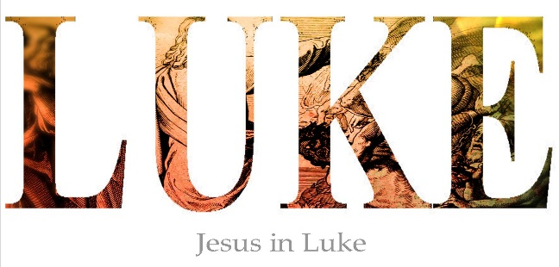
Jesus is serene, beatific, unflappable, faultless
Zen master image of dignified perfection
Happy, angst-free nativity, brand new genealogy—completely irreconcilable with Matthew’s versions
While Mark’s Jesus dies in anguish and despair, Luke’s Jesus exits with composure and acceptance
Will NOT be right back during follower’s lifetimes

Slide 75
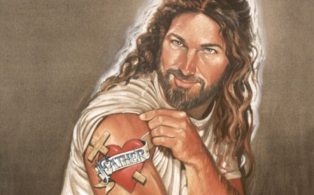
John’s Jesus
Superman—large & in charge, he knows he’s God
Not born of a virgin, not born in Bethlehem
Ministry = 3 years not 1 (as per other Gospels)
Republican Jesus—no parables, no Sermon on Mount
Hates the Jews—brought up 71 times, over half in nasty anti-Semitic fashion

Slide 76
John’s Jesus
No Lord’s Supper
John’s SuperJesus does not cry or need angels to comfort him
Doesn’t let Judas kiss on his Jesus, or let anyone carry his cross up the hill for him
John has virtually nothing in common with any other Gospel—theme, content, time duration, order of events, style, or Jesus’ sayings

Slide 77
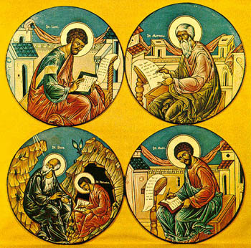
Conclusions?
Gospels written with agenda
Each writer had angle, axe to grind
Written long after Paul’s Epistles
By members of fanatical cult
Believed their dreams were communications from God

Slide 78
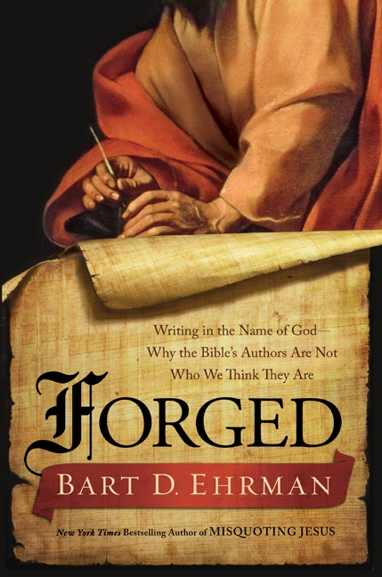
Whole basketfuls of fake books (forgeries) written by Christians
Over a dozen more Gospels, bogus letters, wild fantasies about the deeds of Jesus in his childhood
No sound basis for trusting the “canonical” Gospels

Slide 79
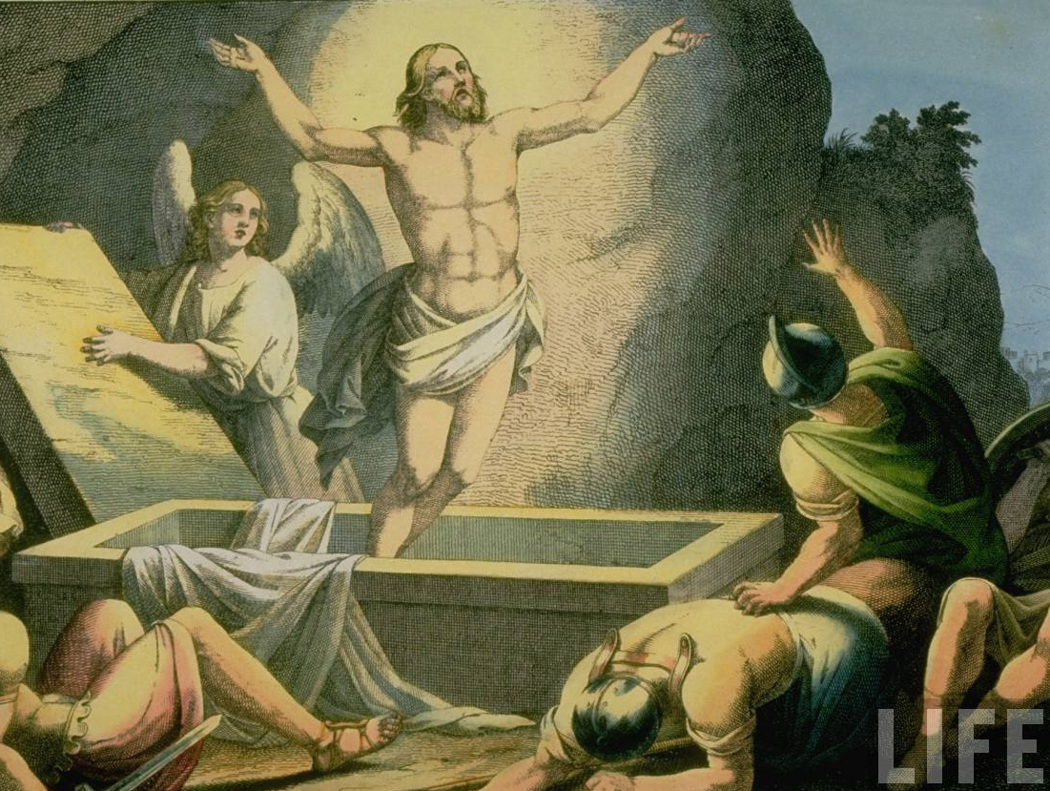
Earliest Christians—spiritual not bodily resurrection

Slide 80
Later Gospels elaborated & exaggerated for persuasive effect

Slide 81
Inconsistent Easter Chronology—Gospel accounts cannot be harmonized

Slide 82
30% American Christians do not believe resurrection

Slide 83
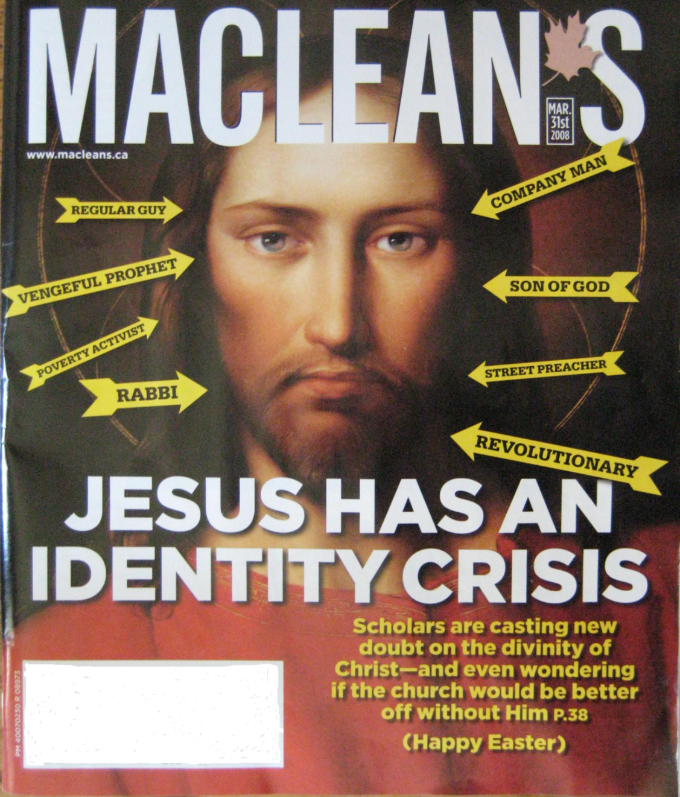
How Do We Reconcile?
Paul’s silence historical Jesus
Silence contemporary writers
Gospels’ discrepancies and fabrications

Slide 84
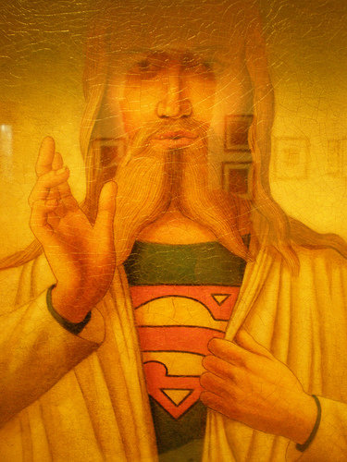
Gospels are Mythology
Gospel writers created mythic figure for propaganda purposes

Slide 85
Like comic-book writers—goal to historicize a myth—a savior, hero, cult figure
Gospel writers wrote evangelism and theology, not history

Slide 86
Biographical details of Gospels based on Old Testament
Joshua & 1 Kings
“Hero” ticked the right boxes and prophesies of Isaiah
Isaiah = good savior template

Slide 87
AD 33-64 incendiary political climate
Many Messiahs and messianic movements within Judaism
Period in which Jesus supposedly appeared teamed with fire-breathing prophets, exalted madmen, hysterics, heralds of the apocalypse

Slide 88
First century Palestine rife with messianic Jewish sects disgruntled by annexation & taxation by Roman overlords
Believed an immanent apocalypse, delivered by a “Savior,” would set world to rights
As prophesied in their sacred texts

Slide 89
“Jesus” means “God saves, has saved, will save”
“Jesus Christ” = name or title of epic hero
“Christ Jesus” is a mythic hero/savior in one, or perhaps several, versions of a savior myth
Served as catalyst for messianic aspirations of the period

Slide 90
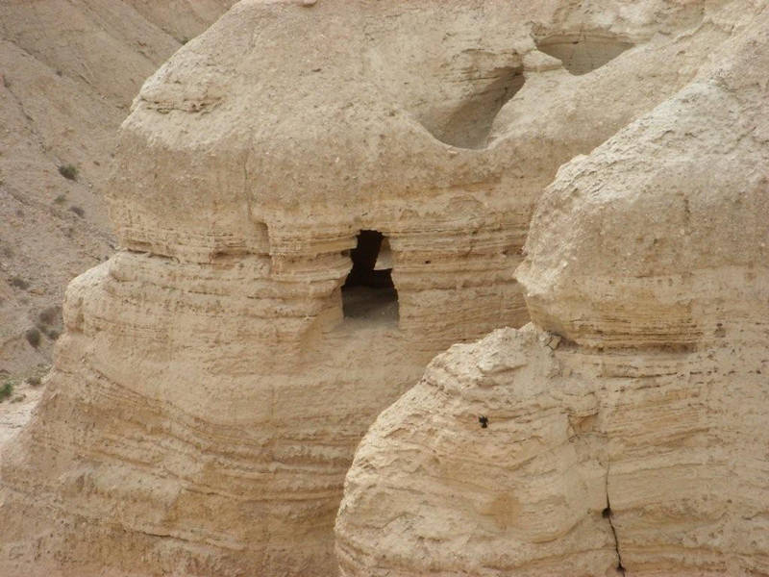
Essenes

Slide 91
Thy Kingdom Come

Slide 92
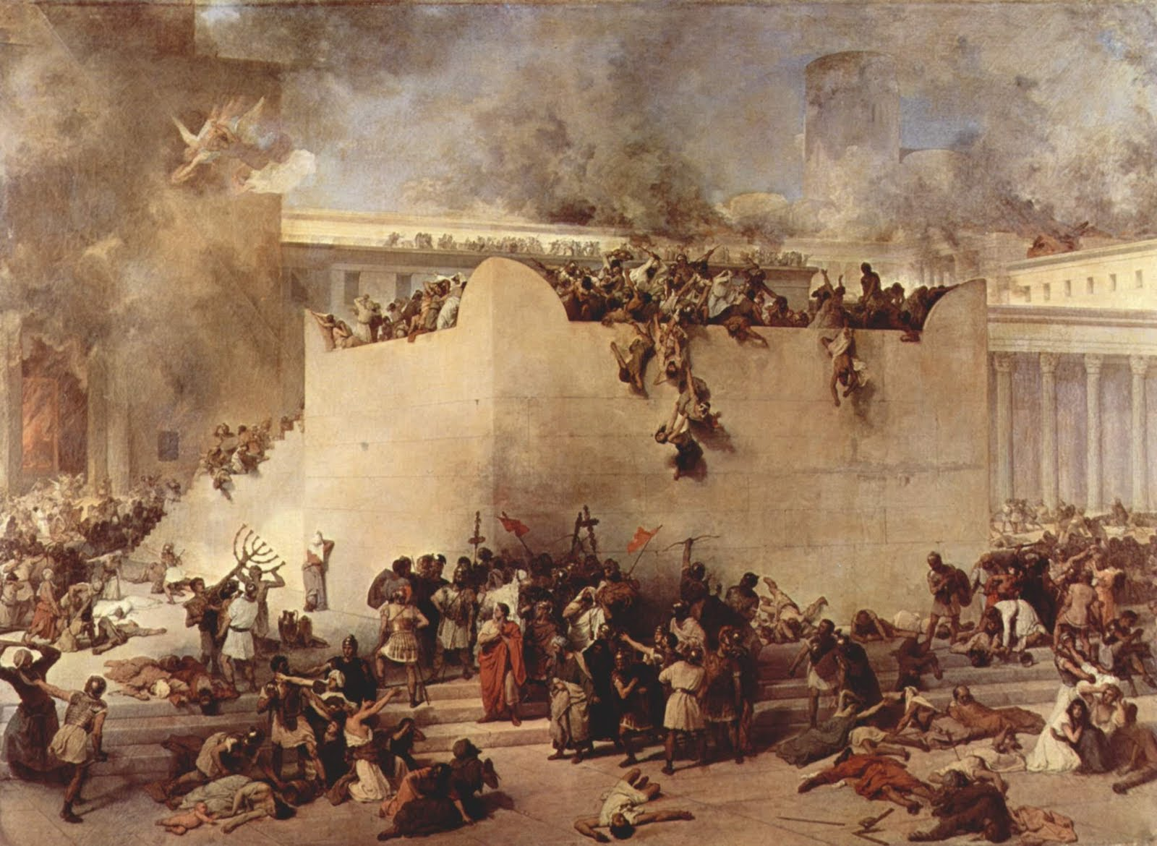
Jewish Rebellion 66-70 CE
Romans destroyed Temple 70 CE

Slide 93
Christians quit Jerusalem for Edessa & did not return until 4th CE

Slide 94
New Testament Gospels written 90s CE or later
Propaganda Purposes

Slide 95
Jesus was a character-type modeled on pre-existing crucified Gods
Christianity is almost entirely derivative from the many dying and resurrecting Mystery godmen of Mediterranean cultures predating Gospel Jesus

Slide 96
A number of pagan myths told of a savior who was sired by a god, born of a virgin at the winter solstice, surrounded by twelve zodiacal disciples, sacrificed as a scapegoat at the spring equinox, sent into the underworld, resurrected amid much rejoicing, and symbolically eaten by his followers to gain salvation and immortality

Slide 99
Raglan Hero

Slide 100
Osiris in Egypt
Dionysus in Greece
Attis in Asia Minor
Adonis in Syria
Bacchus in Italy
Mithras in Persia
The list goes on …

Slide 101
Synthesized different spiritual traditions

Slide 102
Osiris-Dionysus is God made flesh, the savior and “Son of God”
His father is God and his mother is a mortal virgin
He is born in a cave or humble cowshed on December 25 before three shepherds
He offers his followers the chance to be born again through the rites of baptism
He miraculously turns water into wine at a marriage ceremony
He rides triumphantly into town on a donkey while people wave palm leaves to honor him

Slide 103
He dies at Eastertime as a sacrifice for the sins of the world
After his death he descends to hell, then on the third day he rises from the dead and ascends to heaven in glory
His followers await his return as the judge during the Last Days
His death and resurrection are celebrated by a ritual meal of bread and wine, which symbolize his body and blood
From 1500 BCE
Osiris-Dionysus from 3rd century BCE

Slide 104
Christianity is derivative = Jewish adaptation of the ancient Pagan Mystery religions
Mysteries = myths about dying and resurrecting godman
Notes:
104

Slide 105
Church Fathers like Firmicus Maternus and Justin Martyr were greatly troubled by the similarities of Jesus’ allegedly historical biography to his fellow saviors’ pagan mythologies

Slide 106
They didn’t deny the commonality, obvious to everyone in the ancient world
Nor did they try to accuse the long-established mainstream pagan religions of stealing from the story of Jesus

Slide 107
The only defense left to them was …
The Devil did it
They invented the concept of Diabolical Mimicry: that Satan was able to decipher the Old Testament prophecies …

Slide 108
Foreseeing the coming of Christianity, Satan used his evil powers to inspire the heathen nations to pre-emptively copy all the rites and rituals, theological ideas, and religious language of ‘True Christianity’

Slide 109
Even details of the life of its Savior – centuries before Christianity even began!
‘Even the Devil has his Christs!’ Firmicus bemoaned

Slide 110
More Likely Explanation?

Slide 113
The fundamental mistake is confusing the Gospels as history rather than mythology

Slide 115
Jesus existed as a crystallization of the aspirations of his era—hero to deliver exiled Jews
Followers created the myth and were created by it
Believers invented their creation, then made it the object of a cult

Slide 117
So What?
What if we have a purely mythical Jesus and not a historical Jesus?
What would be lost to Christianity?

Slide 118
CDD
Former Catholic Priest

Slide 122
What would be lost to Christianity?
Only the incarnation, the inflesh-ment, the claim that the character of God is revealed in the factual life of a historical person and not in the fictional life of a parabolic person
Only, in other words, the heart of Christianity itself

Slide 123
Crossan’s historical Jesus theory?
Clash between the nonviolent historical Jesus and the violent apocalyptic Jesus that convinces me that the former was an actual and factual person
By all accounts Dominic Crossan is a decent, gentle human being … and so is his Jesus

Slide 124
If the Jesus of faith is not also the Jesus of history, he’s powerless and he’s meaningless
Unless he’s rooted in reality, unless he established his divinity by rising from the dead, he’s just a feel-good symbol who’s as irrelevant as Santa Claus

Slide 125
If Jesus was not historical, he would be meaningless
It is impossible for him to be meaningless, because he is meaningful to me
Therefore he is historical

Slide 126
I have never come to disdain Christianity
Pastor of Baptist Church for 6 years—now Episcopalian
I rejoice to take the Eucharist every week and to sing the great hymns of the faith

Slide 127
For me the Christ of faith has all the more importance since I think it probable that there was never any other

Slide 128
Paradox:
Either this Jesus was a remarkable individual who said and did a host of amazing, revolutionary things—but no one outside his fringe cult noticed for over a century
Or he didn’t—and yet shortly after his death, tiny communities of worshipers that cannot agree about the most basic facts of his life spring up, scattered all across the empire

Slide 129
The truth is inescapable …
There simply could never have been a historical Jesus (David Fitzgerald, 2010)

Slide 131
Group B

