Slide 1
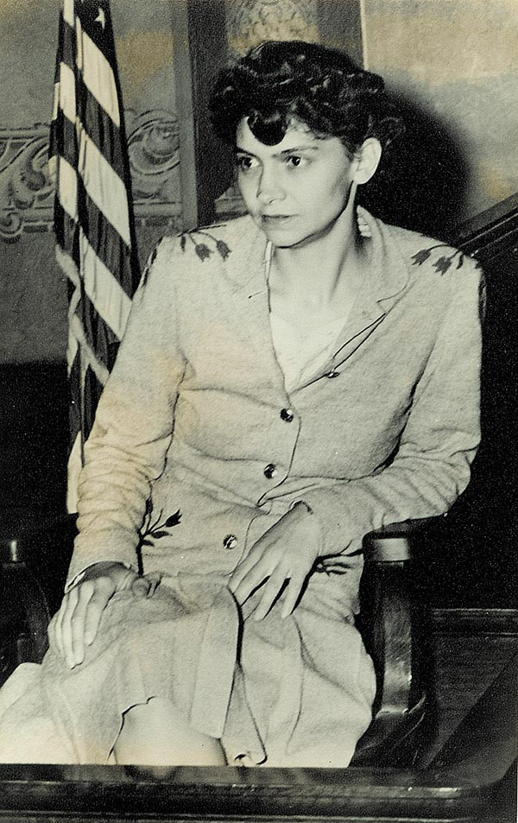

Slide 3
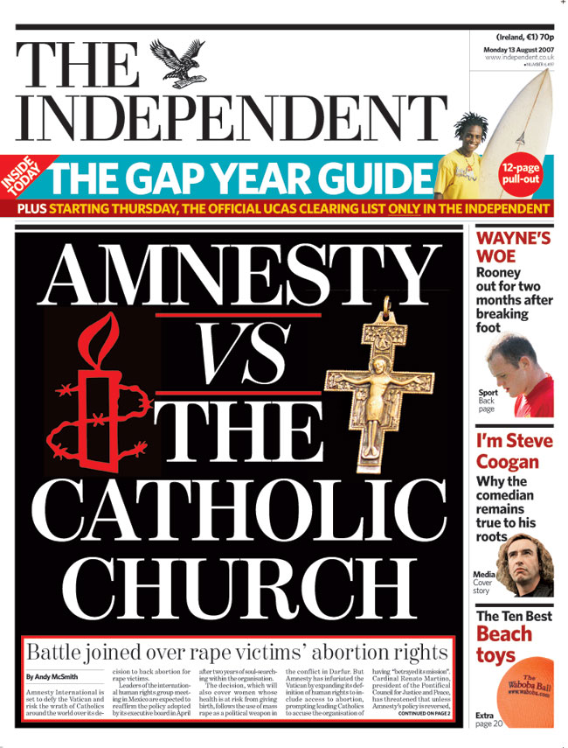

Slide 4
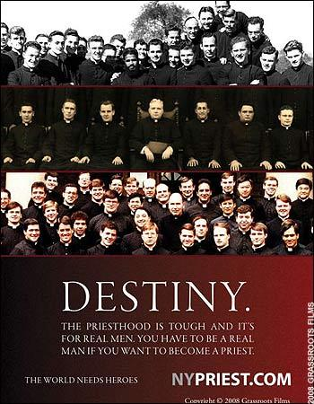
Fishers of Men

Slide 5
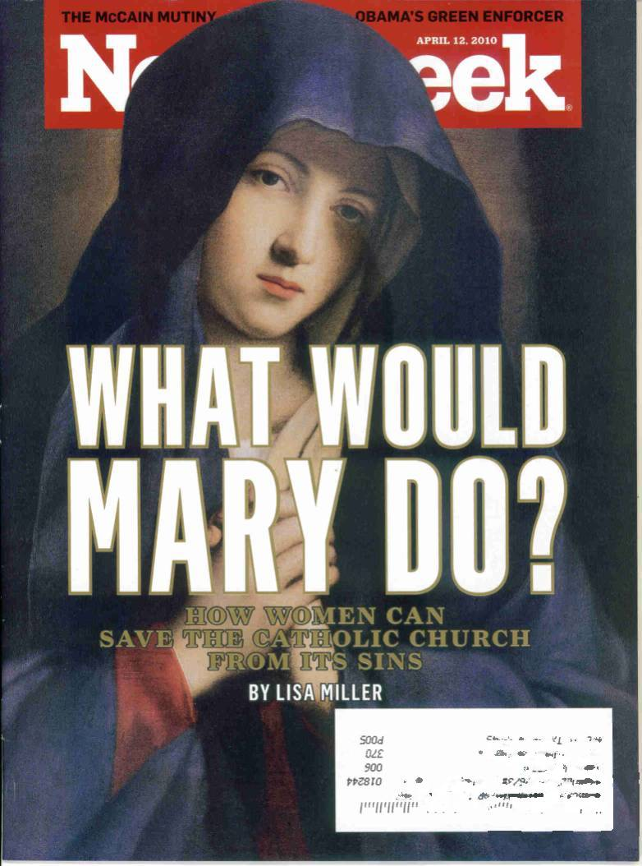
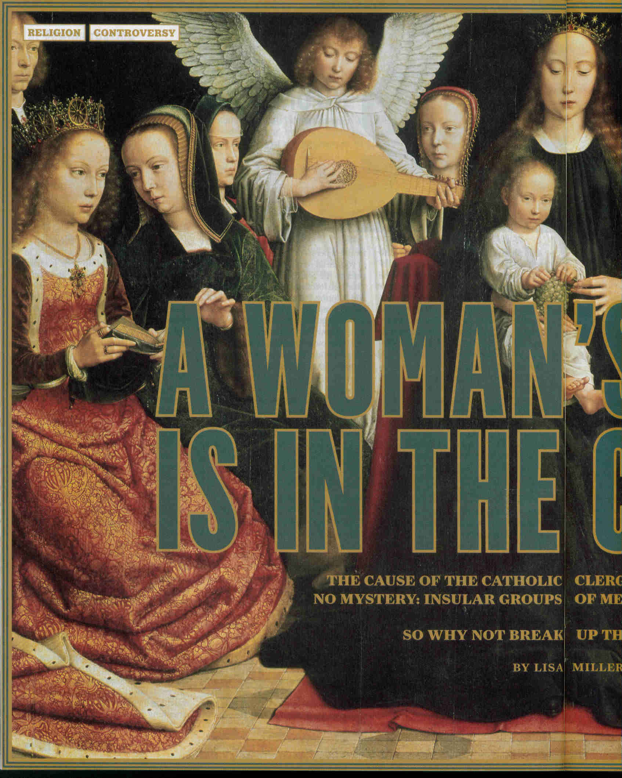
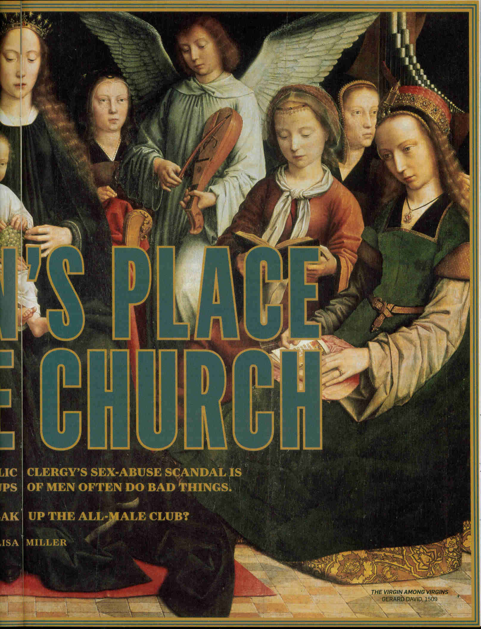

Slide 6
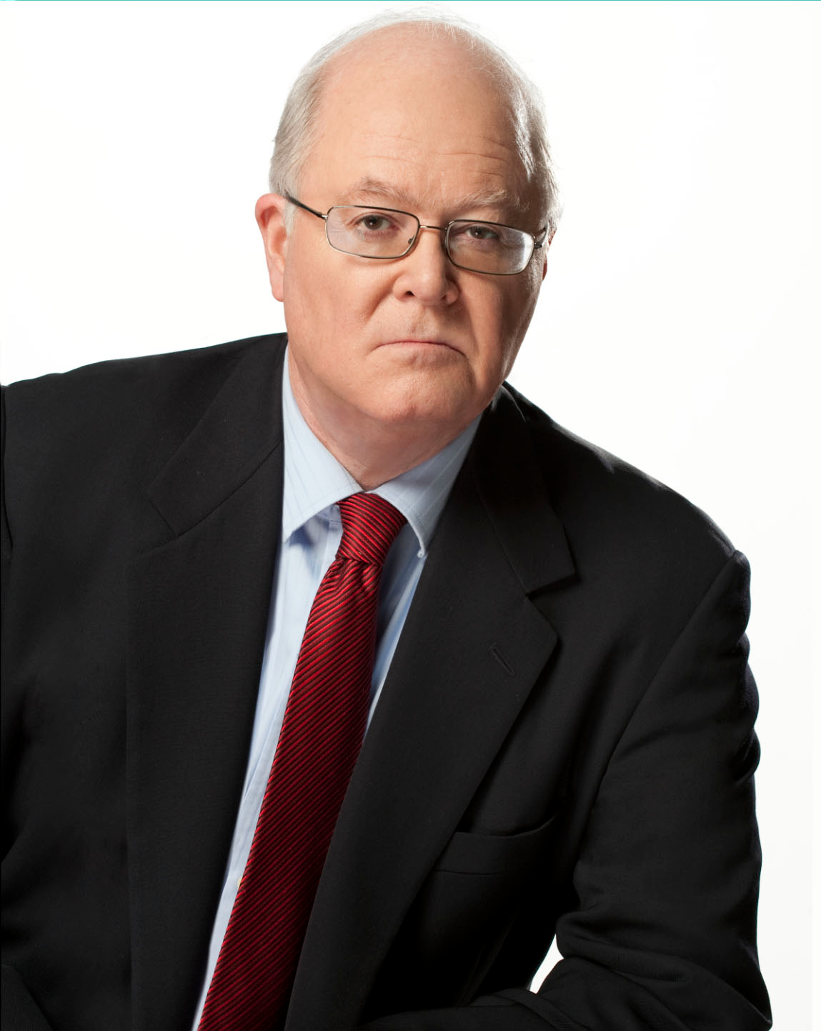
Criticism = anti-Catholic bigotry
“Hollywood is controlled by secular Jews who hate Christianity in general and Catholicism in particular”
Bill Donohue

Slide 7
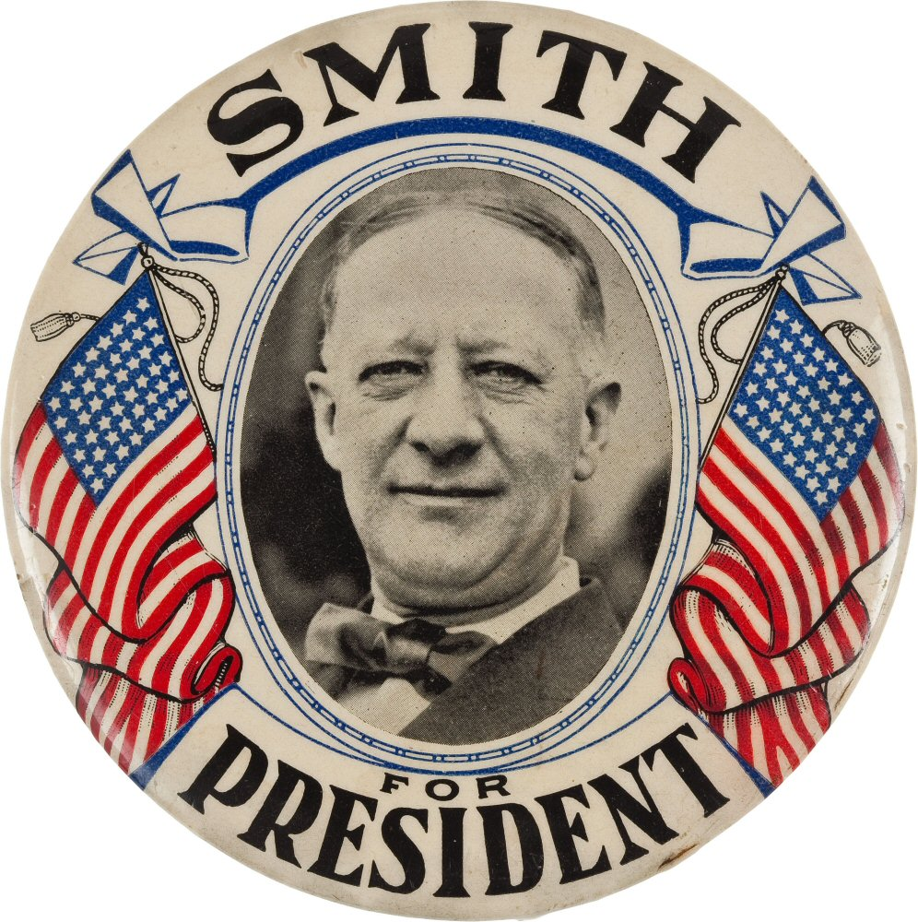
1928

Slide 8
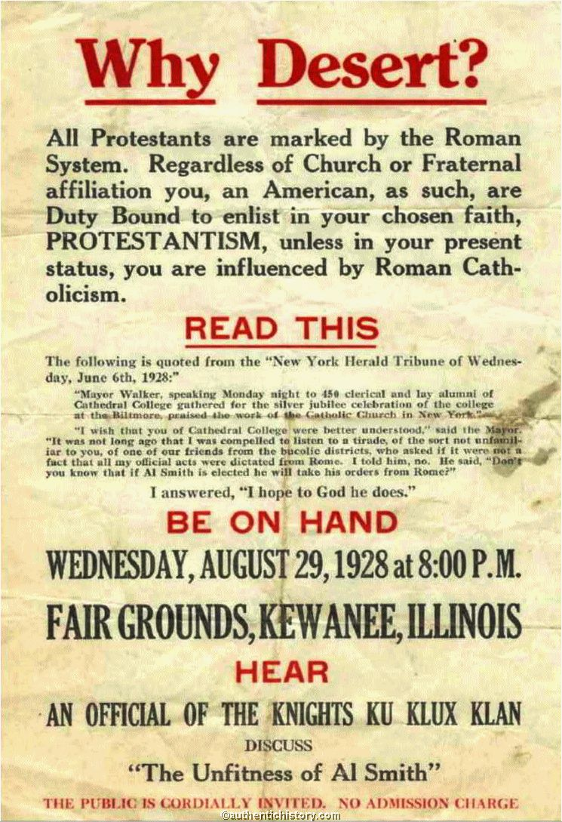

Slide 9
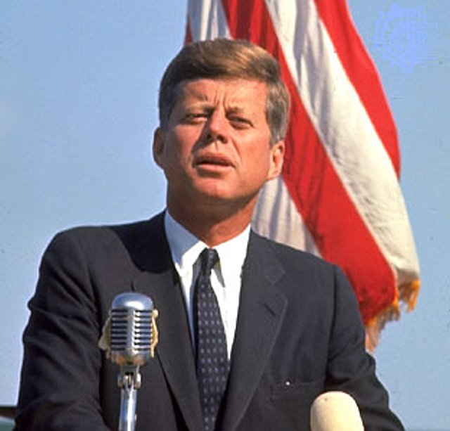
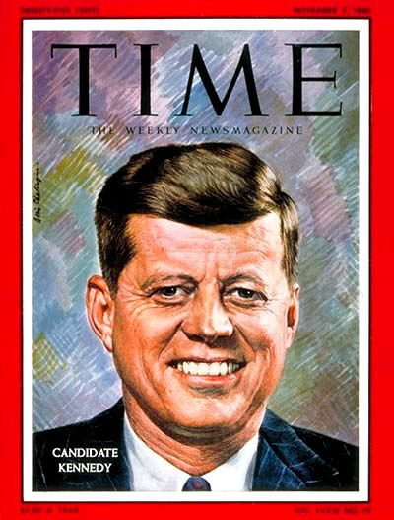
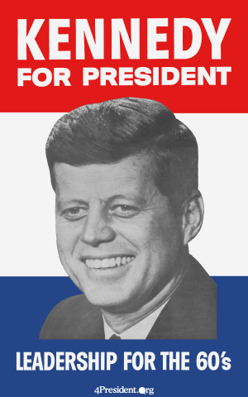

Slide 10
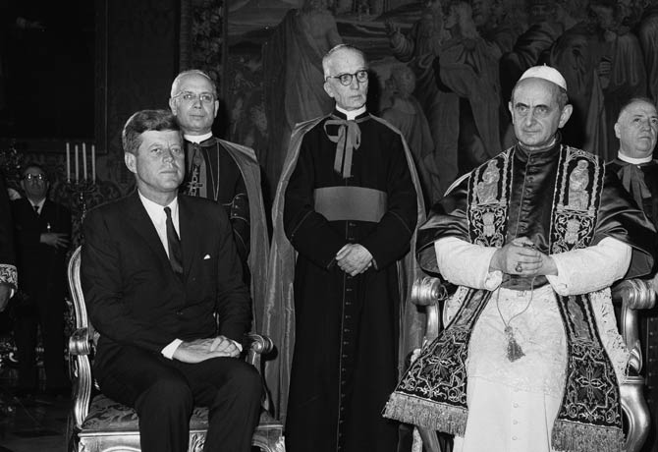
A Catholic might place loyalty to the Pope over obedience to the Constitution

Slide 11
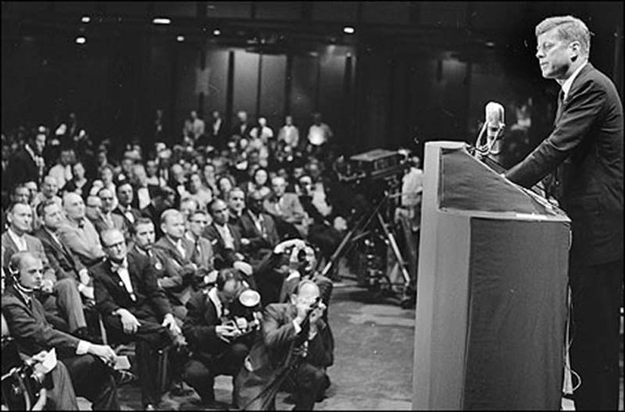
September 12, 1960
Address to the Greater Houston Ministerial Association

Slide 12
Address

Slide 14
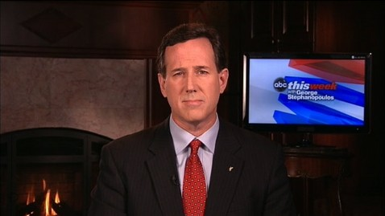
ABC News

Slide 15
What does Rick Santorum not get?

Slide 17
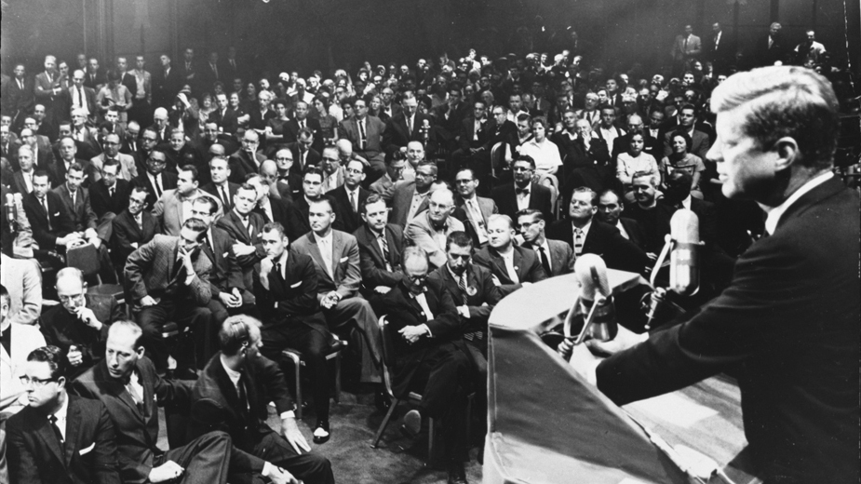
Never said—“only people of non-faith” can participate in public life
Understood, in a democracy— policy positions have to be secular in nature

Slide 18
Public acts of President responsible to all groups and obliged to none

Slide 19
President’s policy decisions, even if informed by religious values, had to be acceptable to anyone, regardless of doctrinal belief

Slide 21
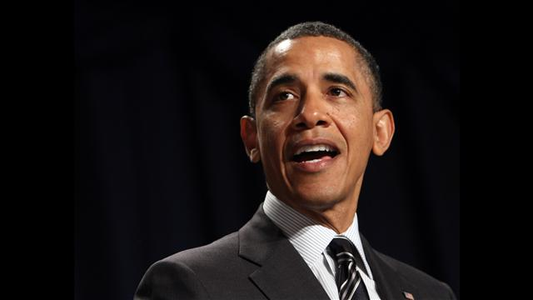
“Democracy demands that the religiously motivated translate their concerns into universal, rather than religion-specific, values”
“It requires that their proposals be subject to argument, and amenable to reason”

Slide 22
“I may be opposed to abortion for religious reasons, but if I seek to pass a law banning the practice, I cannot simply point to the teachings of my church or evoke God’s will”

Slide 23
“I have to explain why abortion violates some principle that is accessible to people of all faiths, including those with no faith at all”

Slide 24
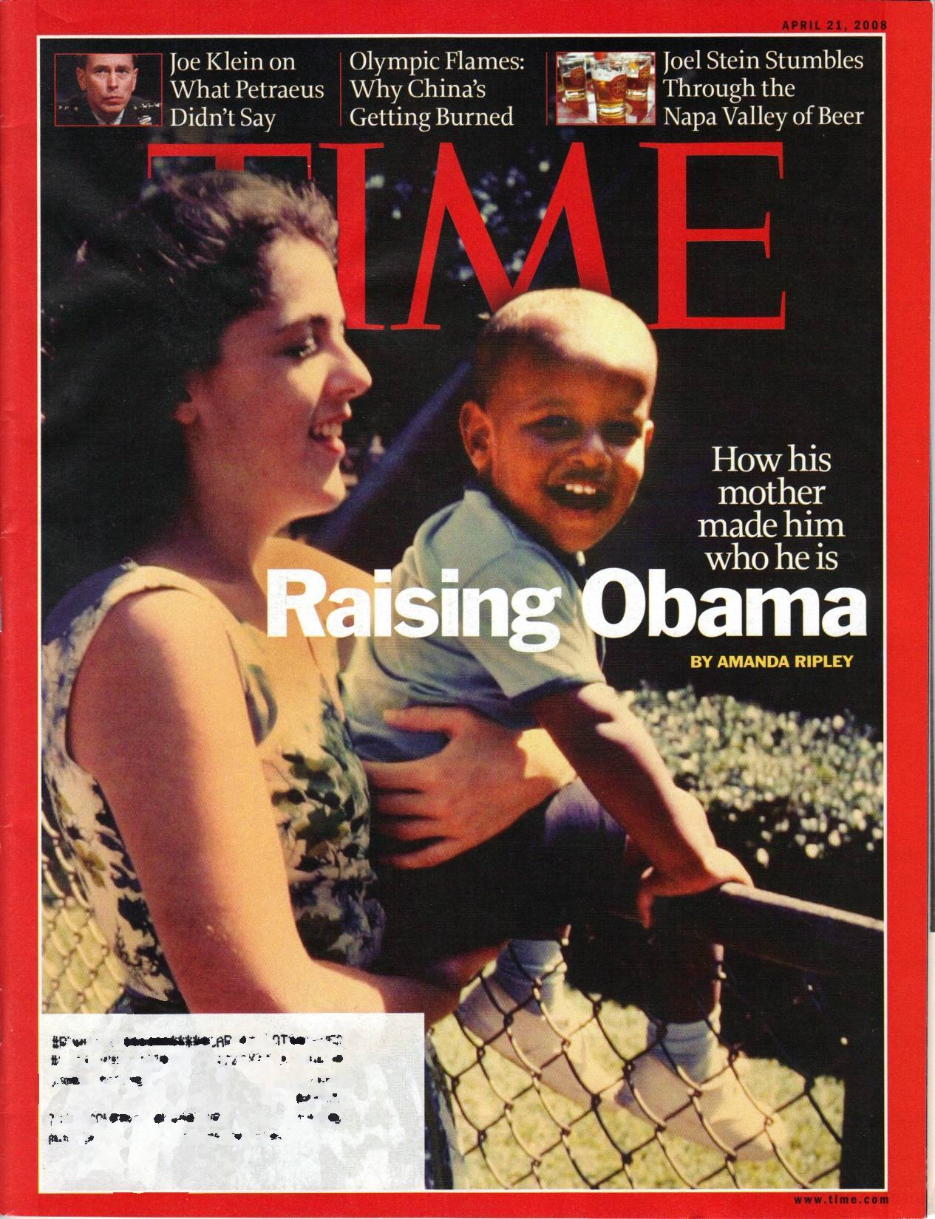

Slide 25
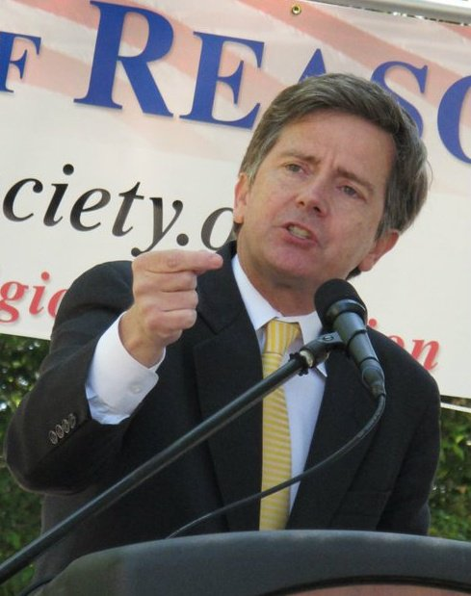
Social Perspectives

Slide 26
Felt cultural allegiance to Catholicism
Positive feelings Irish-Catholic cultural heritage

Slide 27
Preview
Secularism
Christian Nationalism
Godless Constitution
Christian Nationalism Case Study: Texas School Board
Defending Secularism

Slide 28
Purpose of the Book?
Faircloth

Slide 29
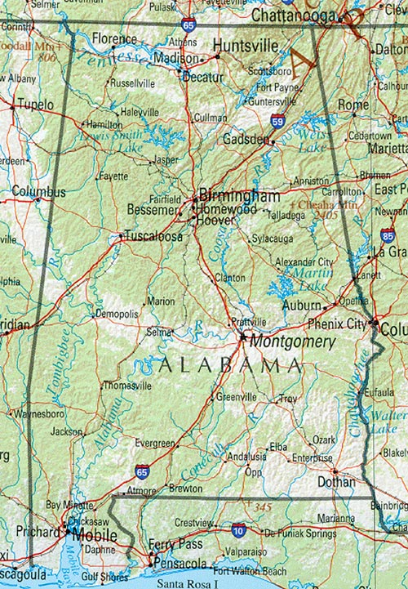
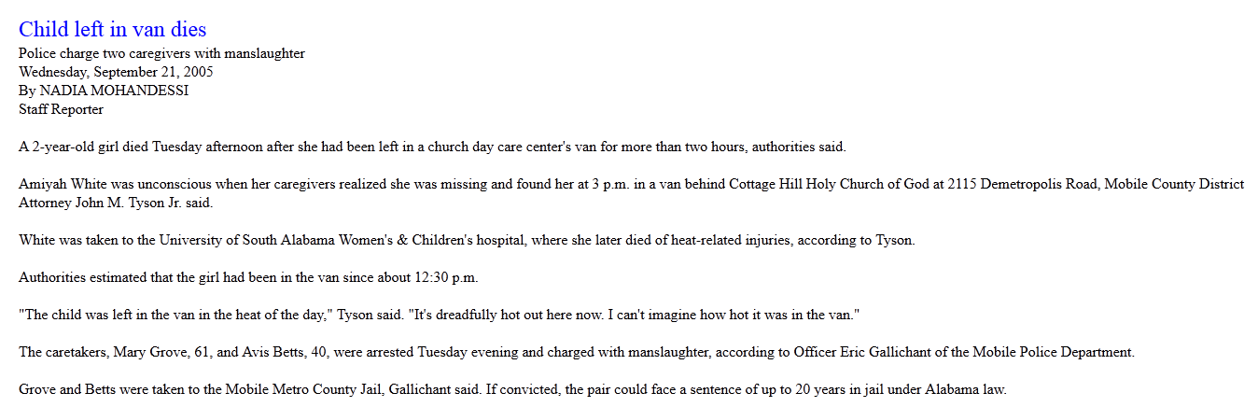
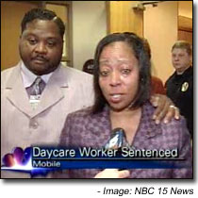

Slide 30
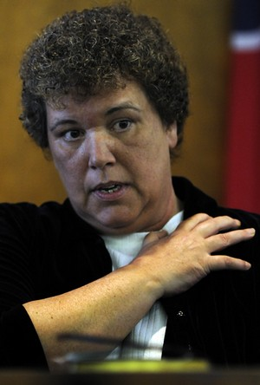

Slide 31
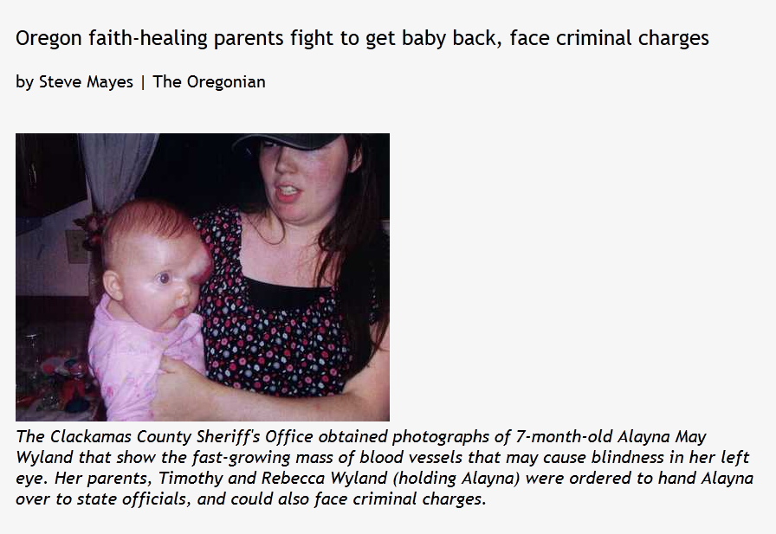
RCAN

Slide 32
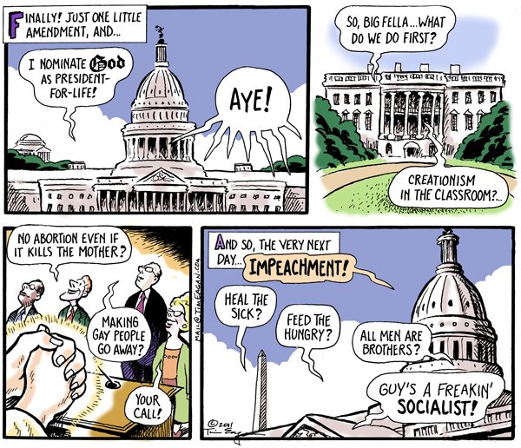
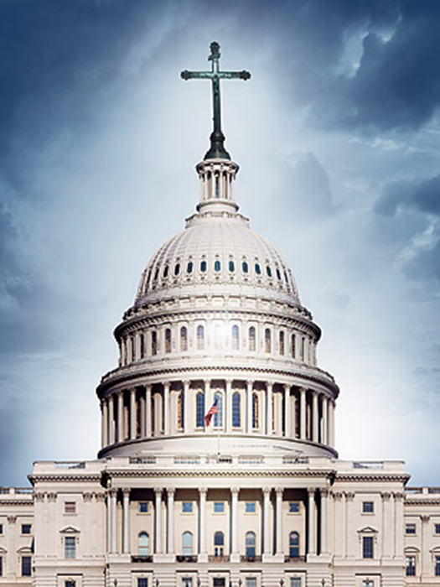
Church/State
Separation?

Slide 33
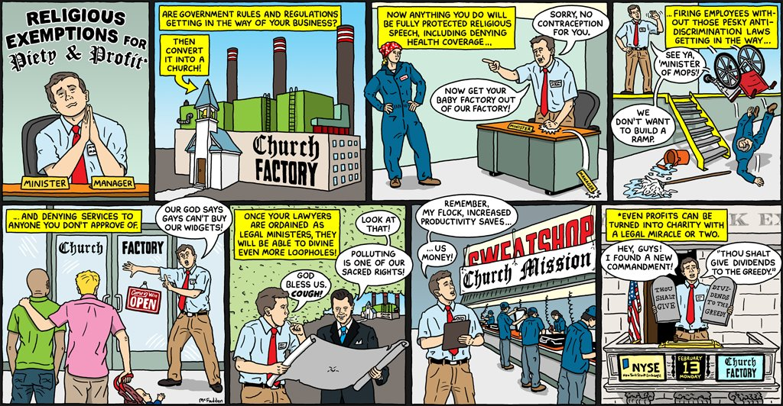

Slide 34
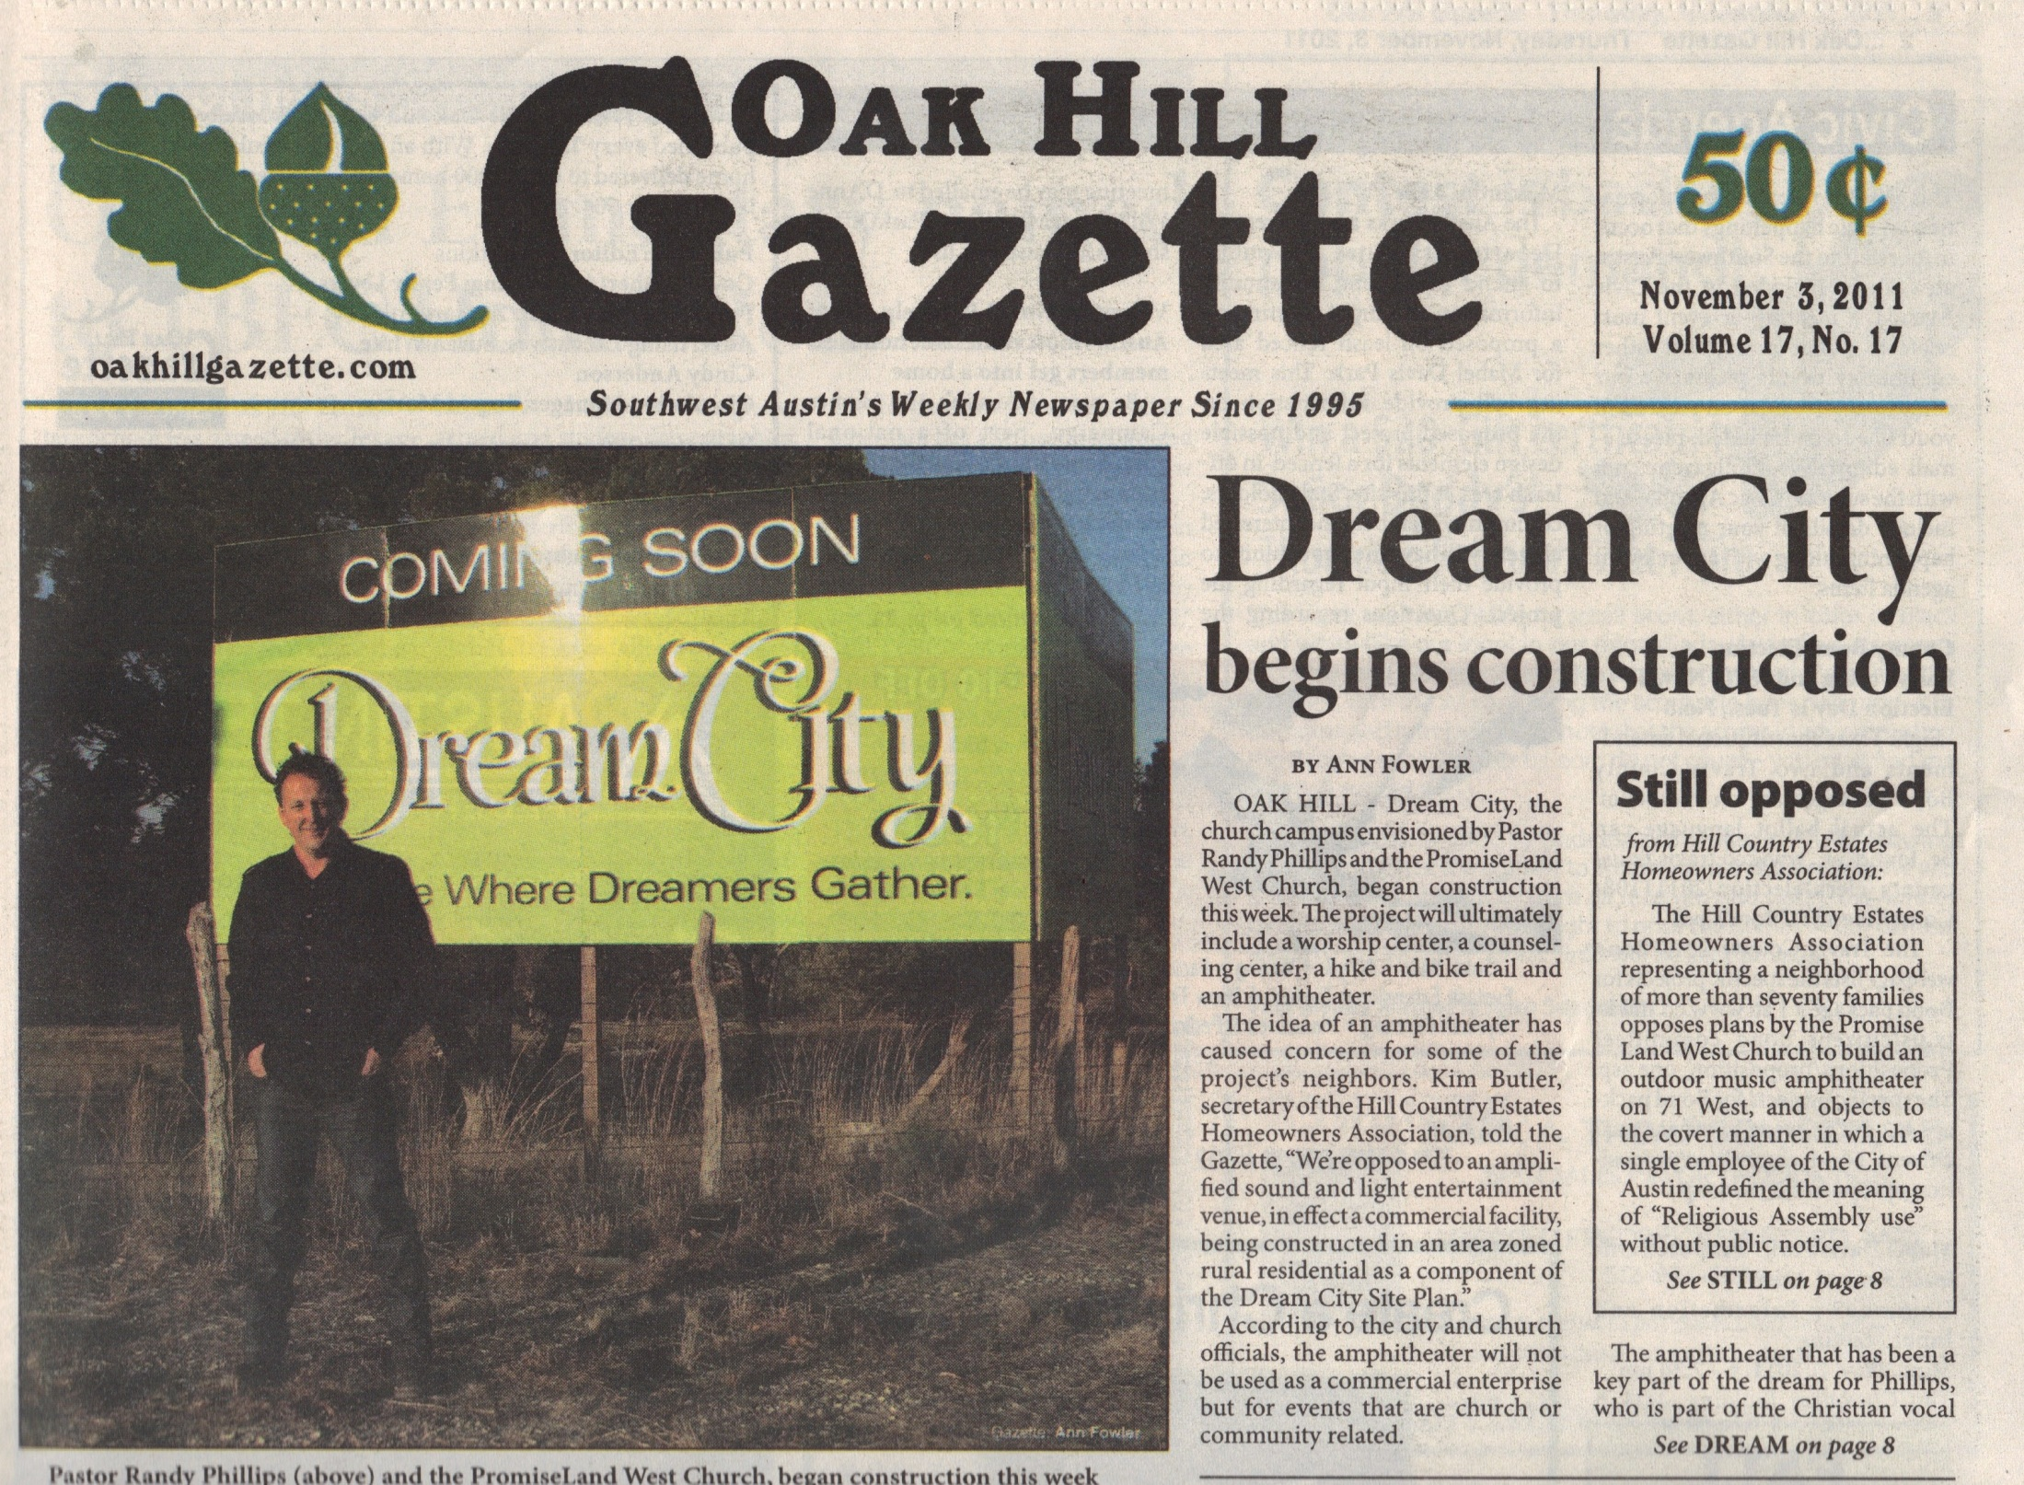
YNN

Slide 35
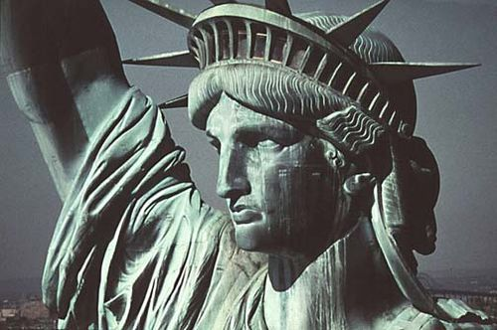
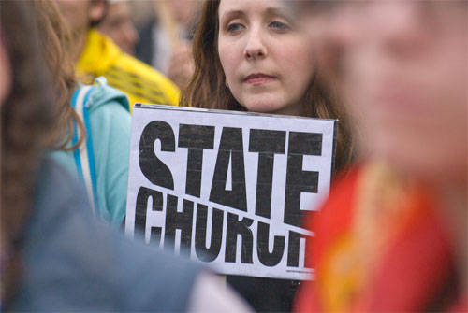
What is Secularism?
Democracy; racial and sexual equality; individual liberty of lifestyle; full freedom of thought, expression, and the press; eradication of religious authority from the legislative process and education; full separation of church and state

Slide 36
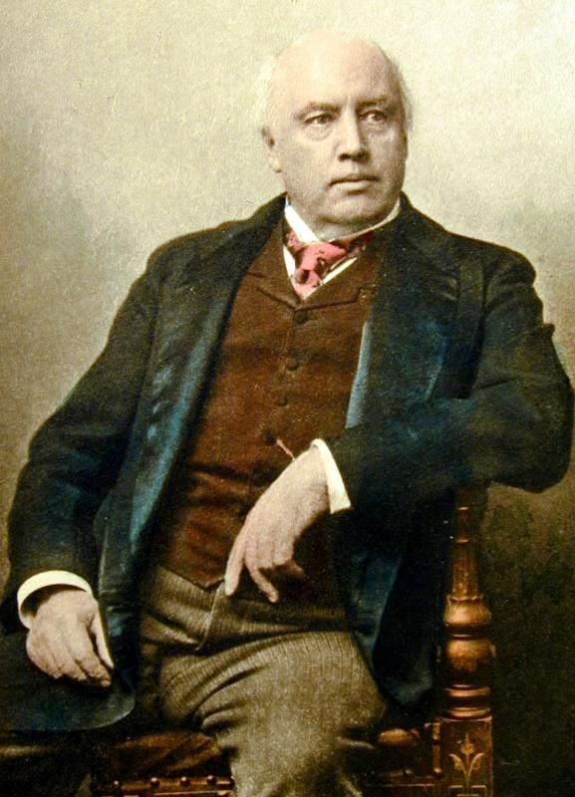
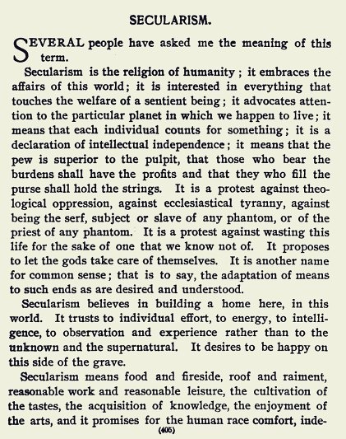
Secularism

Slide 37
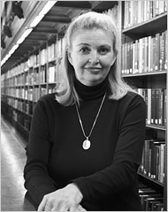
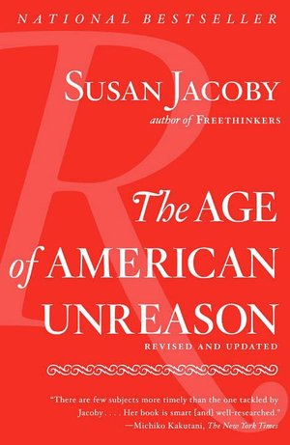
What unites Protestant fundamentalists and right-wing Catholics today, in both religious and political arenas, is a shared hatred of secularism and the influence of secular values on culture and public life

Slide 39
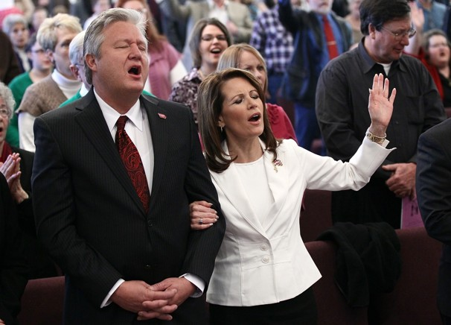

Slide 40
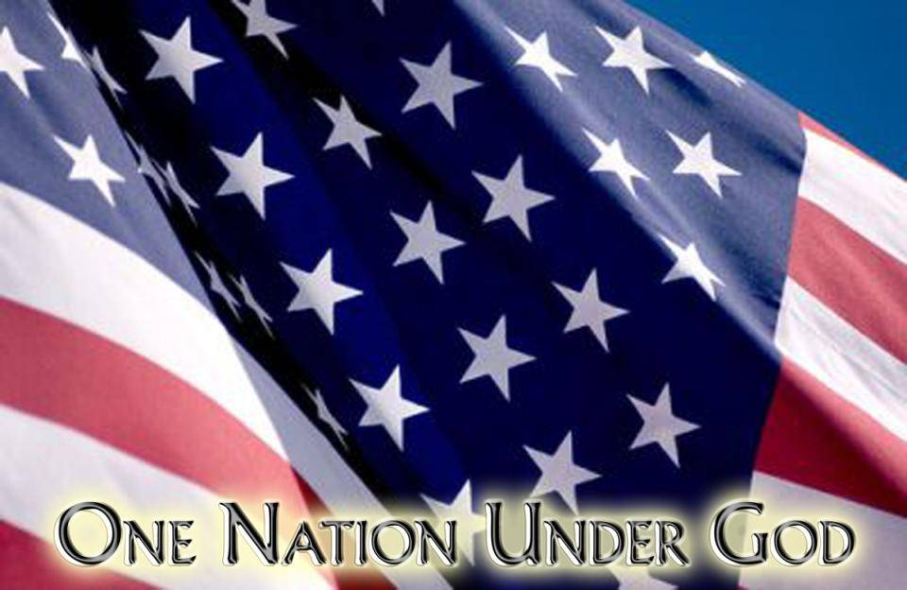
Is America a Christian Nation?

Slide 41
United States established as a Christian Nation
By Christian people
Christian religion assigned central role in guiding nation’s destiny

Slide 42
Conspiratorial Theory of American History

Slide 43
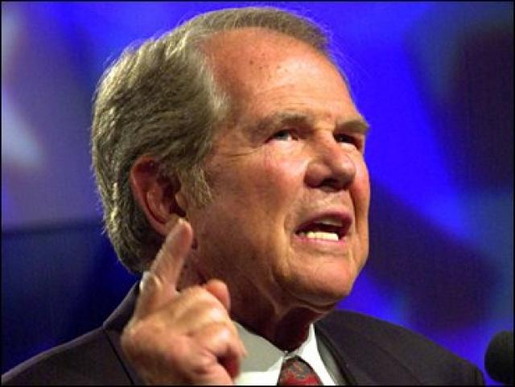
America was founded as a Christian nation until subverted by a cabal of 20th century liberals and freethinkers who replaced it with an un-American secular state

Slide 44
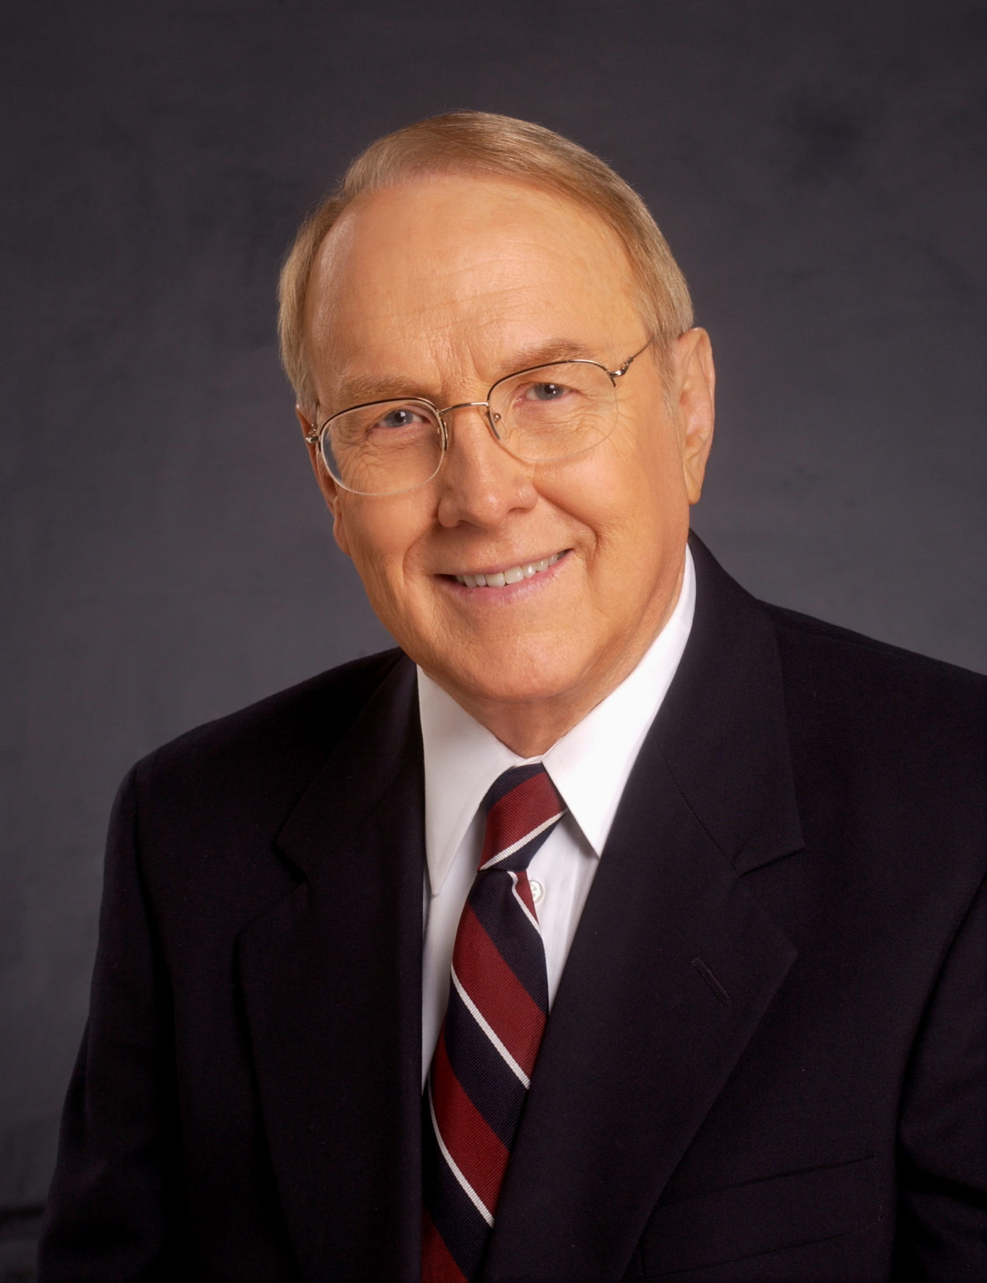
Constitution designed to perpetuate a Christian order
Separating Christianity from government—result in unthinkable damage to nation and people

Slide 45
Christian Nationalism
Aims to supplant Enlightenment Rationalism with “Christian Worldview”

Slide 46
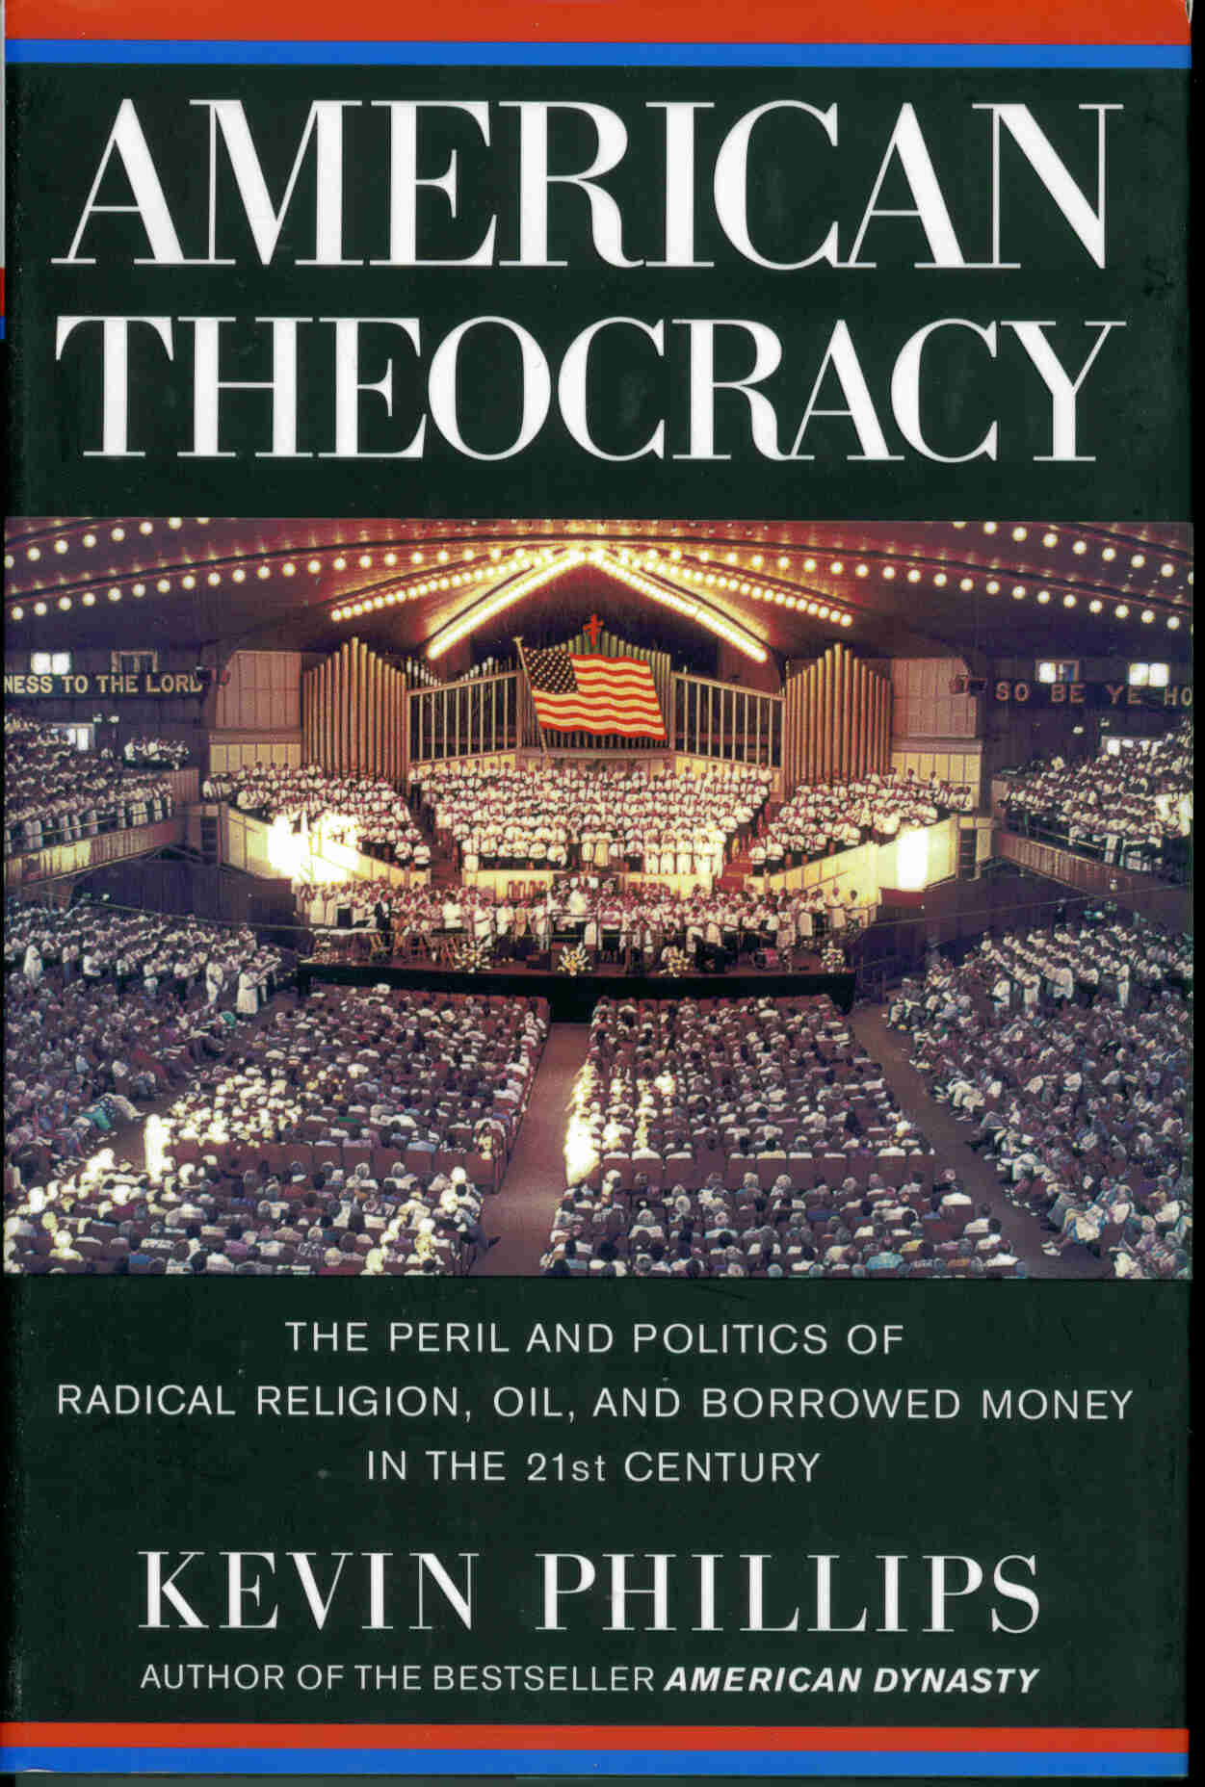
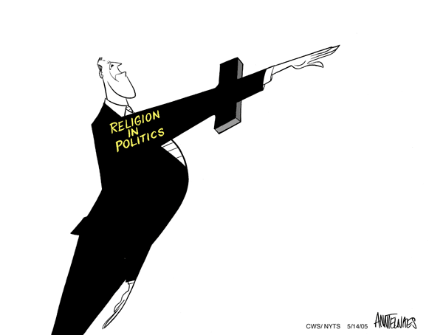

Slide 47
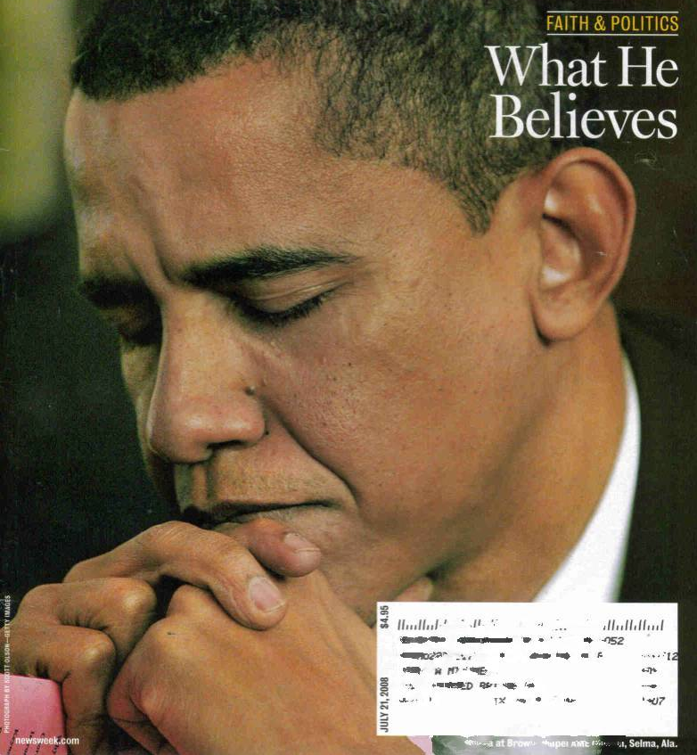
We live in a country in which a person cannot get elected president if he openly doubts the existence of heaven and hell

Slide 48
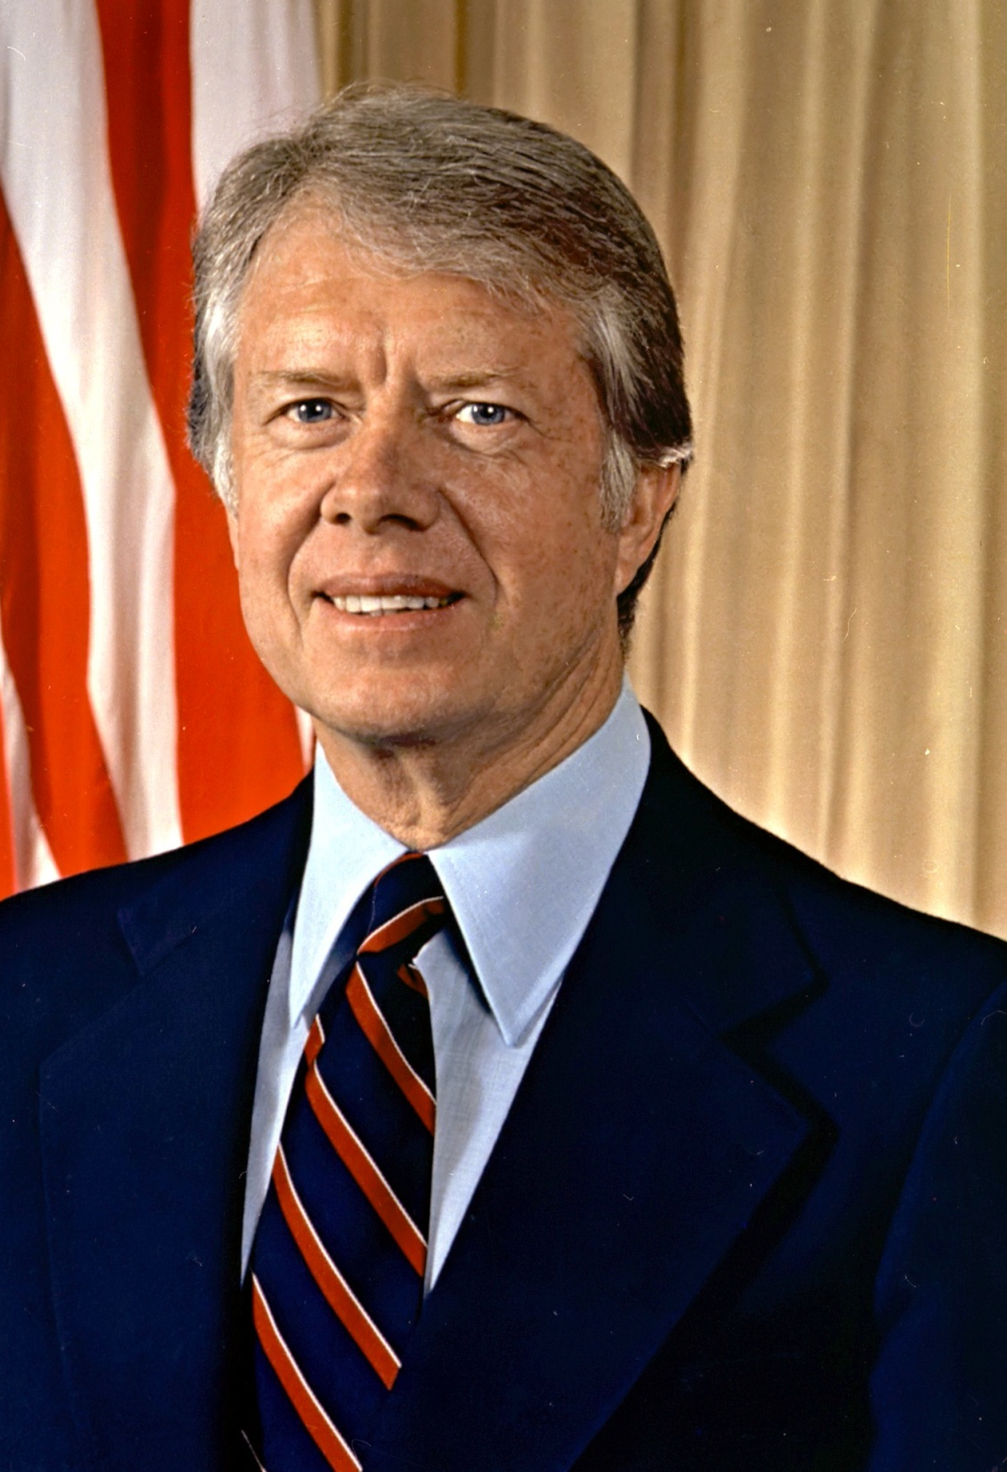
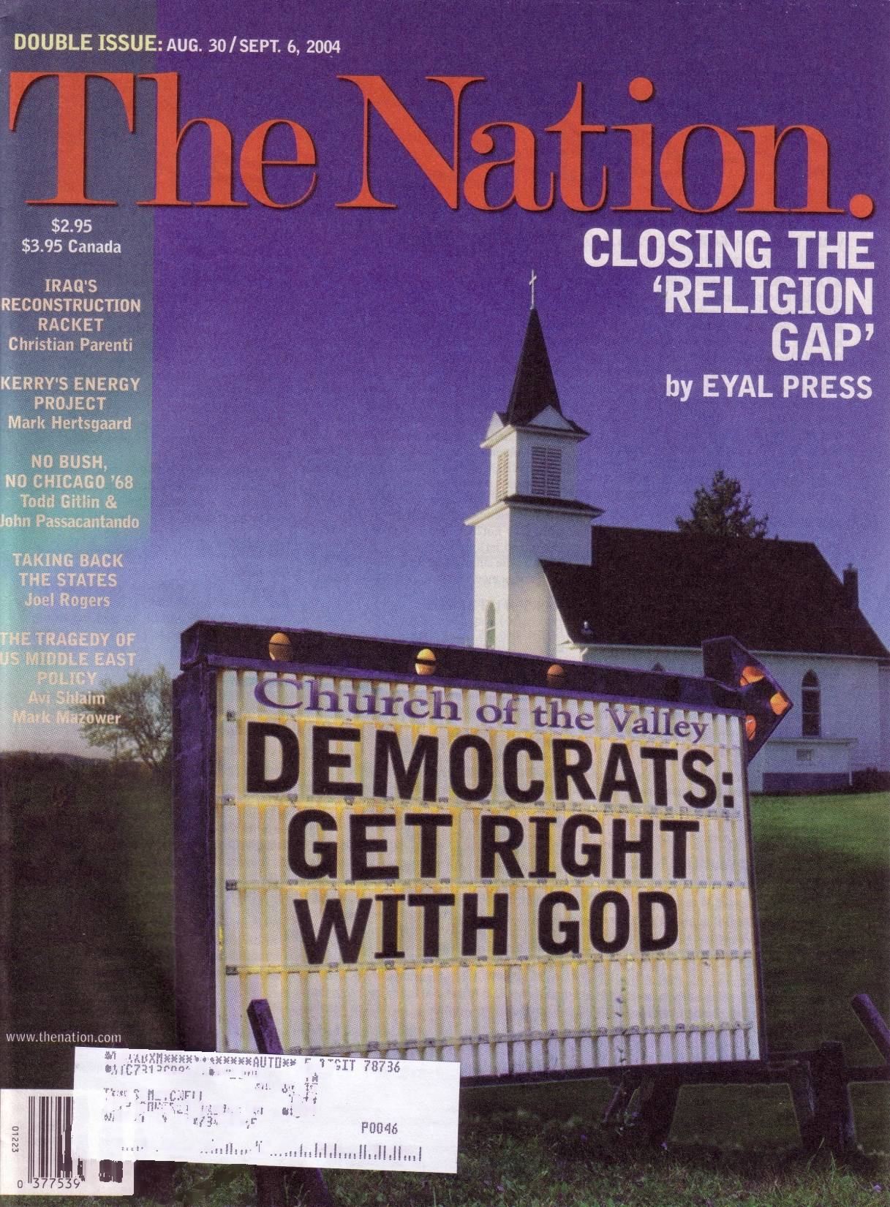
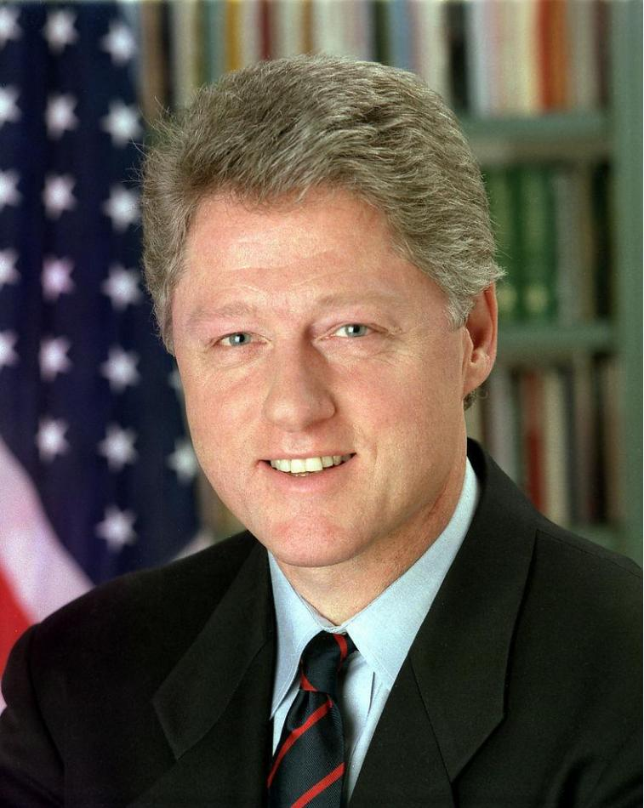
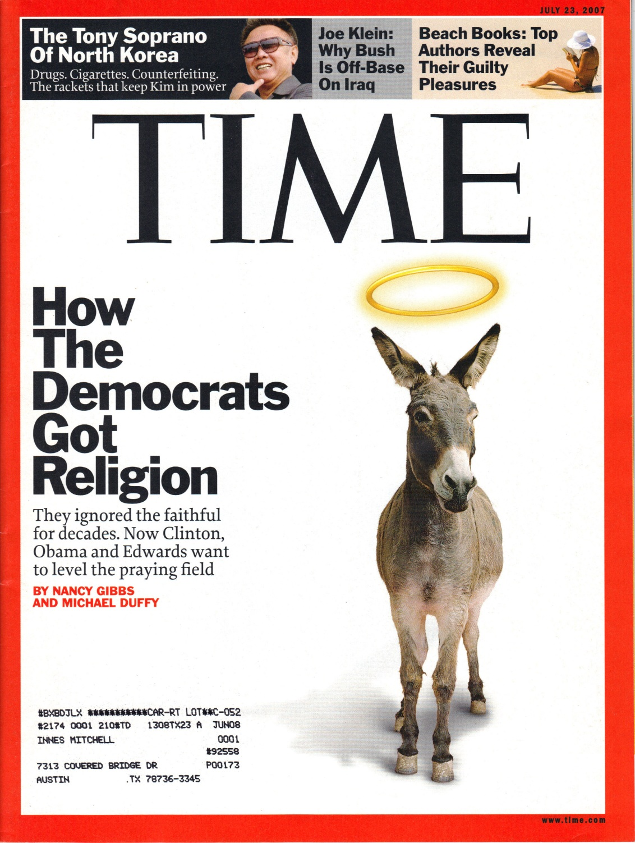

Slide 49
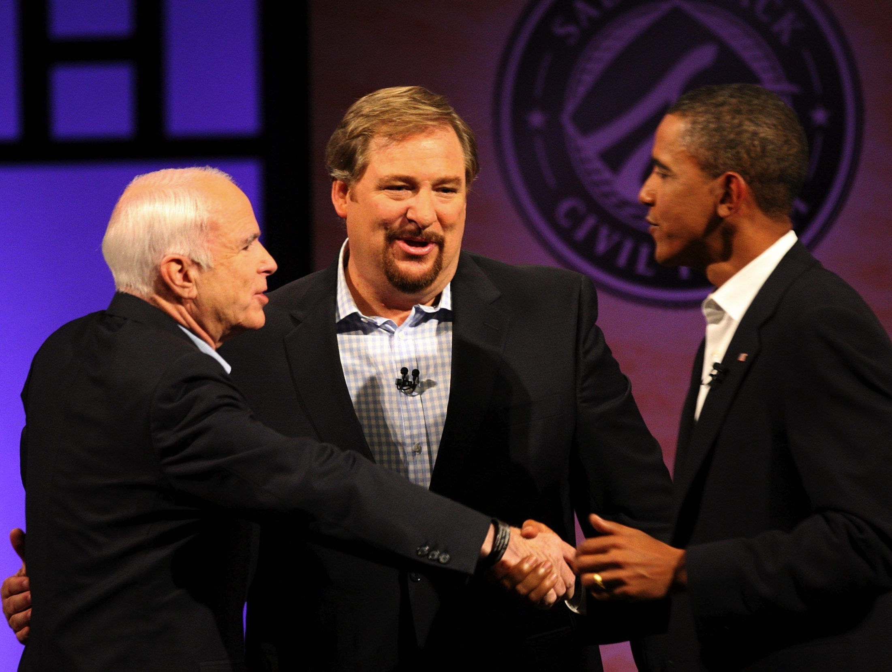
Religious Test 08

Slide 50
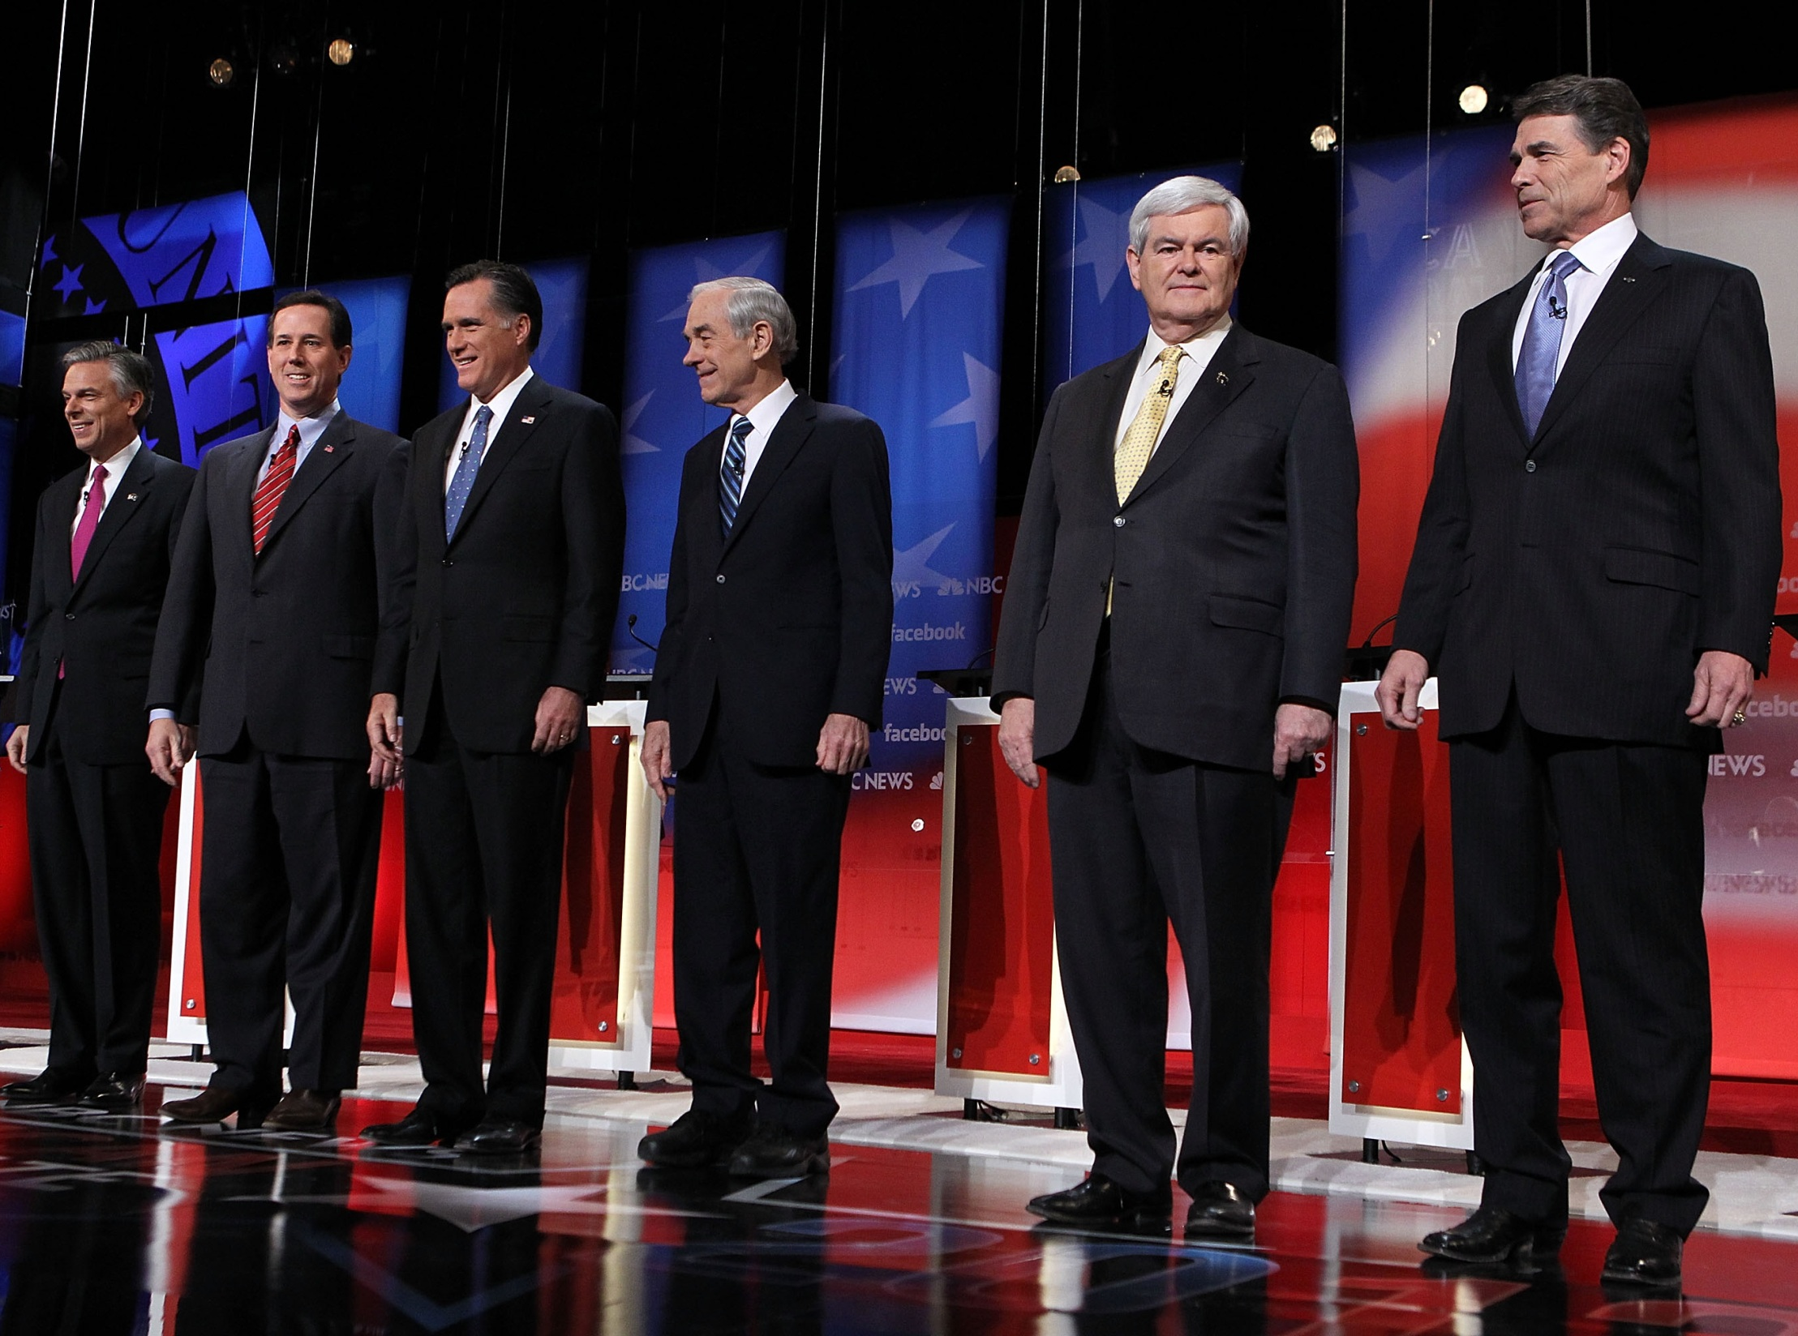
American Faith Party
Christian Conservative Party

Slide 51
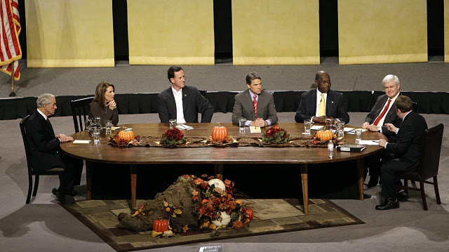
Thanksgiving Family Forum

Slide 52
Santorum
America founded on principles God’s Law
Our Civil Laws have to comport with Higher Law
Take our culture back!

Slide 53
Gingrich
Rights come from our Creator—God’s Greater Plan—responsibilities to Creator
Attempt to create Secular Society—Nightmare!

Slide 54
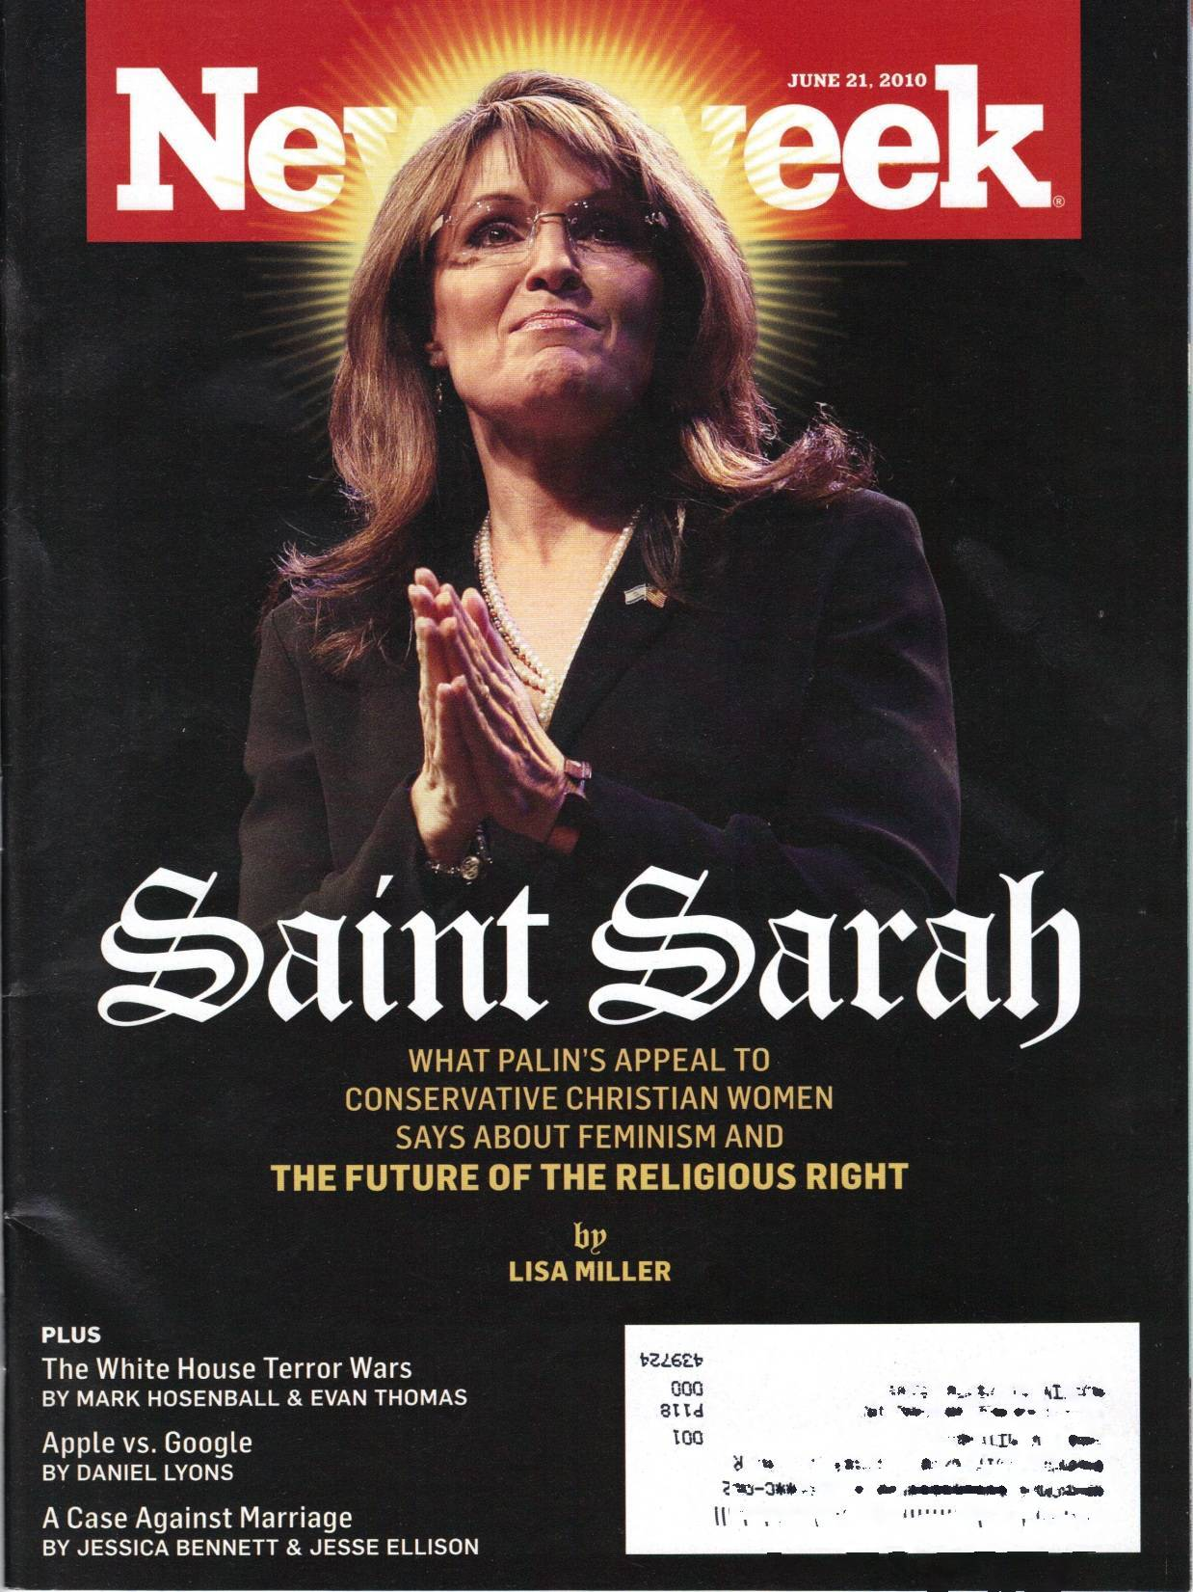
They’re quite clear that we would create law based on the God of the Bible and the Ten Commandments. It’s pretty simple
I think we should keep this clean, keep it simple, go back to what our founders and our founding documents meant …

Slide 55
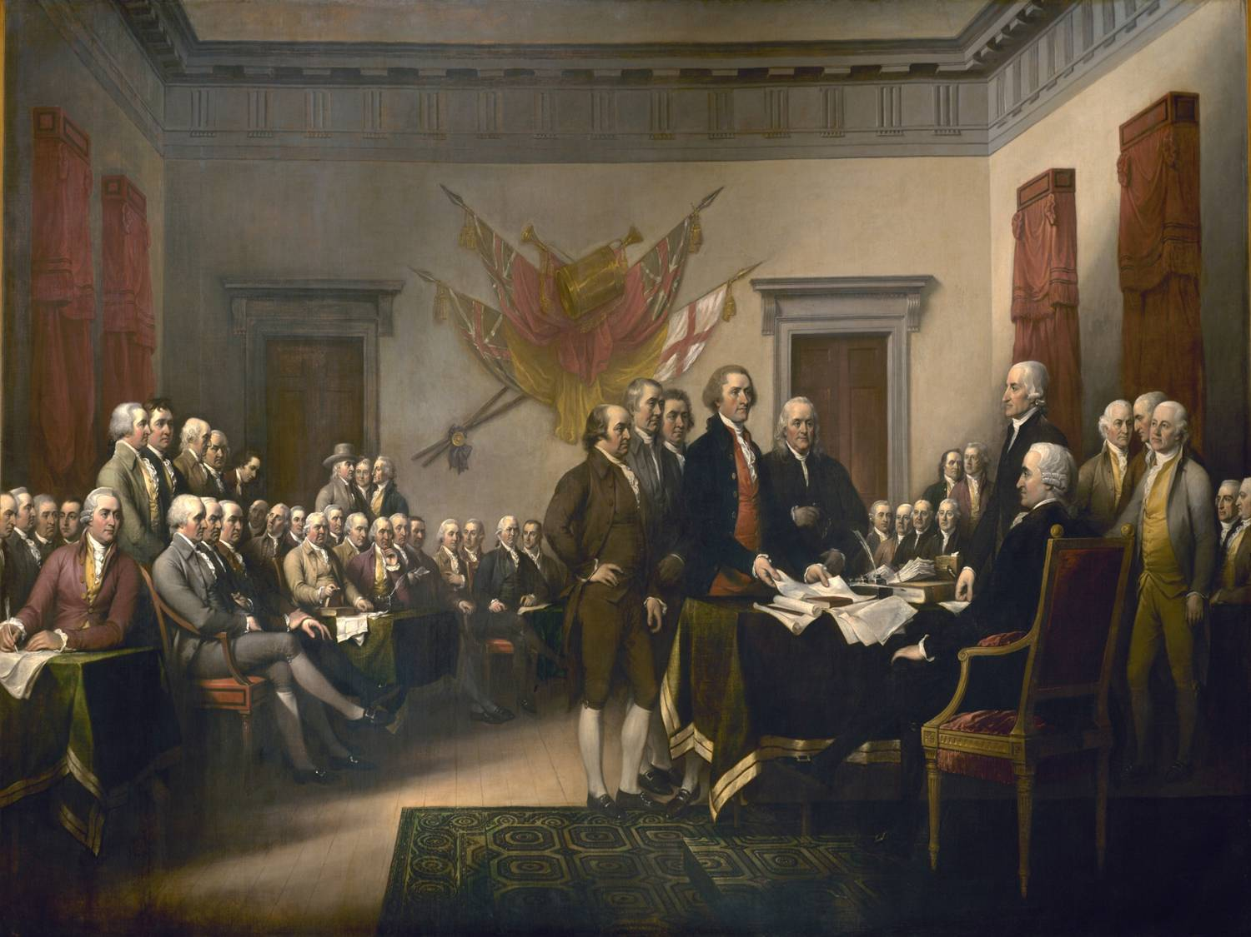

Slide 57
Far from being uniformly Christian
they were freethinkers, agnostics, atheists,
Christians, Freemasons, and Deists

Slide 58
Religious or not, they fought for
a secular state and for
freedom of belief

Slide 60
Our Constitution makes no mention whatever of God

Slide 61
The new nation was not in need of “foreign aid”
Alexander Hamilton

Slide 62
Original Draft
No “Creator”
Under Pressure
Jefferson revised text

Slide 63
Ratified 1791

Slide 64
Rarely attended Church, stood during prayers while others knelt, left before communion
Death bed—three doctors, servants, no clergy

Slide 65
Unanimous Senate Ratification

Slide 66
Religious bondage shackles and debilitates the mind and unfits it for every noble purpose

Slide 67
What have been its fruits? Pride and indolence in the Clergy, ignorance and servility in the laity, in both, superstition, bigotry, and persecution

Slide 68
And the day will come when the mystical generation of Jesus, by the supreme being as his father in the womb of a virgin, will be classed with the fable of the generation of Minerve in the brain of Jupiter— Letter to John Adams, April 11, 1823

Slide 70
The Revelation of St. John he dismissed as “the ravings of a maniac”

Slide 71
When Jefferson won election in 1800
10-15% Americans church members

Slide 72
UV founded 1819
No Religious Affiliation
Jefferson banned teaching theology at the school

Slide 74
History 6:09

Slide 75
“When I do good, I feel good; when I do bad, I feel bad. That is my religion”

Slide 76
This nation was not founded on Christian principles

Slide 77
American Constitution founded on Enlightenment principles

Slide 79
On his death bed (1776) Hume declared—
He had not yet finished the great work of delivering his countrymen from the Christian Superstition

Slide 80
Religions had their origins in primitive societies dominated by “anxious fear of future events”
Priests = enemies of liberty of thought
Generated superstition, faction, and a form of slavery

Slide 81
Enlightenment principles based on reason, liberty, equality before the law, human rights—are only very patchily accepted by societies and governments in much of the world today

Slide 82
The story of the origins and rise of modern equality, democracy, individual liberty, and freedom of thought remains very little studied or known

Slide 83
We need awareness of the tremendous difficulty, struggle, and cost involved in propagating our core ideas in the face of the long-dominant monarchical, aristocratic, and religious ideologies

Slide 84
In the West, these values being very recent as publicly and officially endorsed principles, remain only weakly embedded in education, the media, and in many people’s minds

Slide 87
Preview
Secularism
Christian Nationalism
Godless Constitution
Christian Nationalism Case Study: Texas School Board
Defending Secularism

Slide 91
Kids

Slide 92
“Out of Many, One”

Slide 93
History is written by the Winners

Slide 95
Gail Lowe

Slide 115
Jessica Ahlquist

Slide 120
CNN Interview

Slide 123
Review
Secularism
Christian Nationalism
Godless Constitution
Christian Nationalism Case Study: Texas School Board
Defending Secularism

Slide 125
Romney winning Catholic vote
Santorum’s Catholicism—the hierarchy’s
Not everyday Catholics

Slide 127
Optimistic—trend is towards science & compassion, and among the young, toward justice, secularism, and greater inclusion

Slide 128
Ten Point Vision
Contest Winner

Slide 129
RR

Slide 130
Final Thoughts
Comments
Questions?

