Slide 1
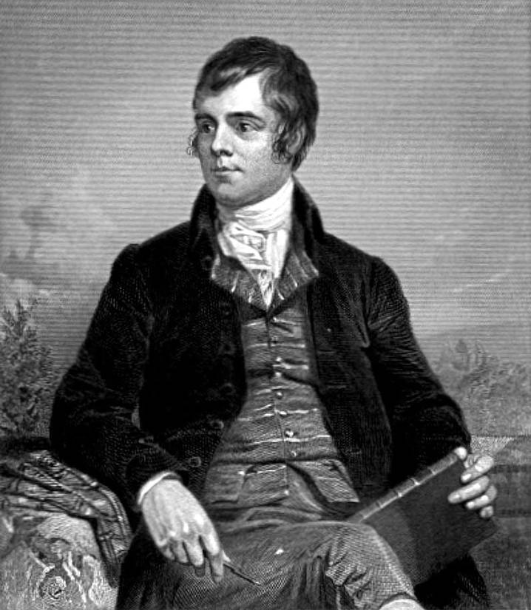

Slide 2
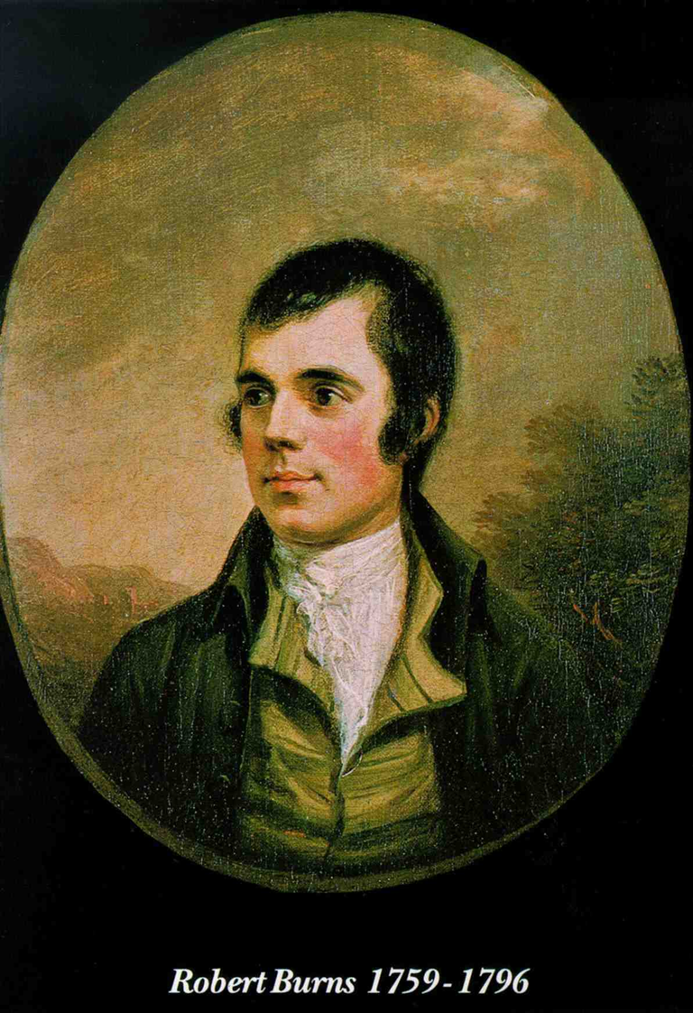
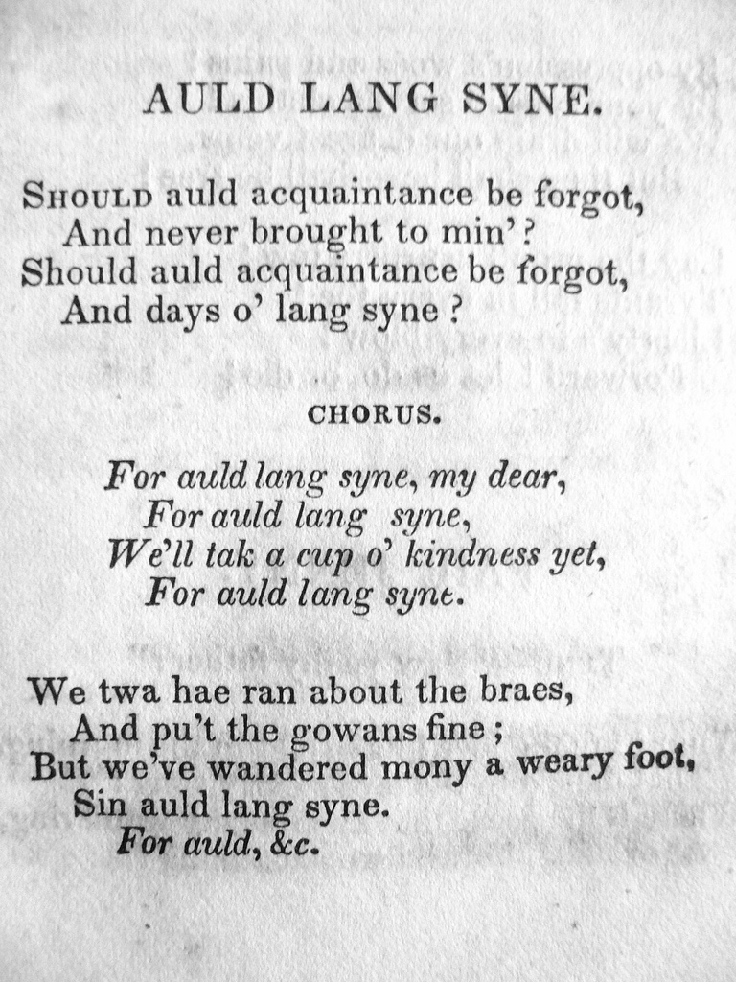

Slide 3
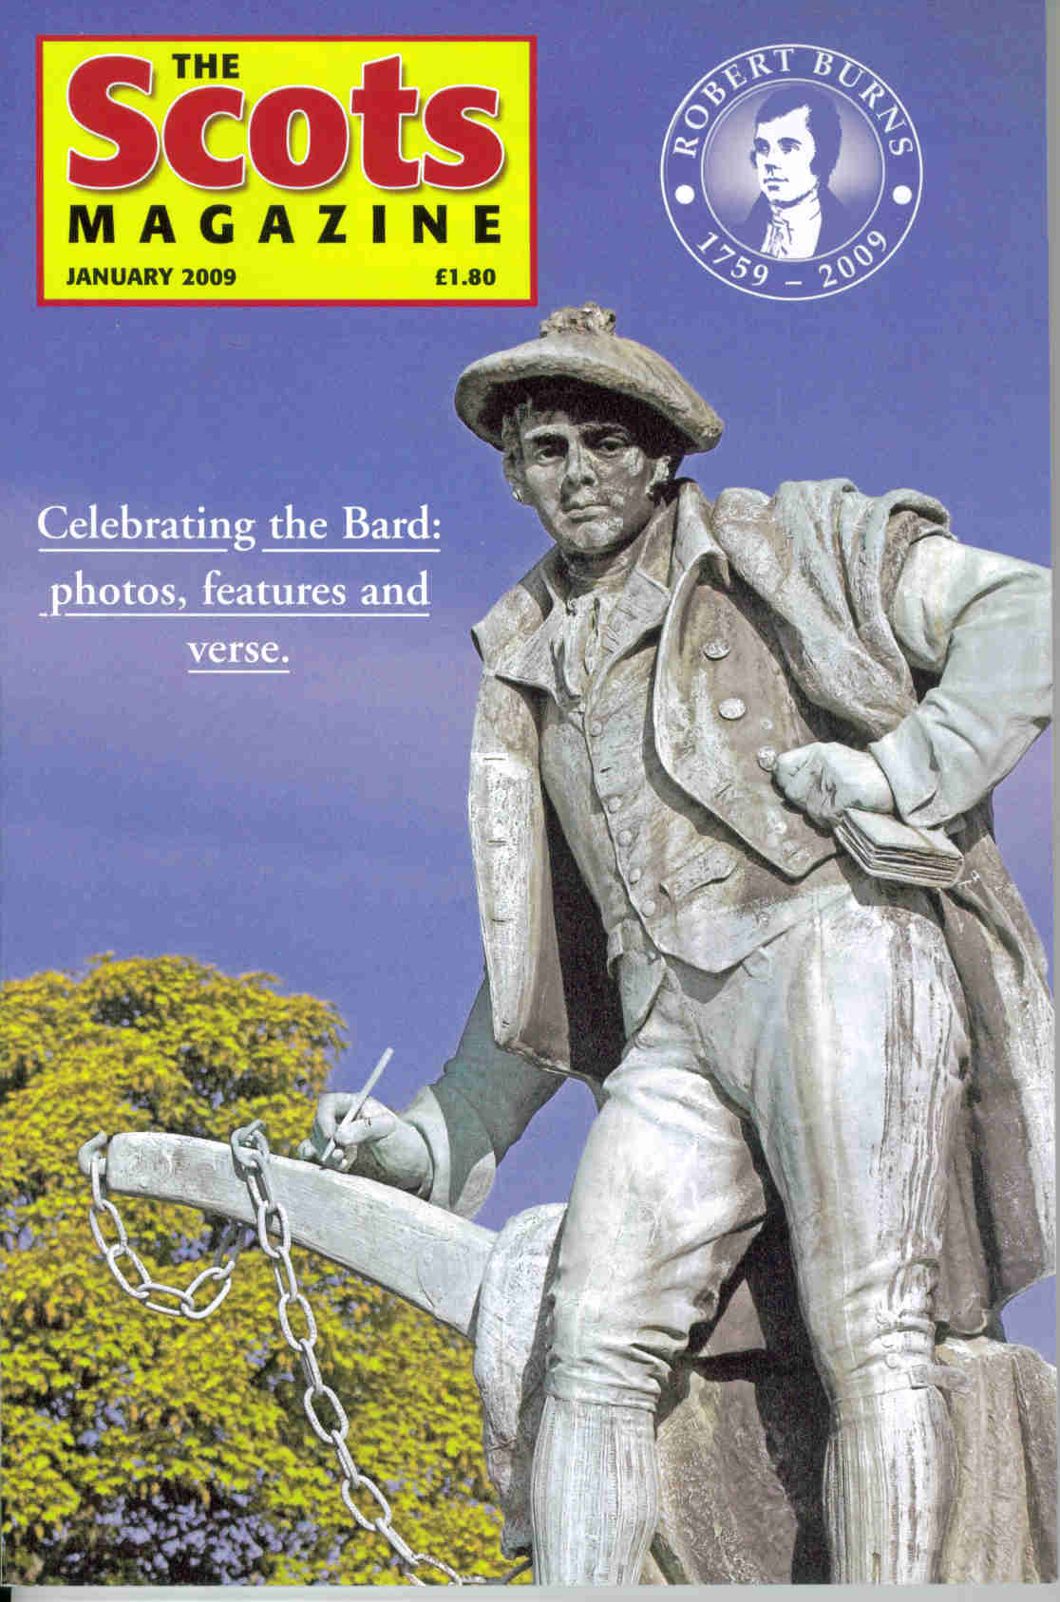
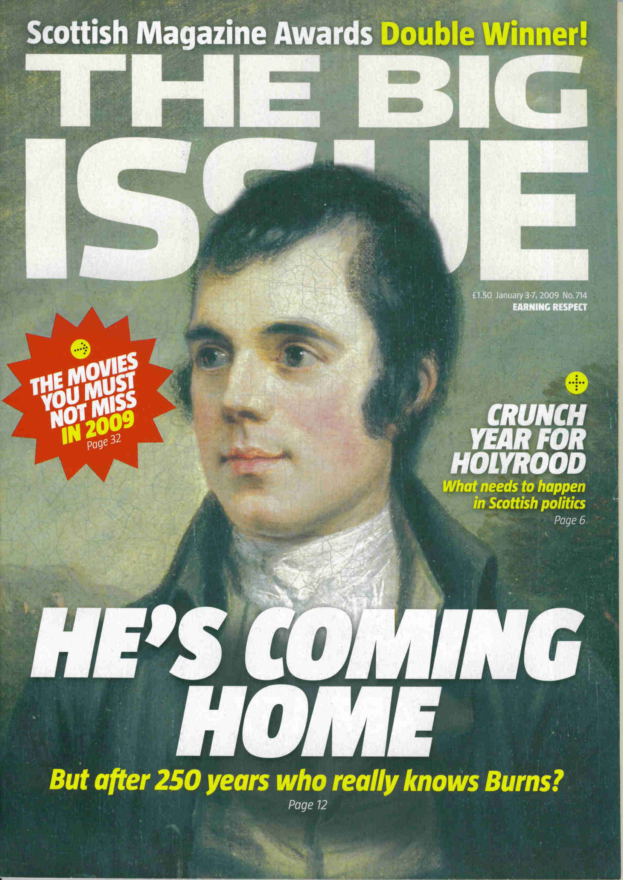
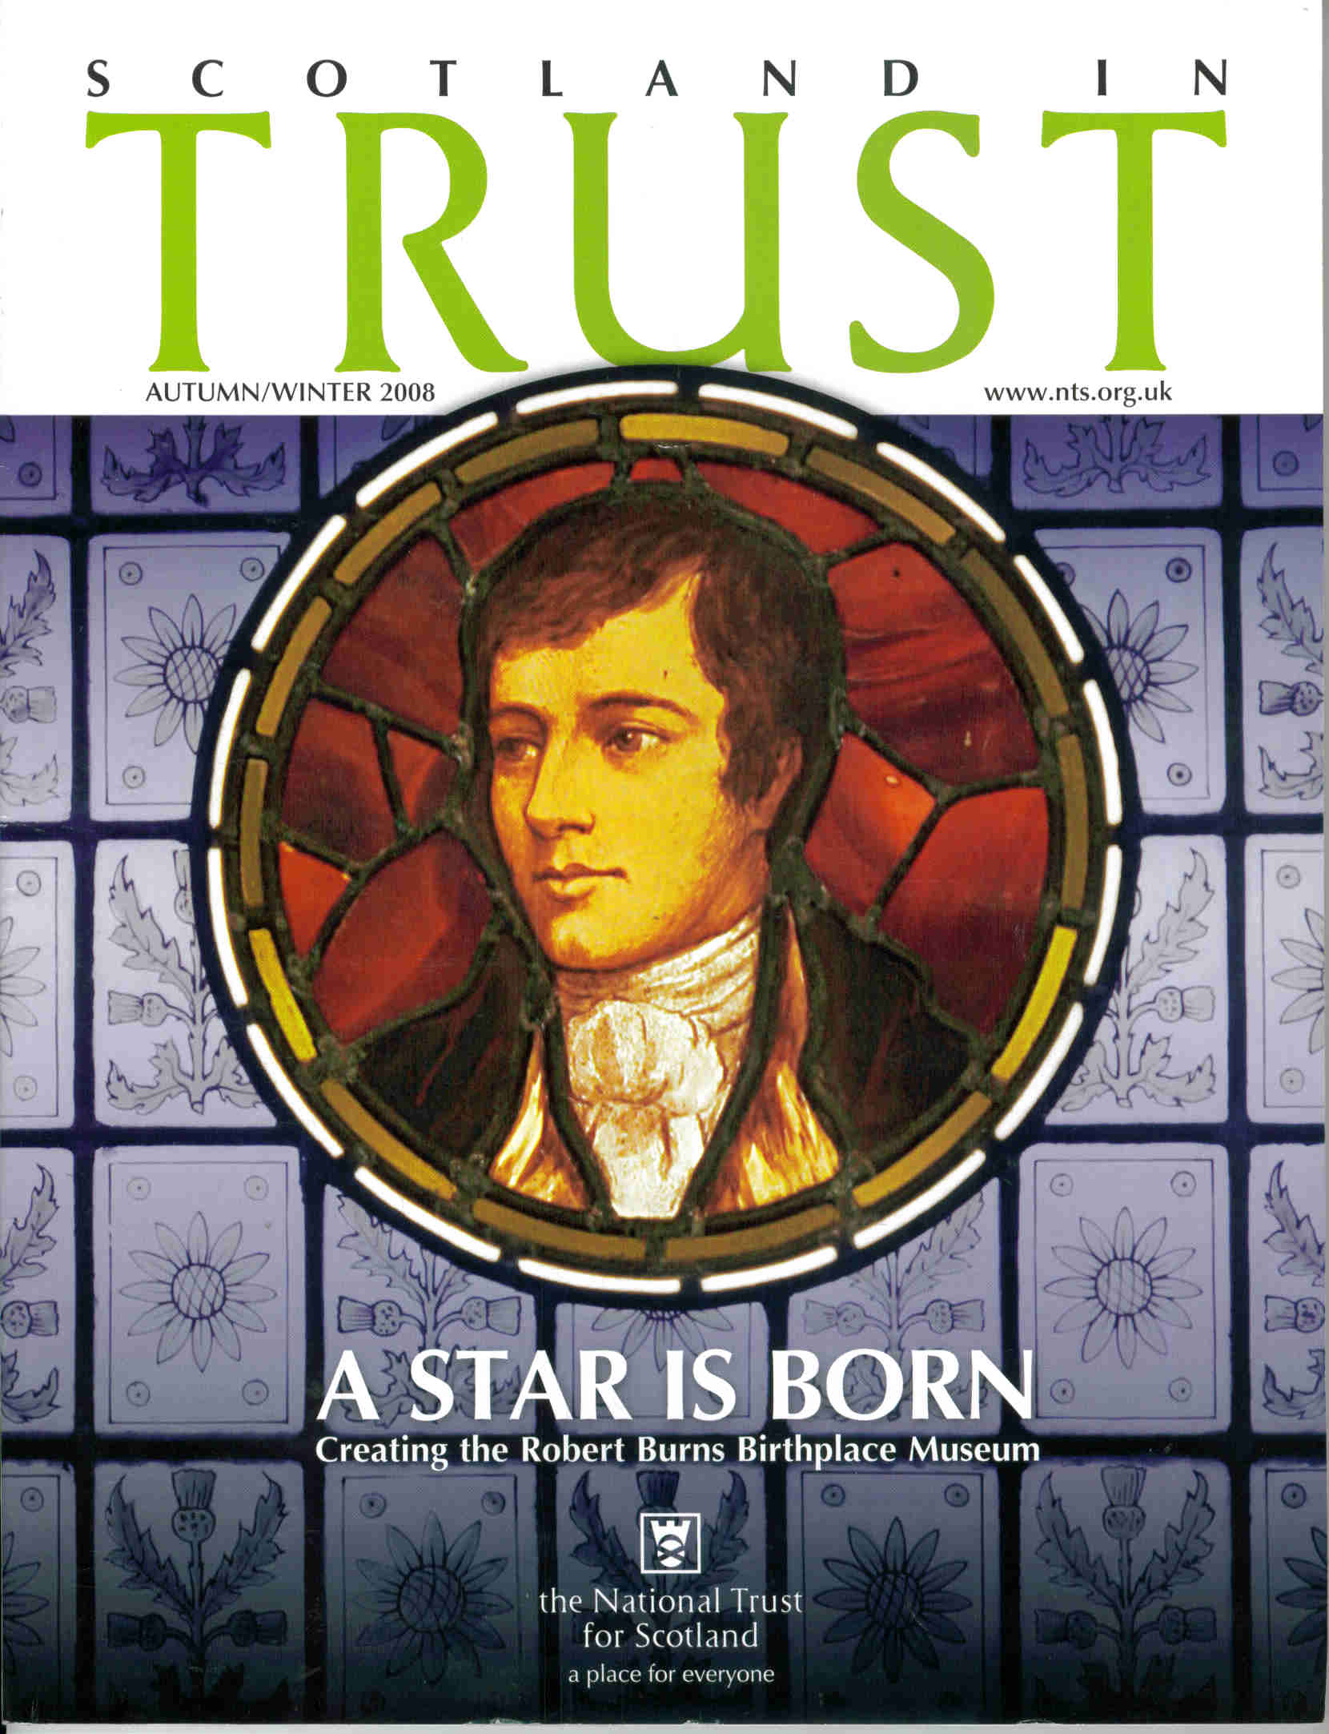

Slide 4
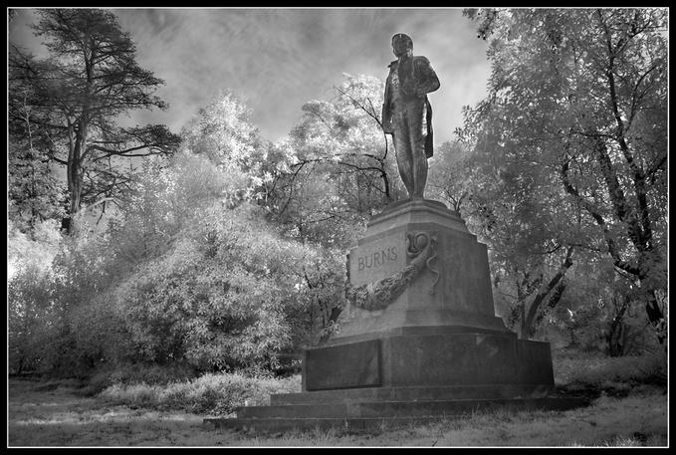

Slide 5
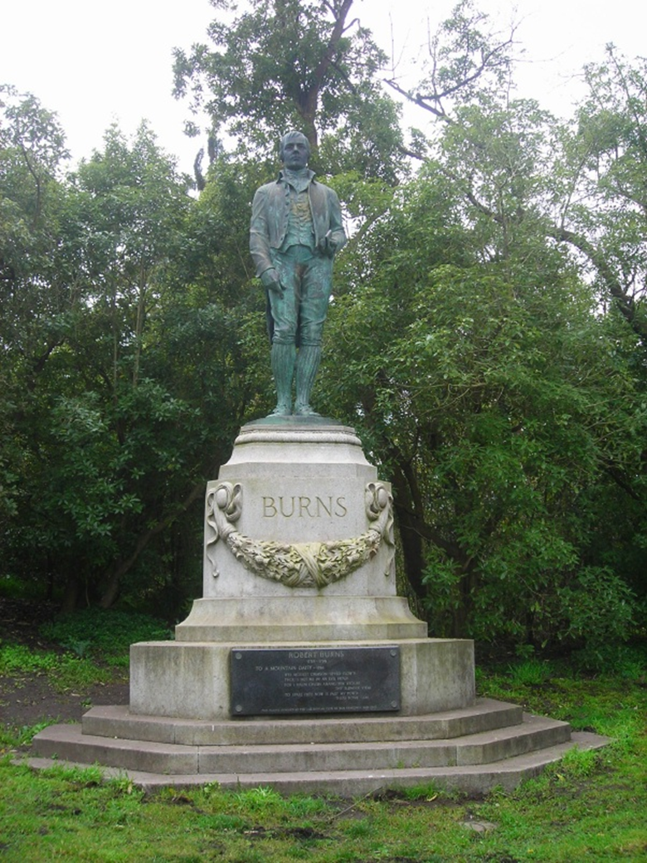

Slide 6
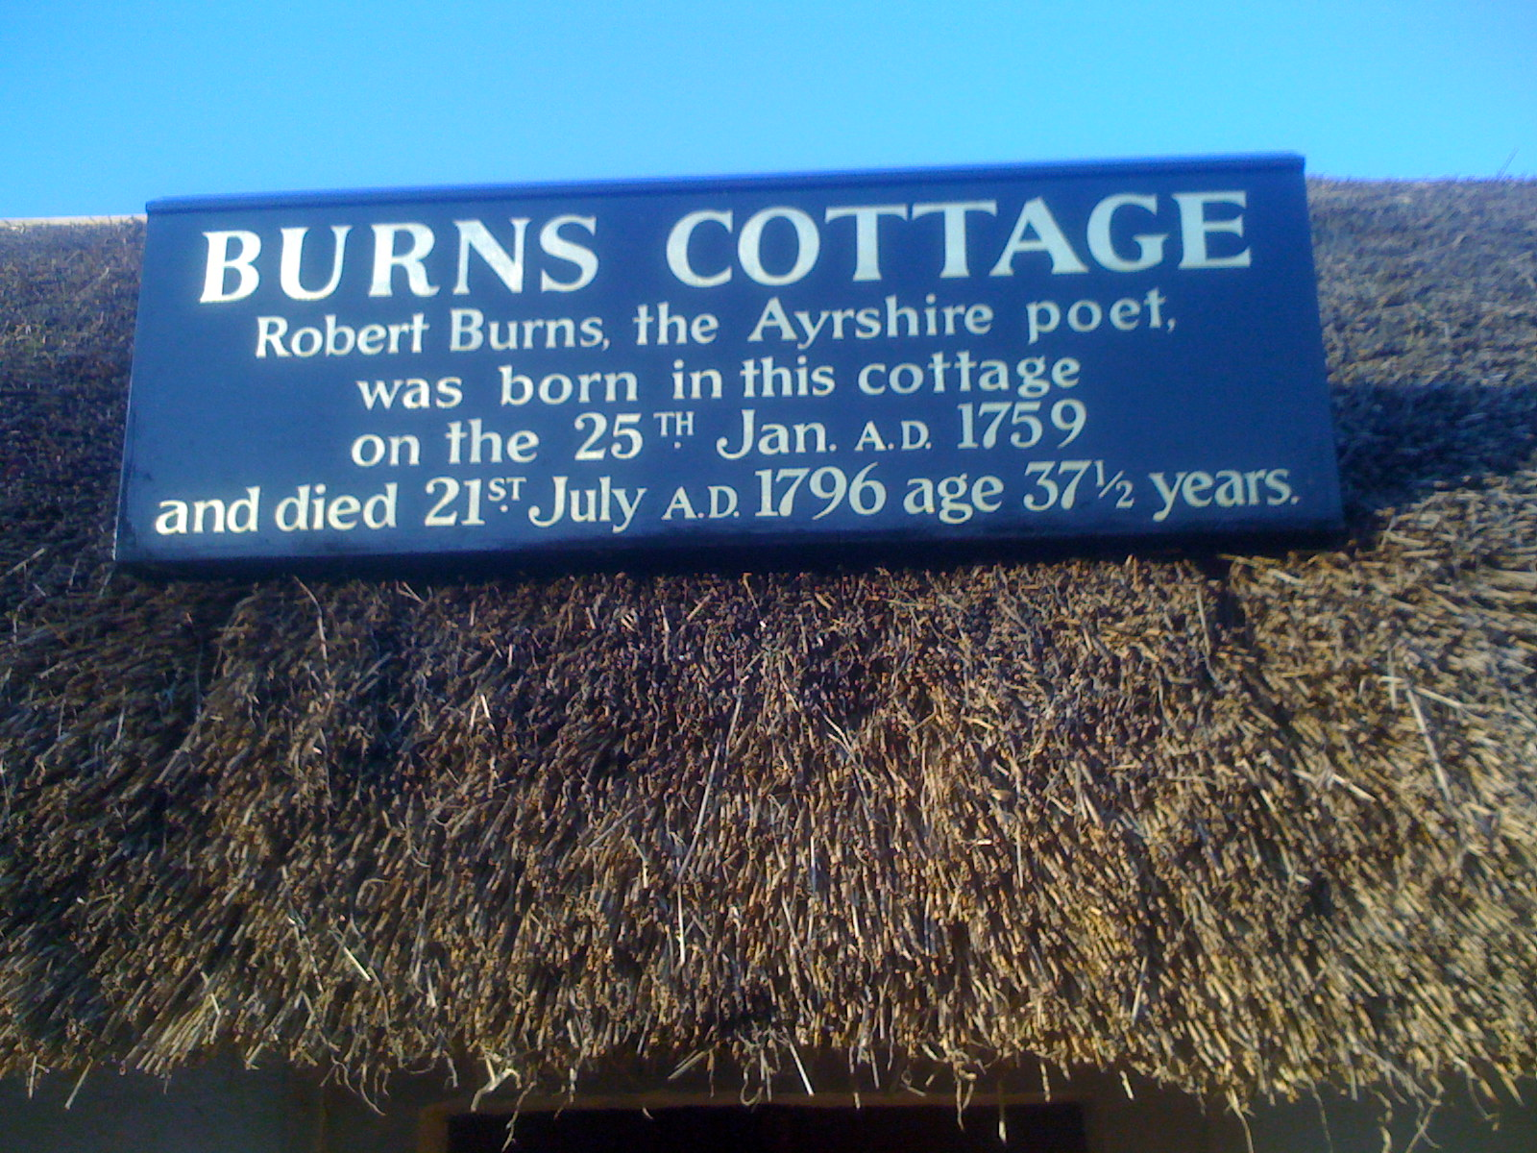
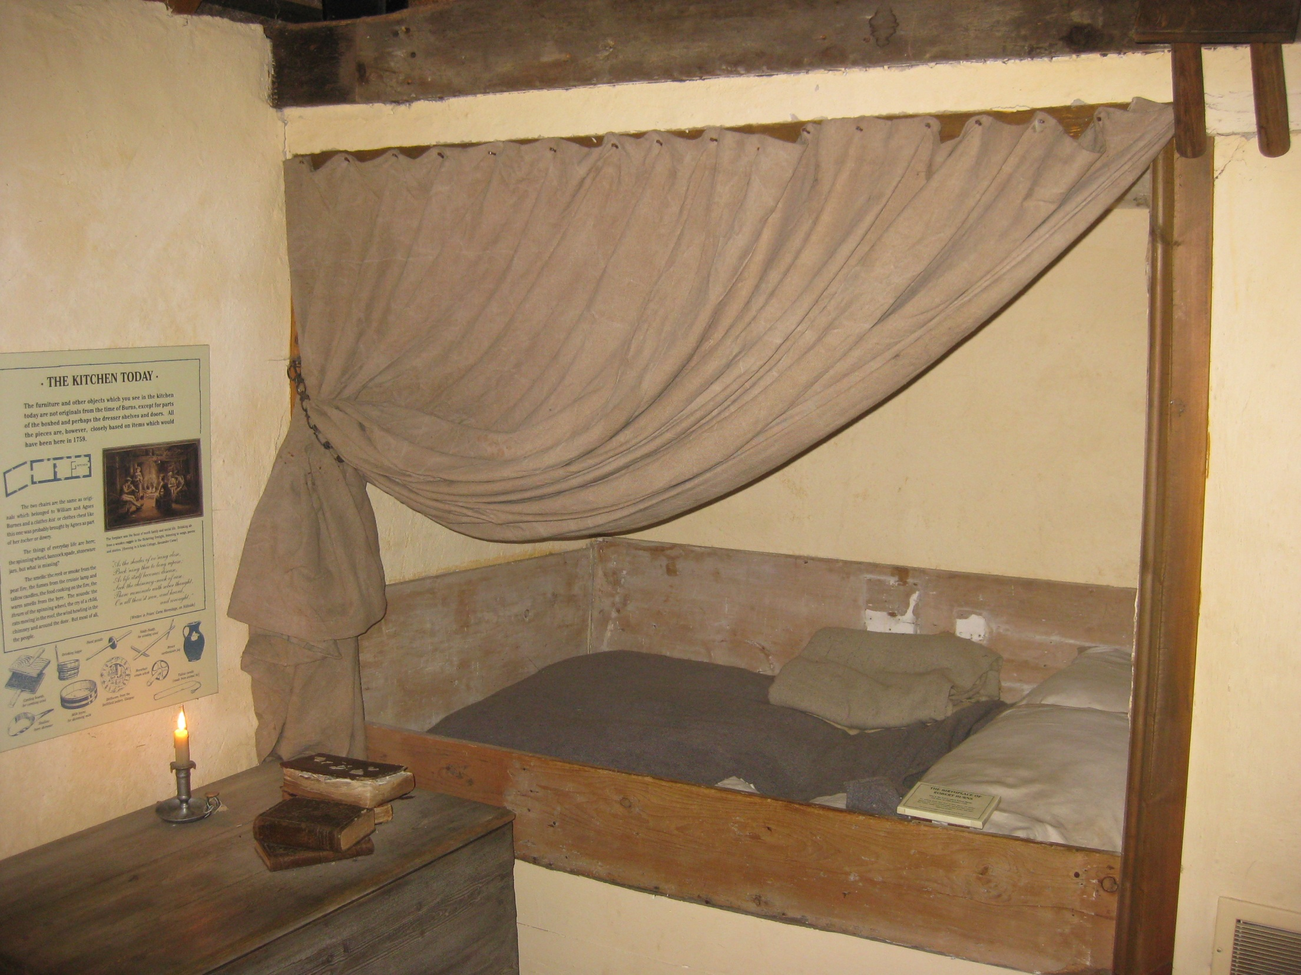
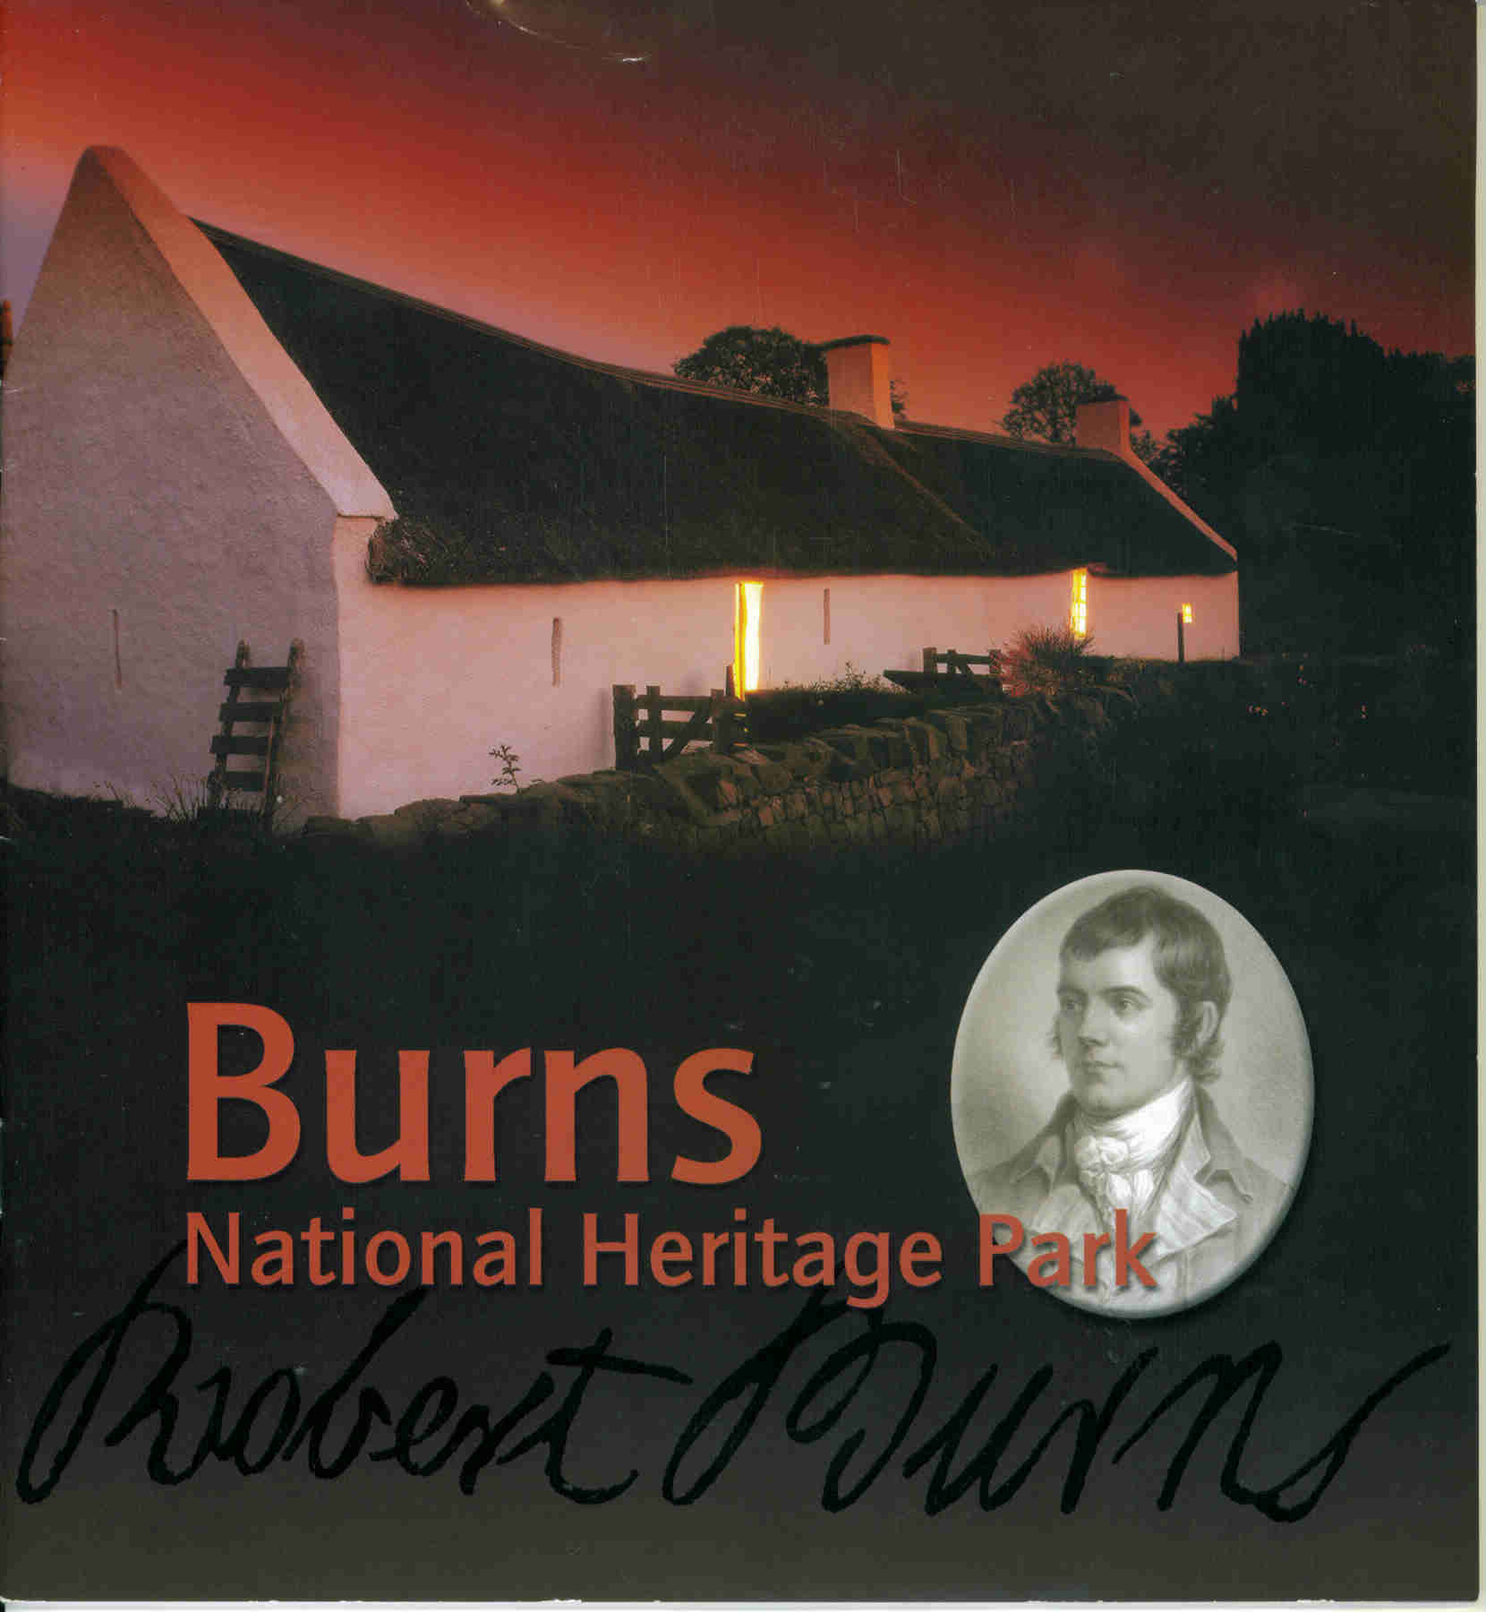
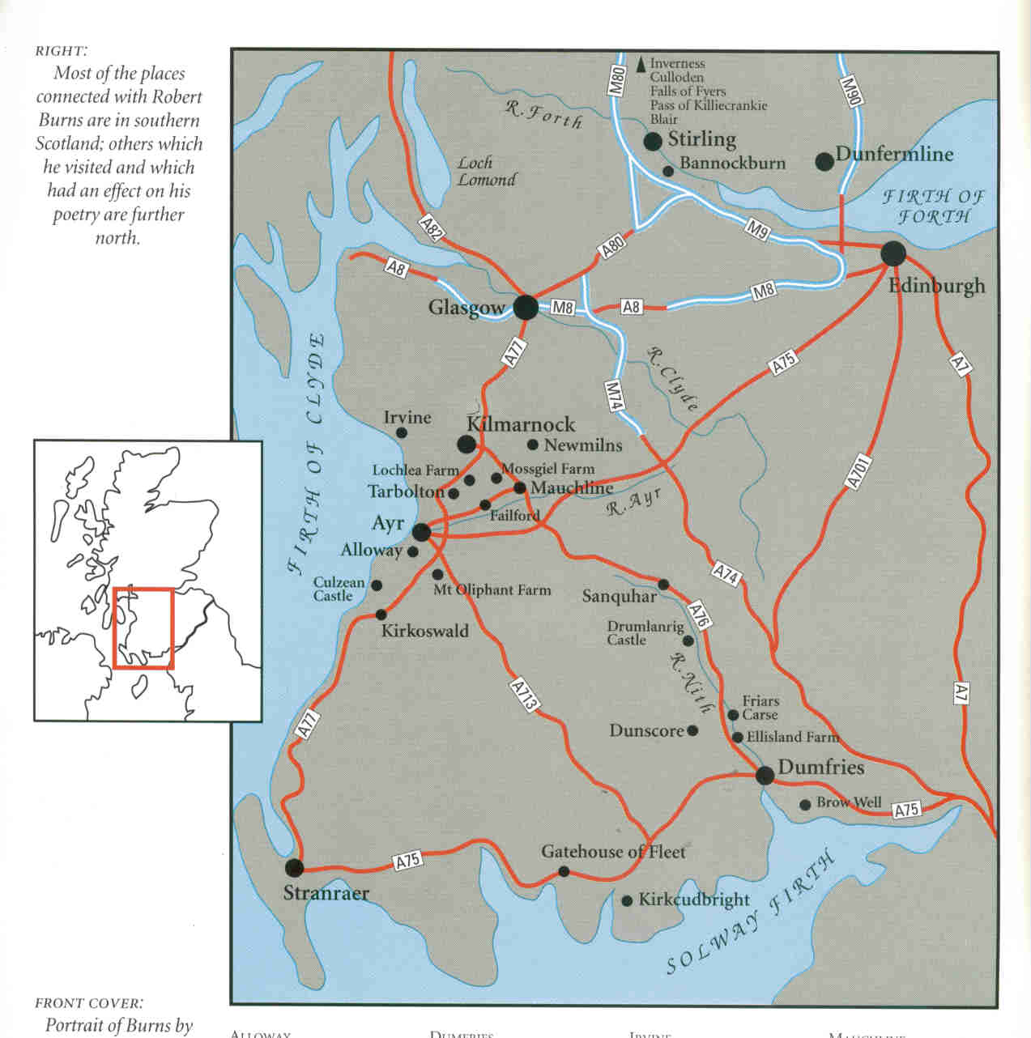

Slide 7
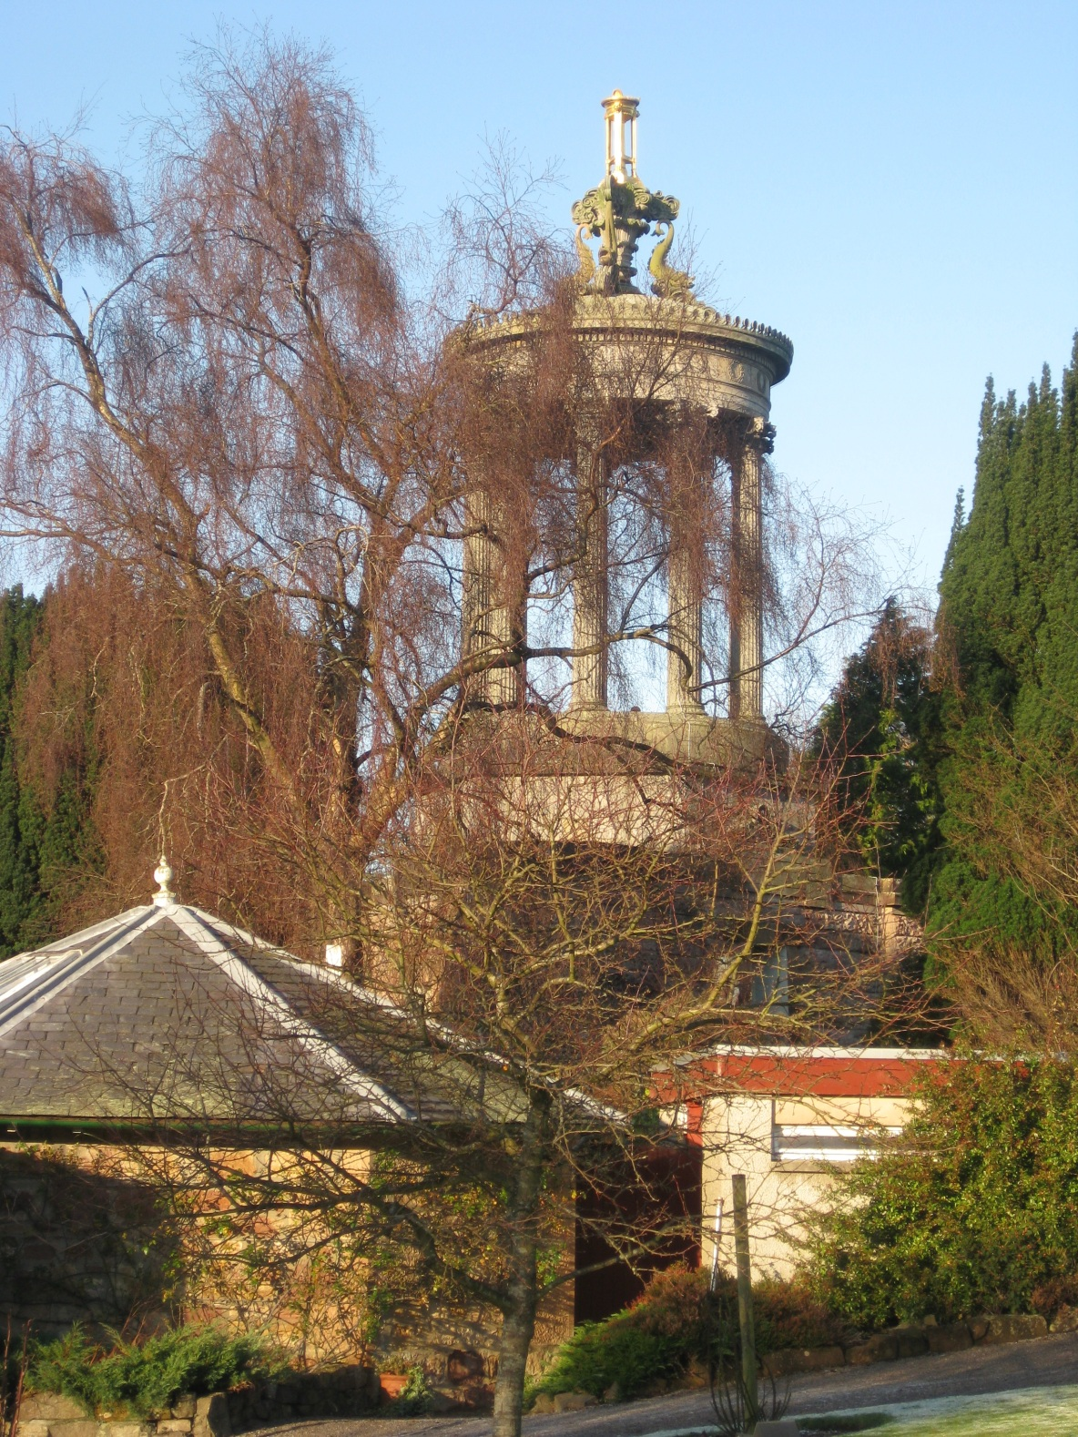
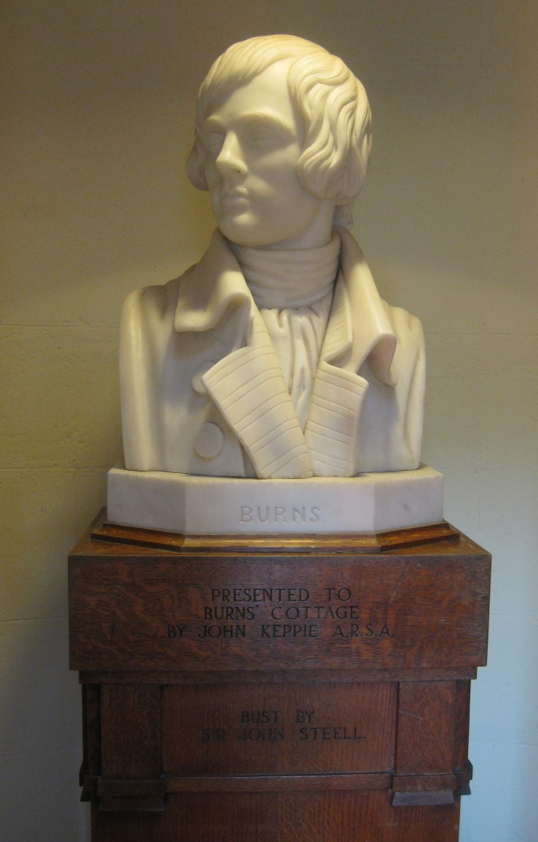

Slide 8
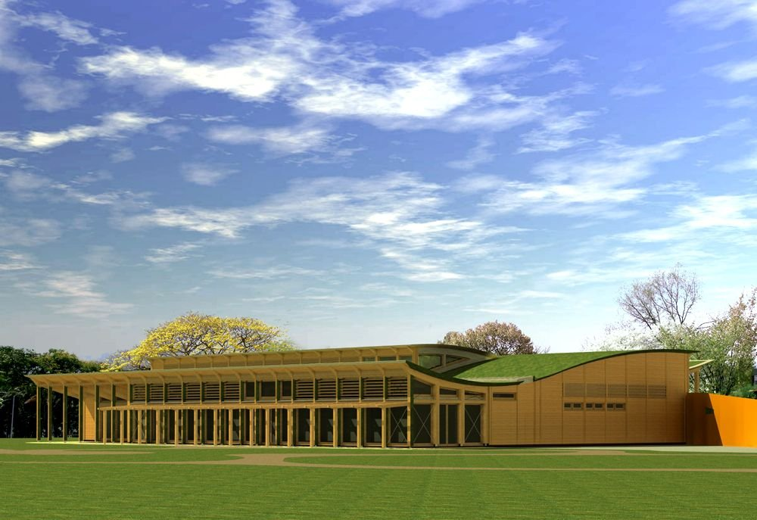
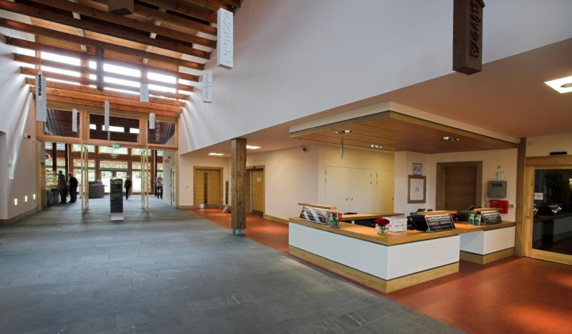
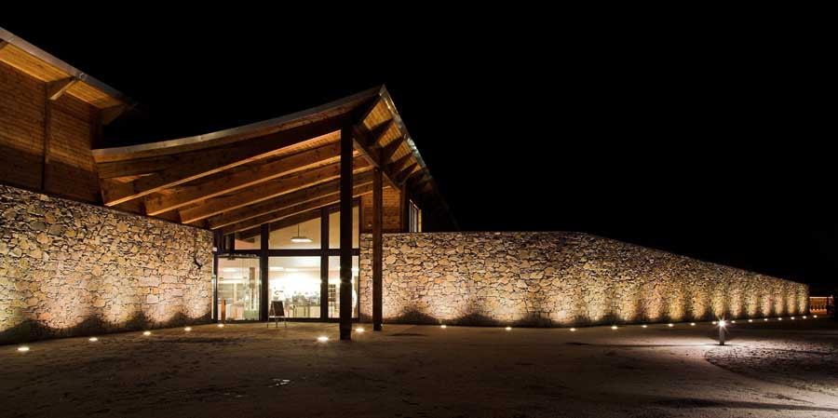

Slide 9
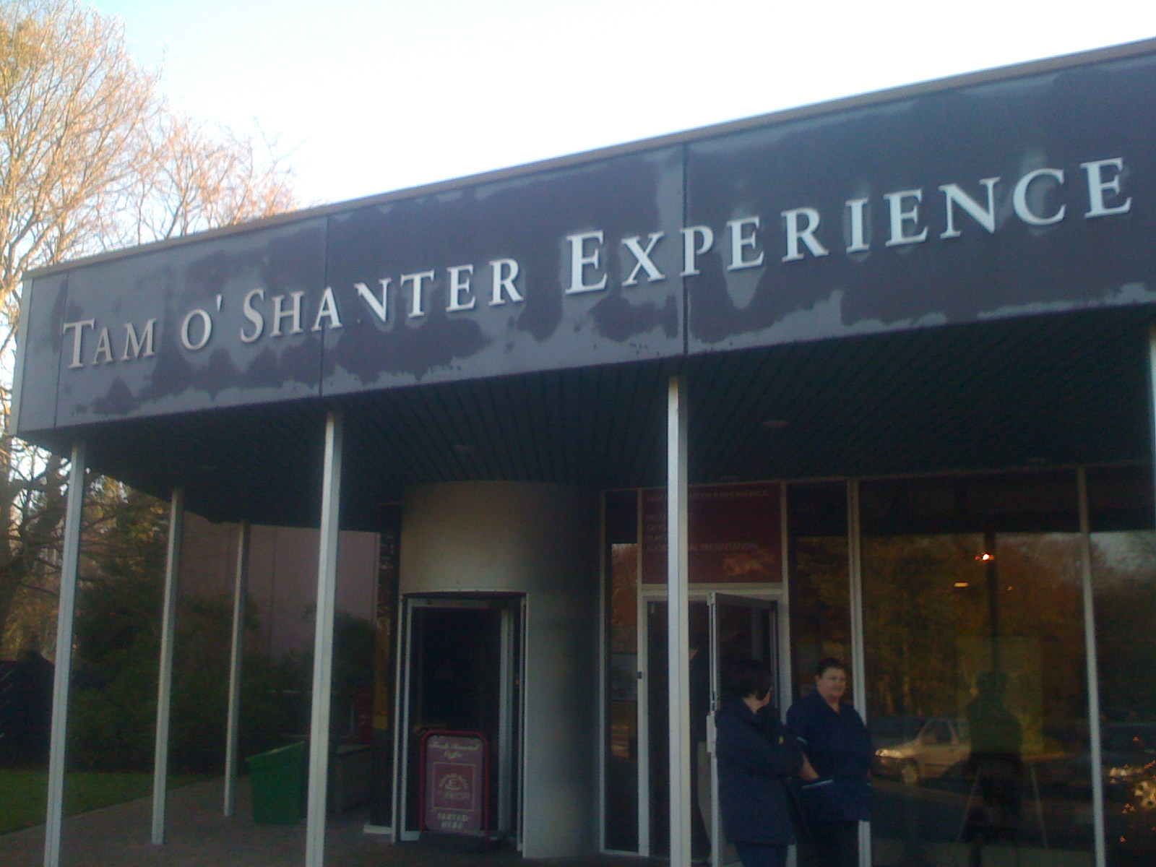

Slide 10
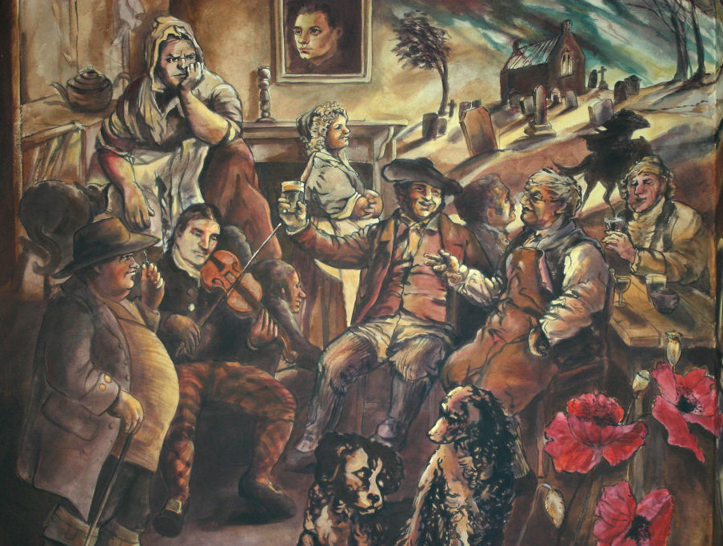
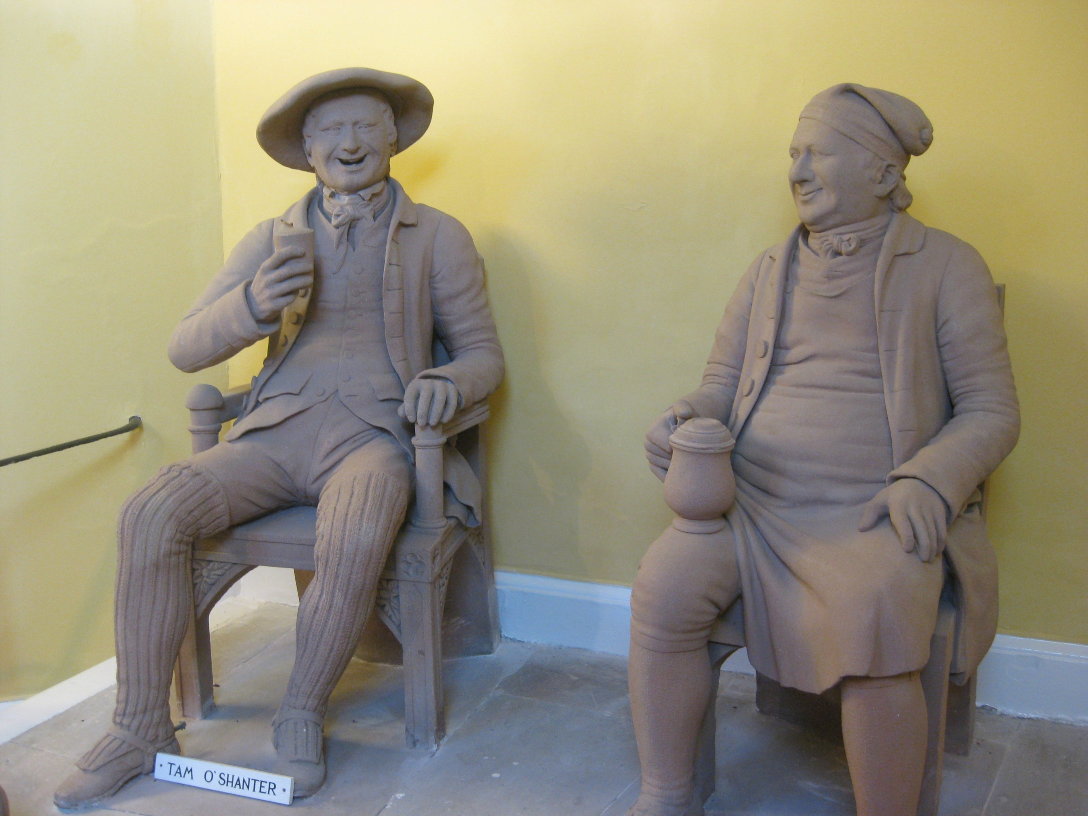
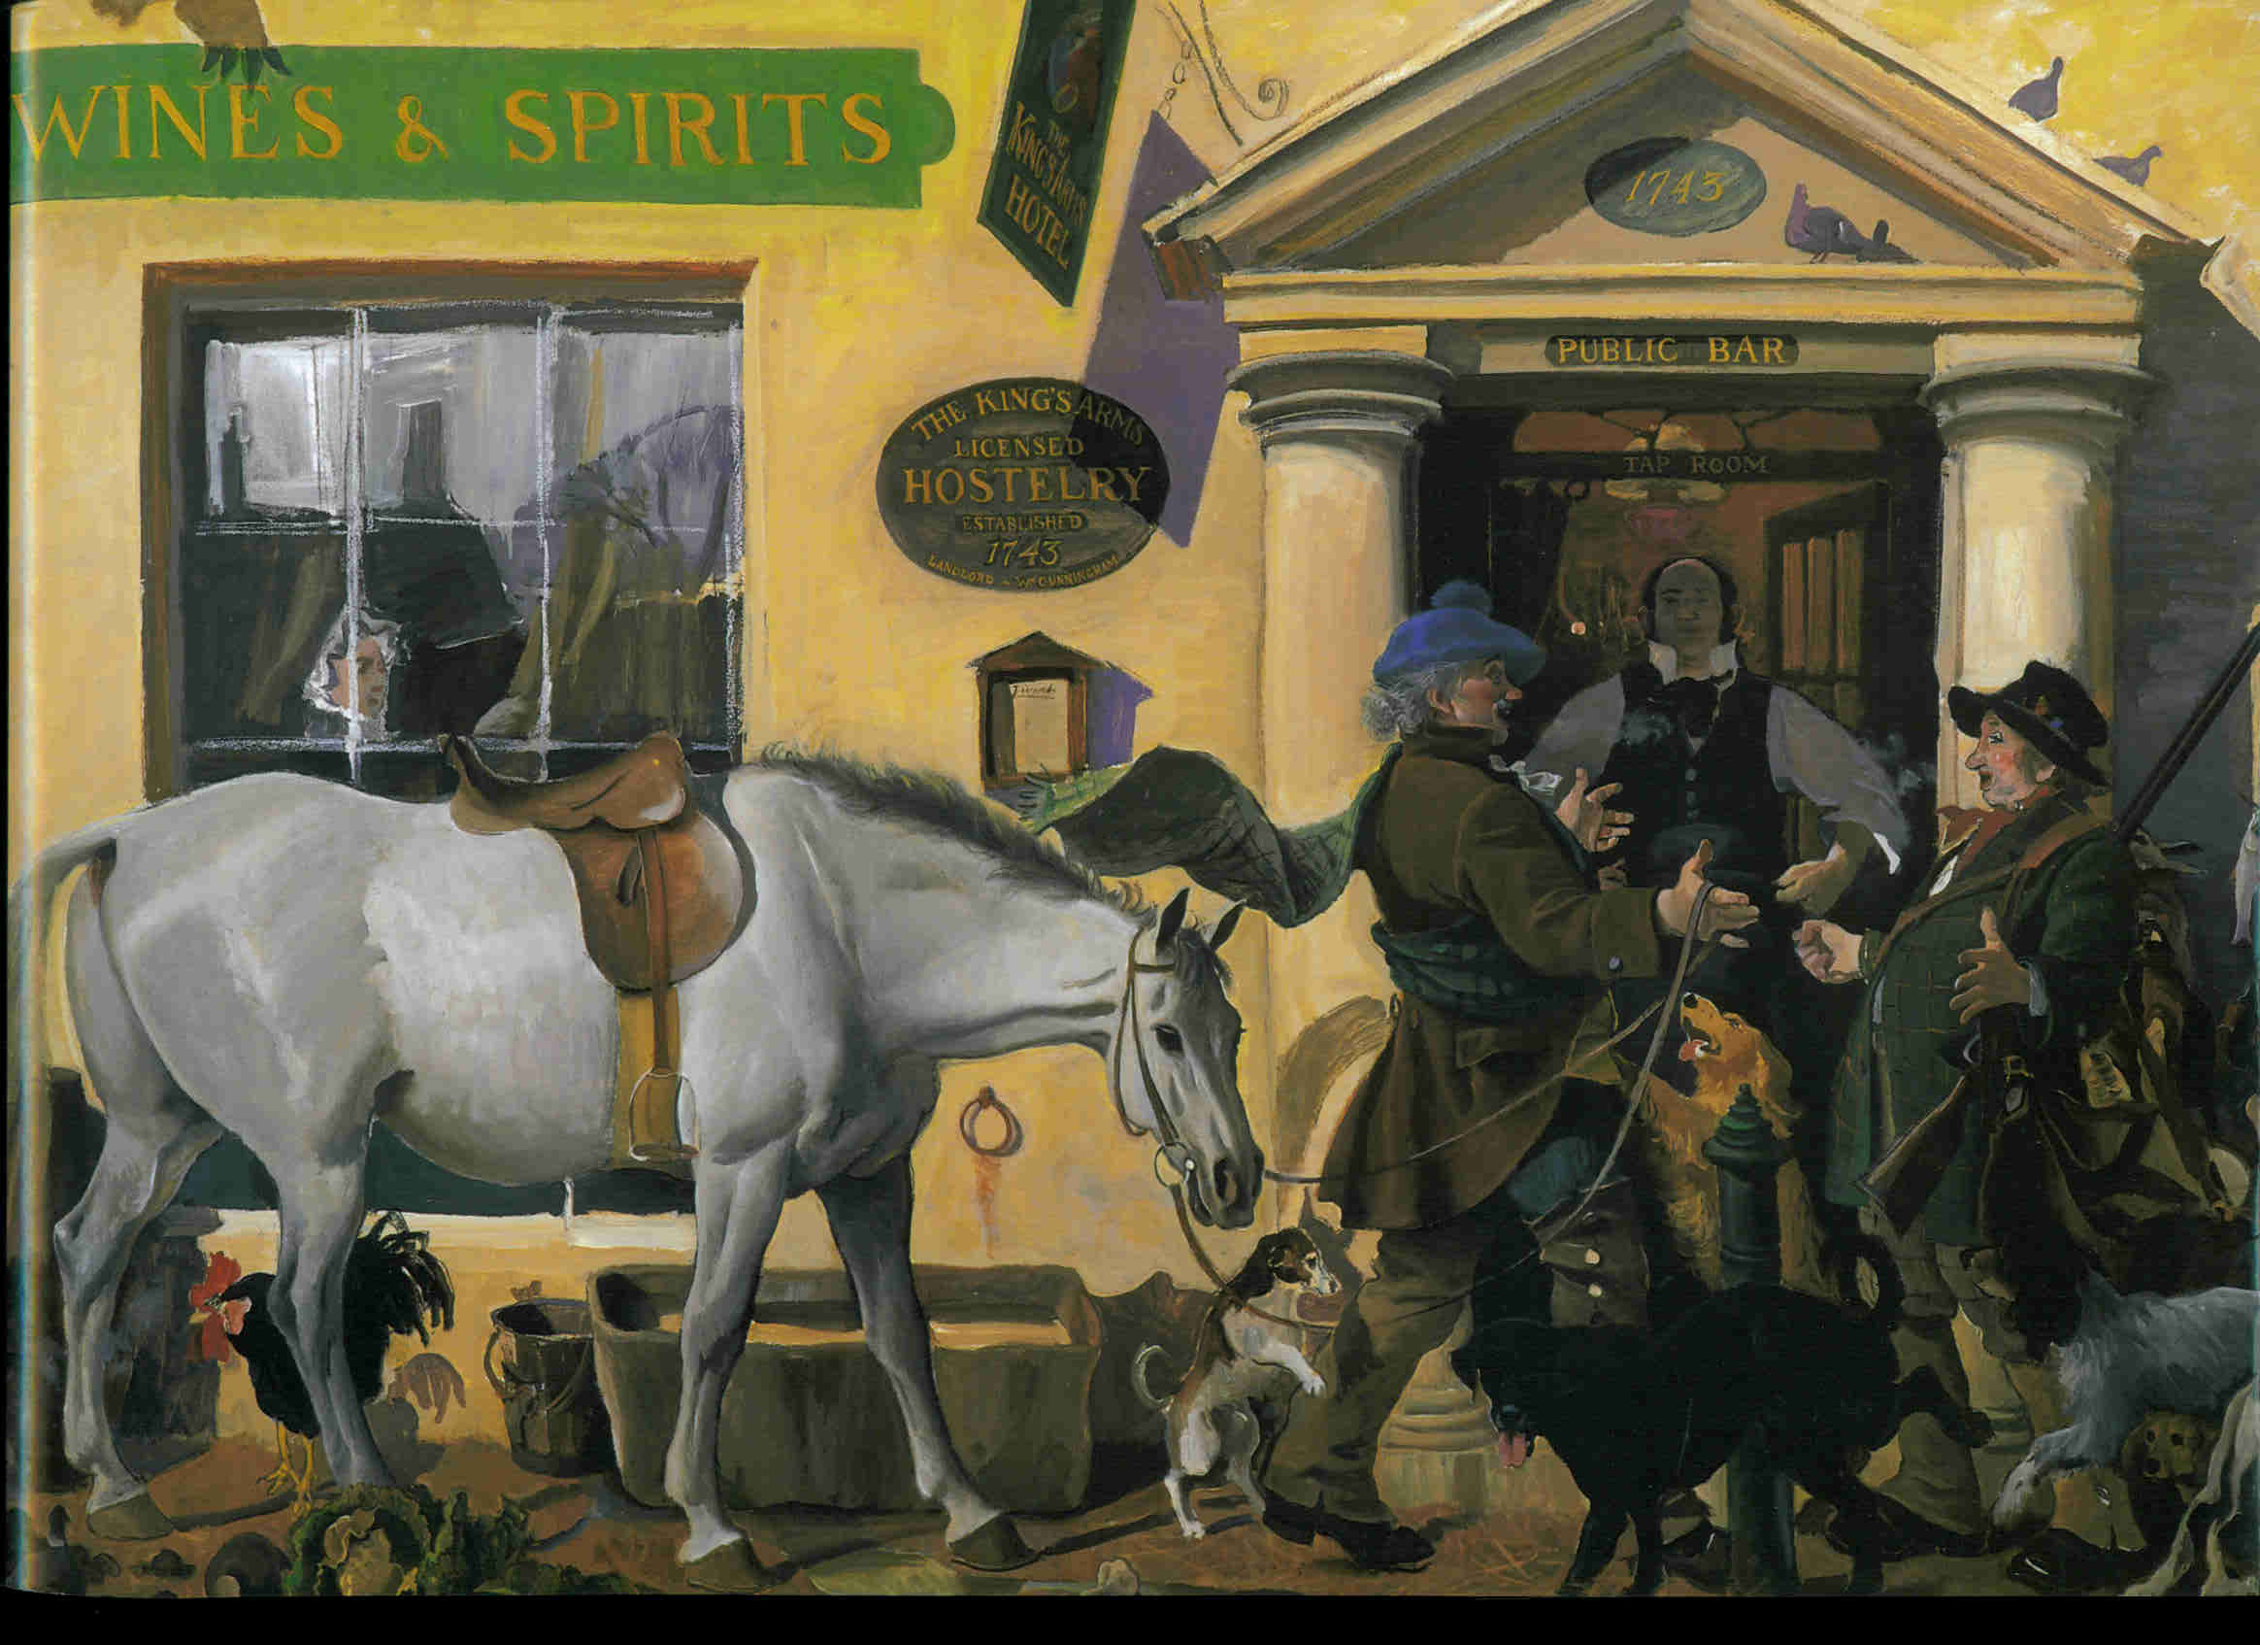
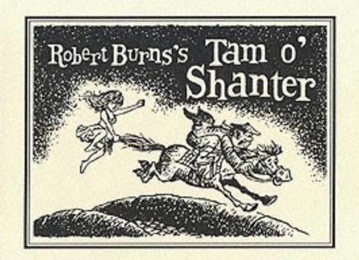

Slide 11
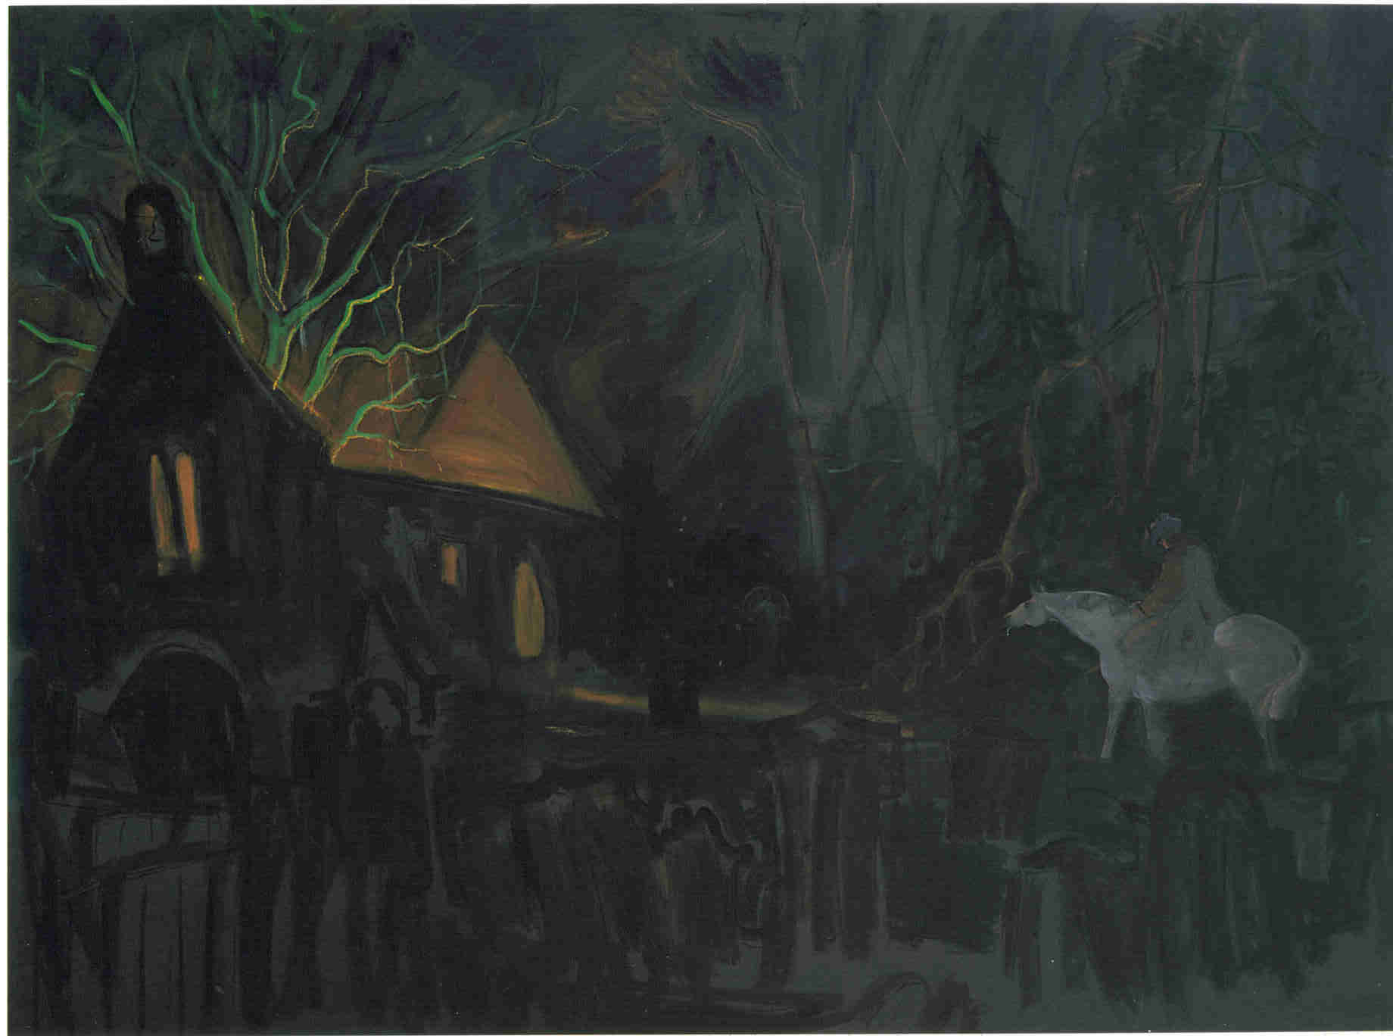
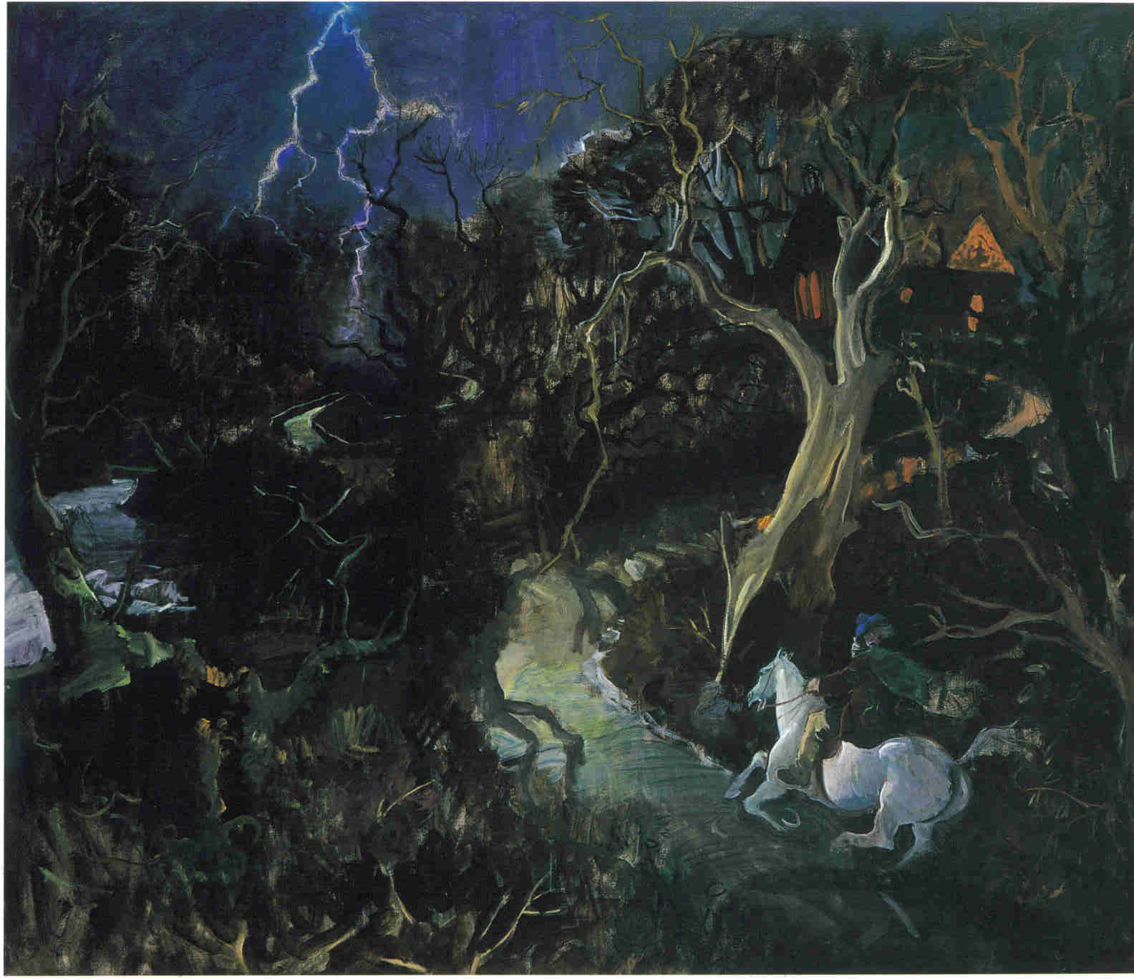
4:30

Slide 12
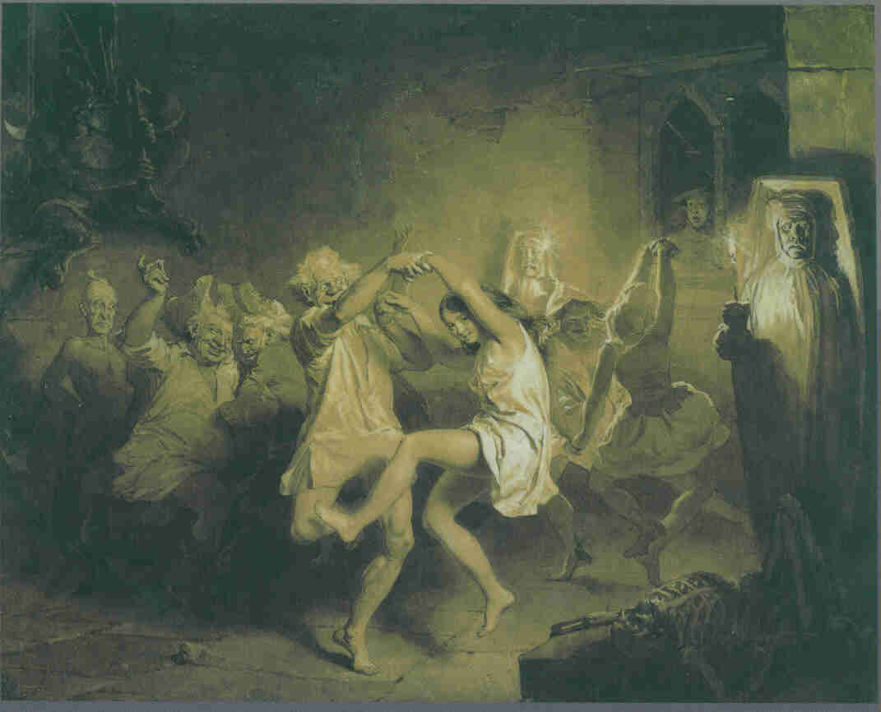
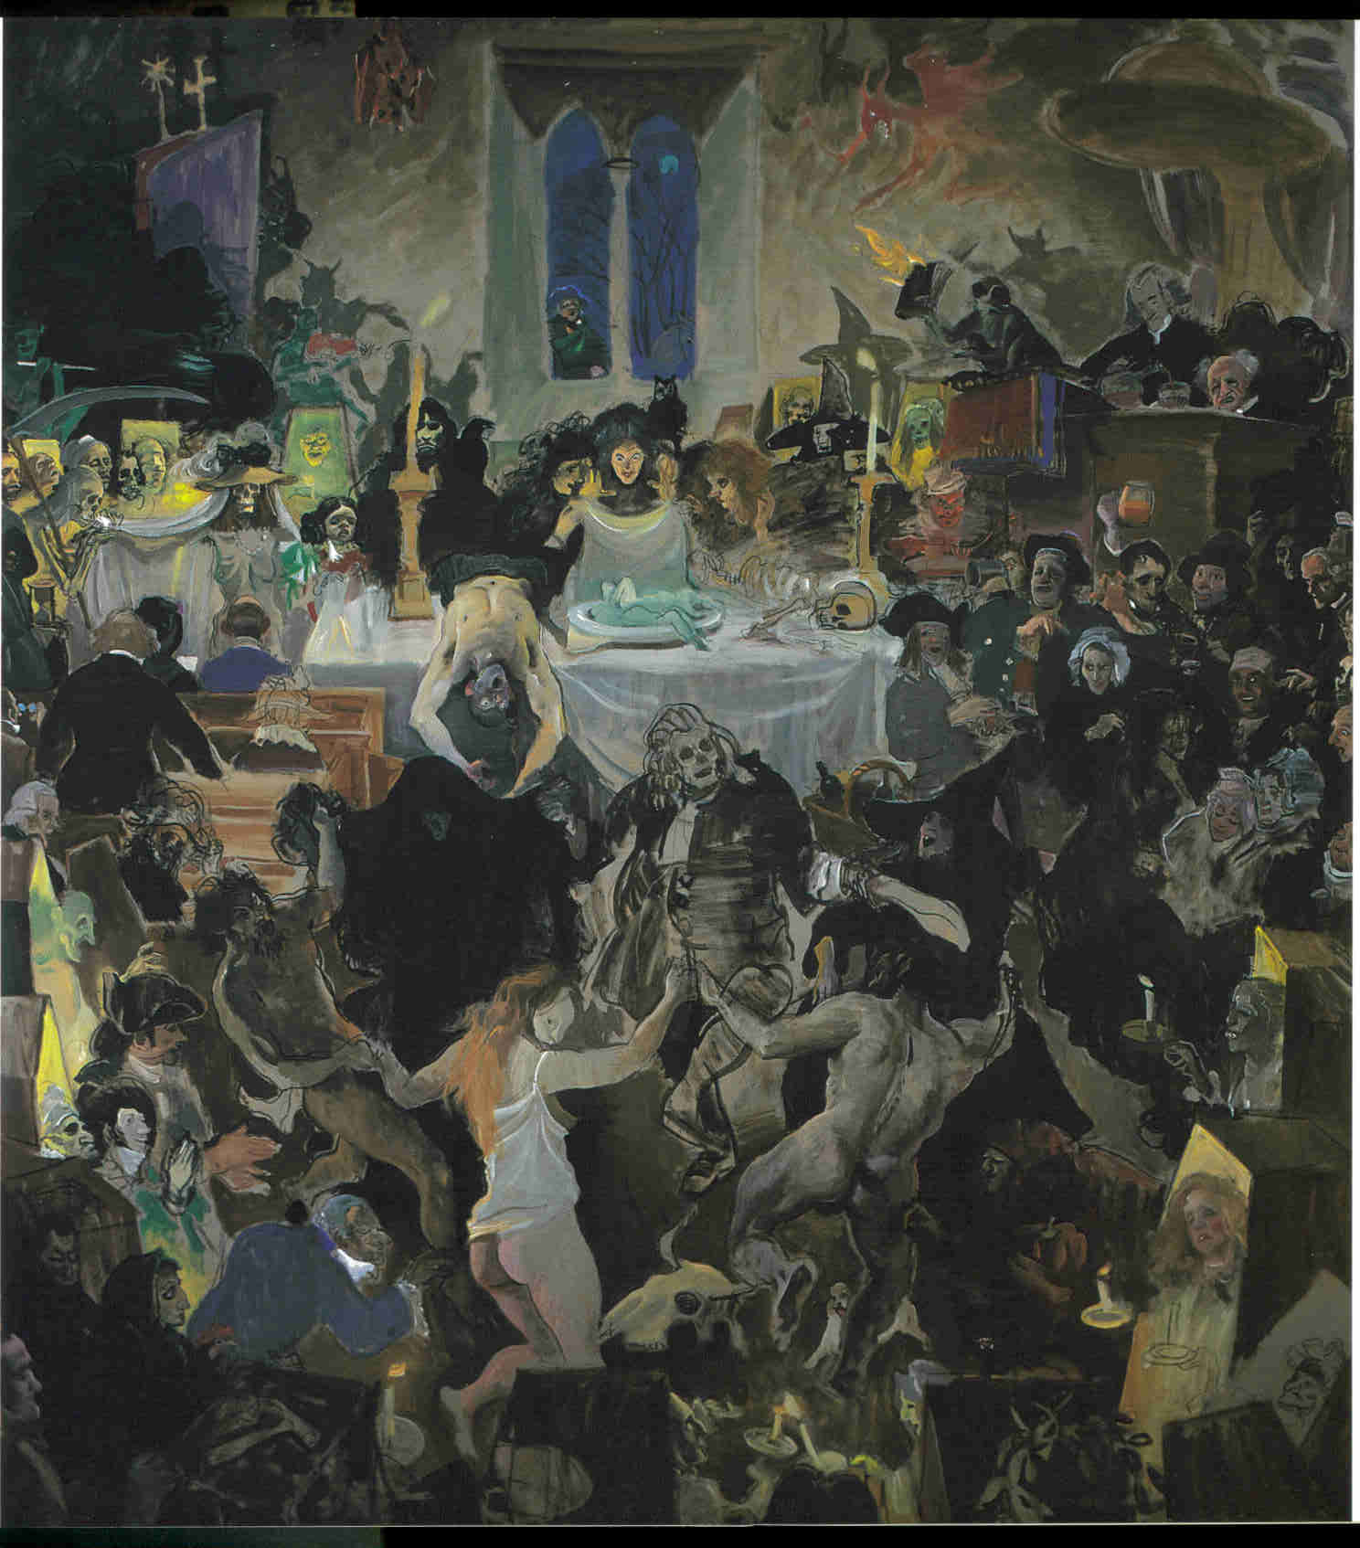
8:18

Slide 13
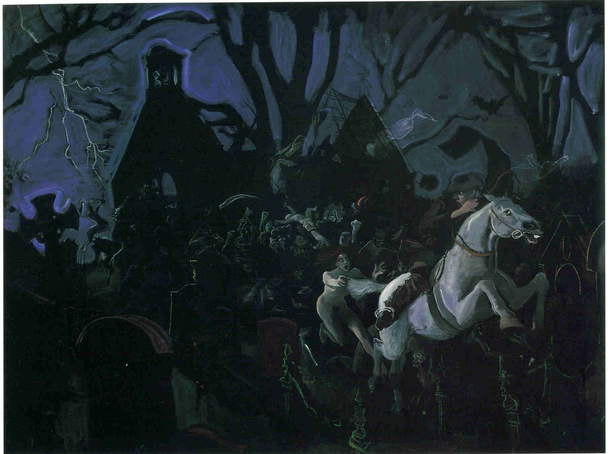
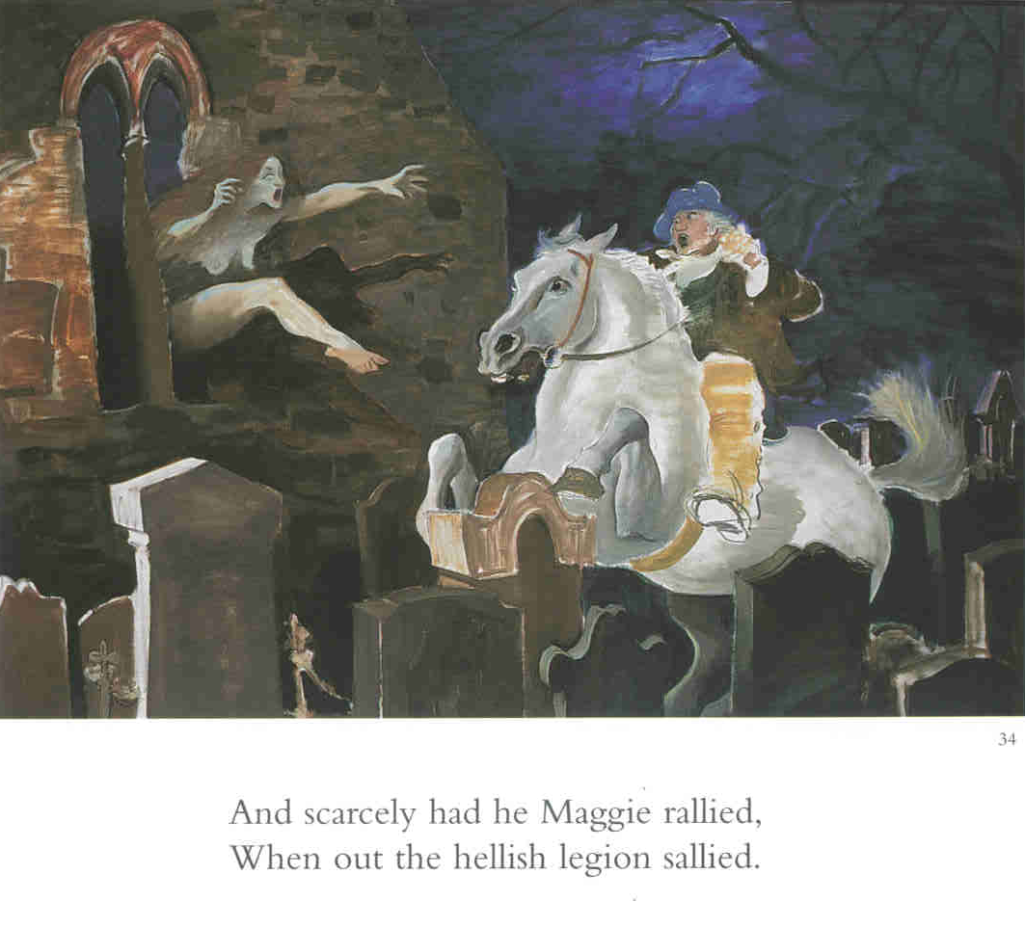

Slide 14
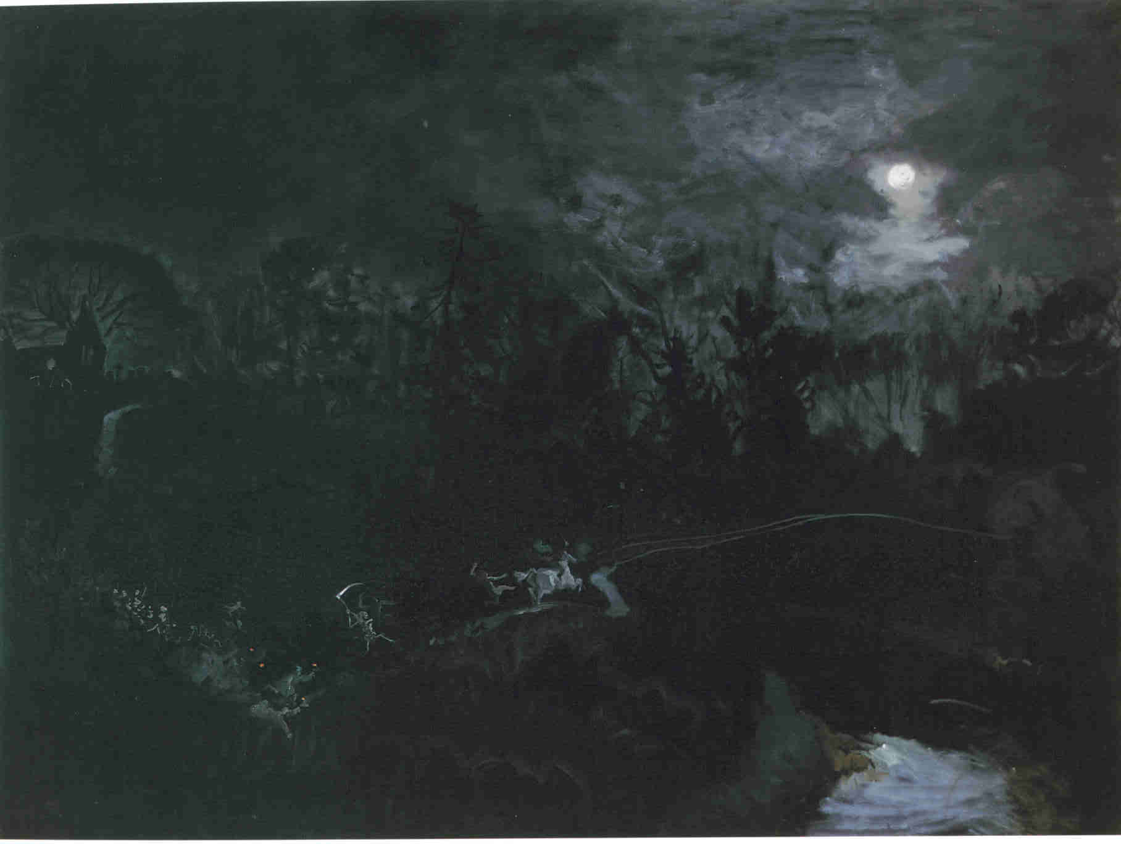
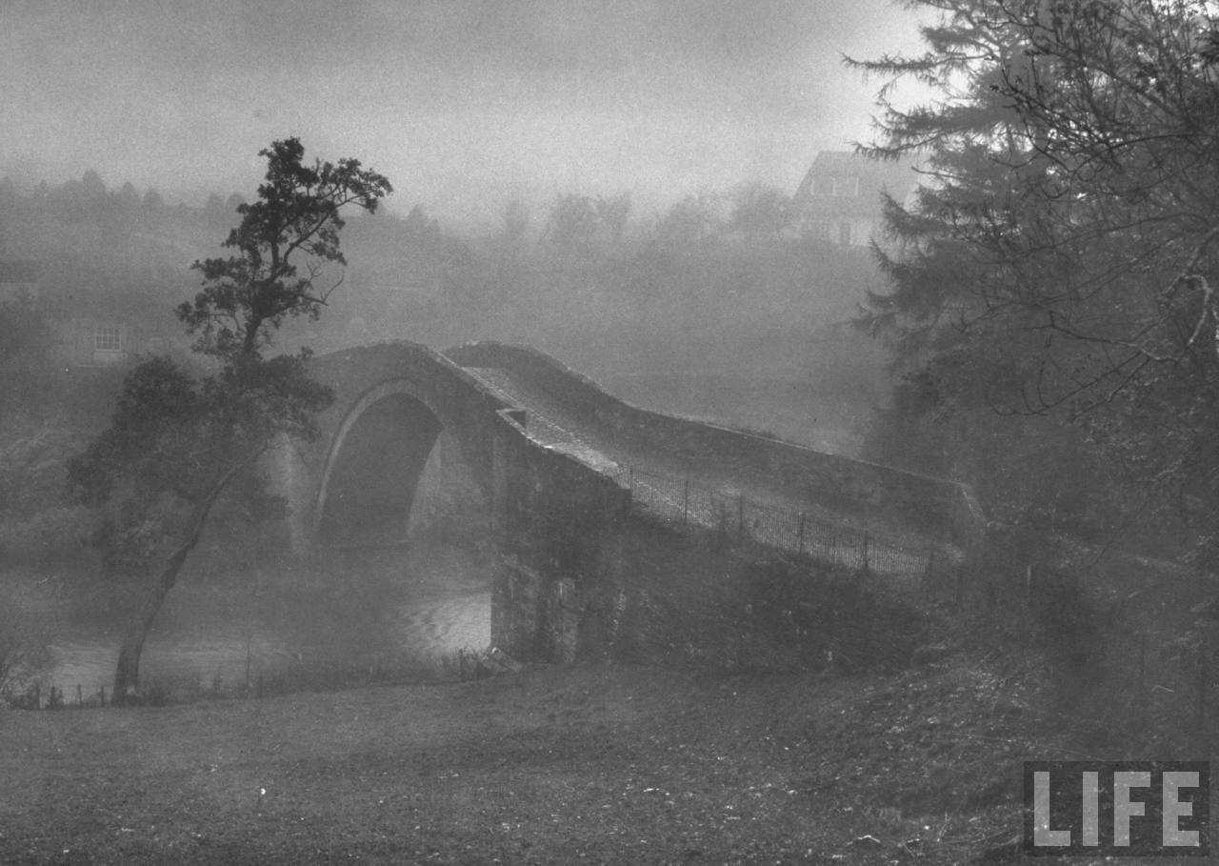

Slide 15
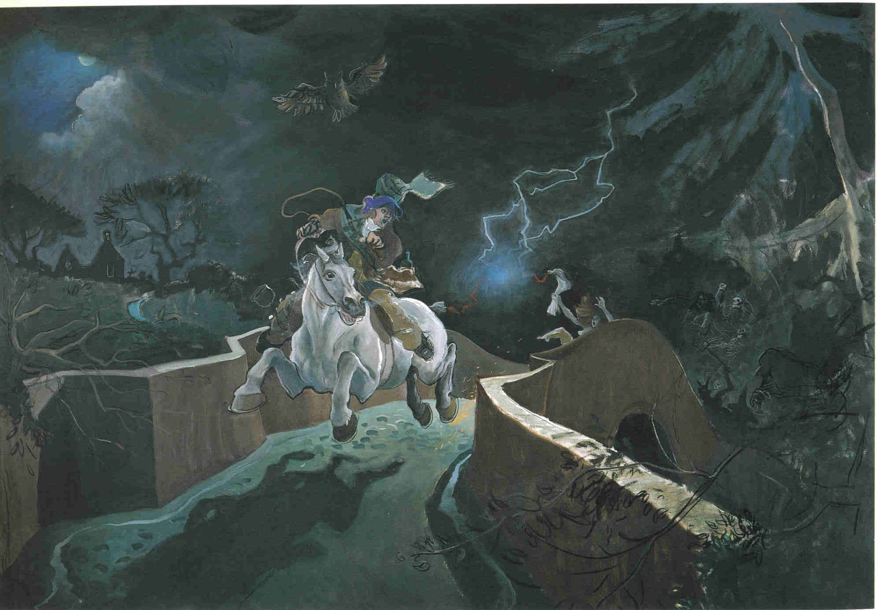
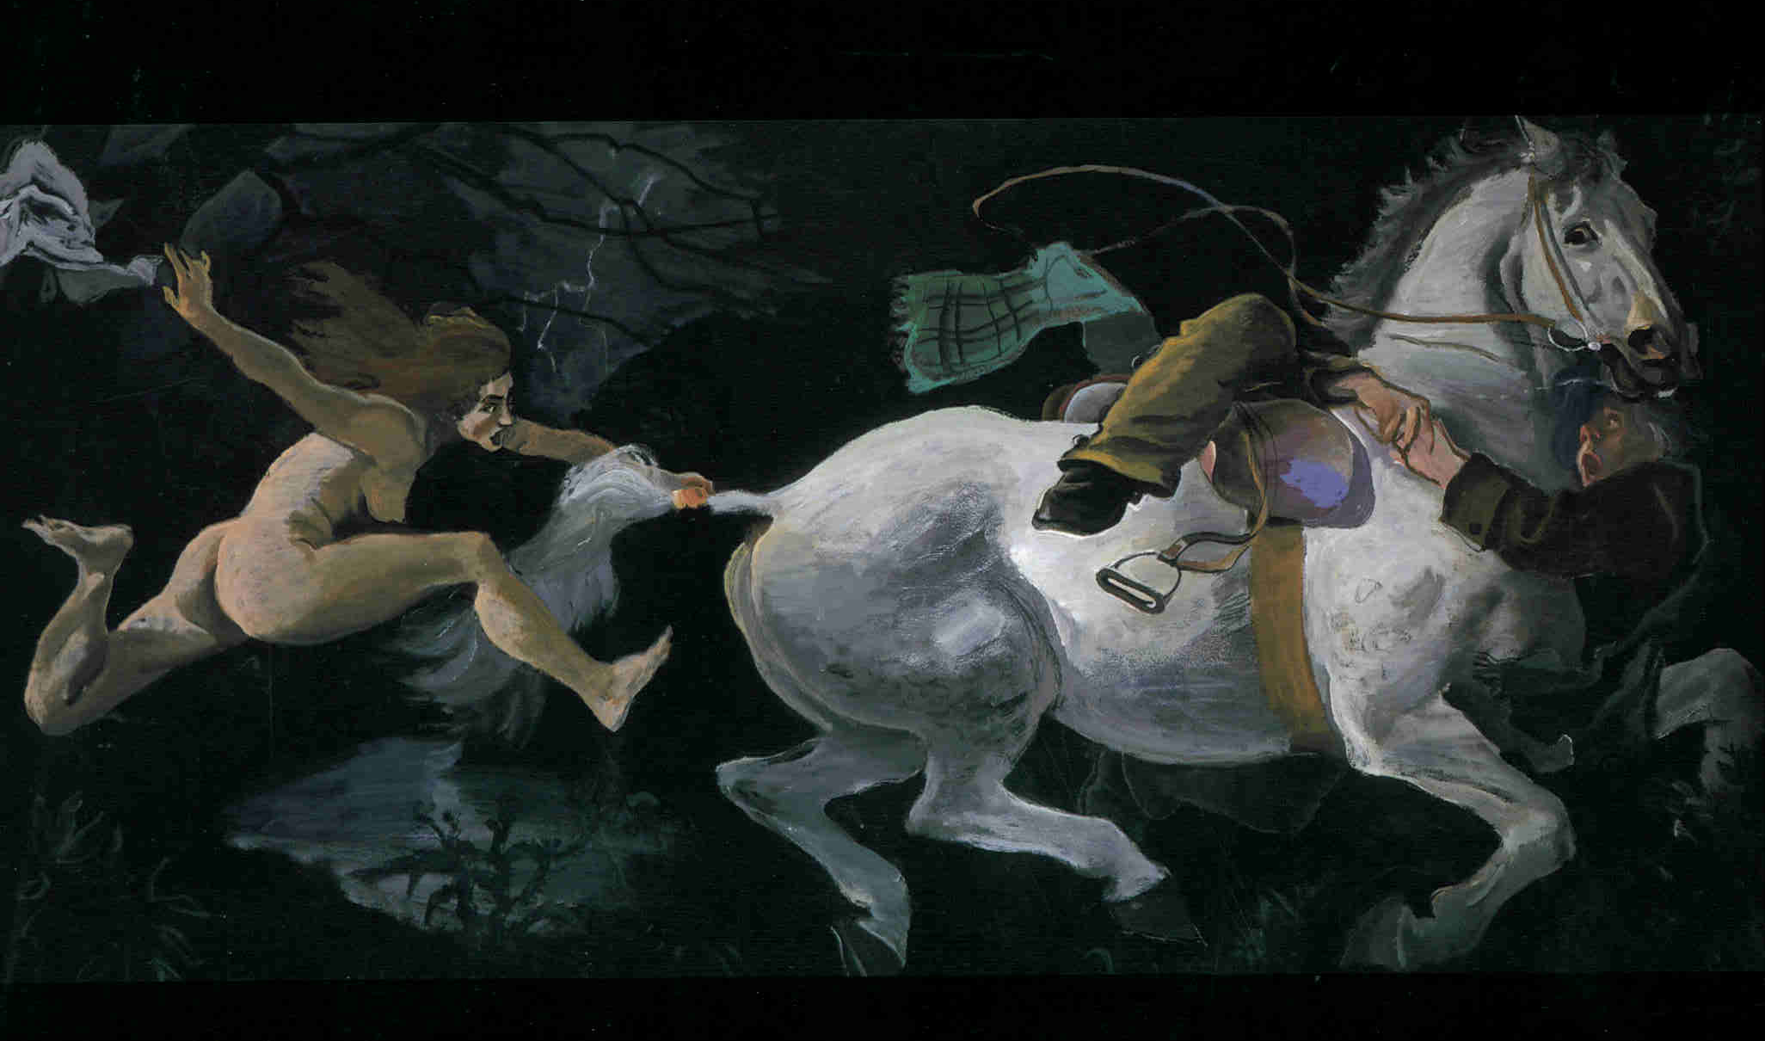
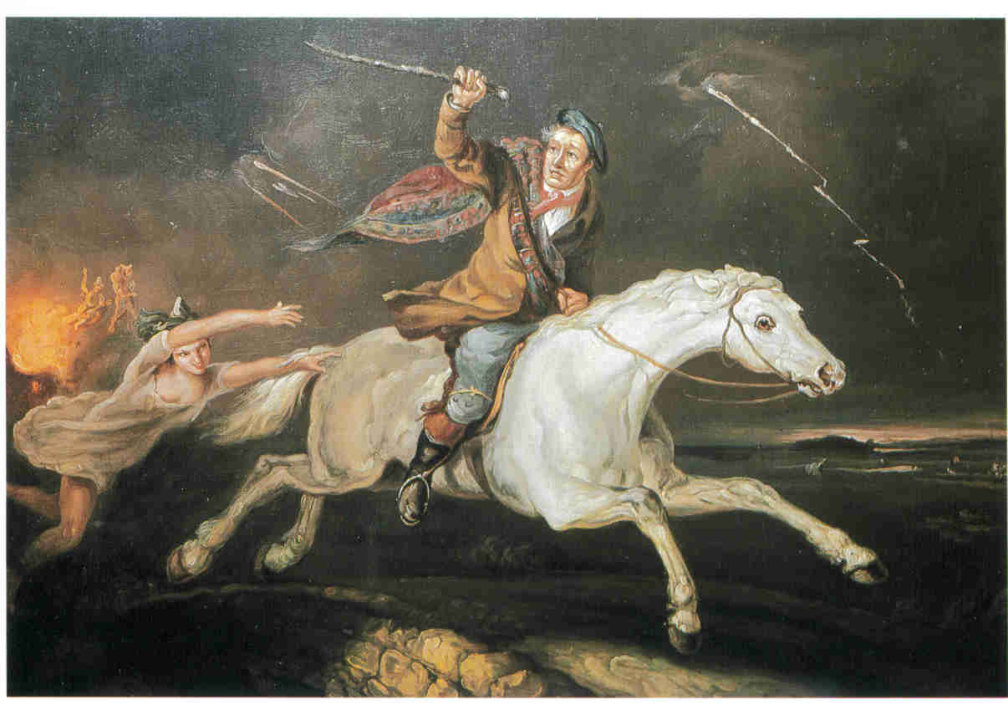
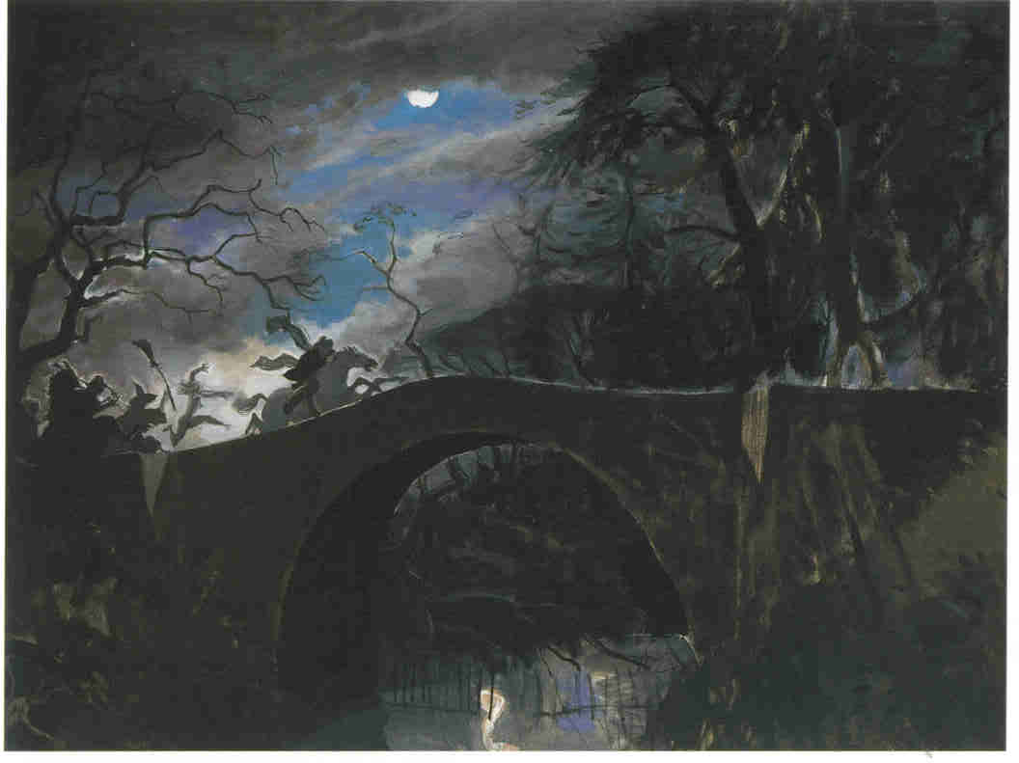
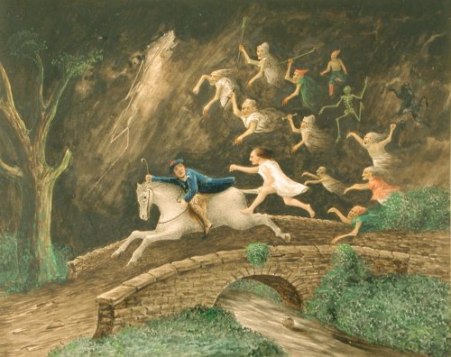

Slide 16
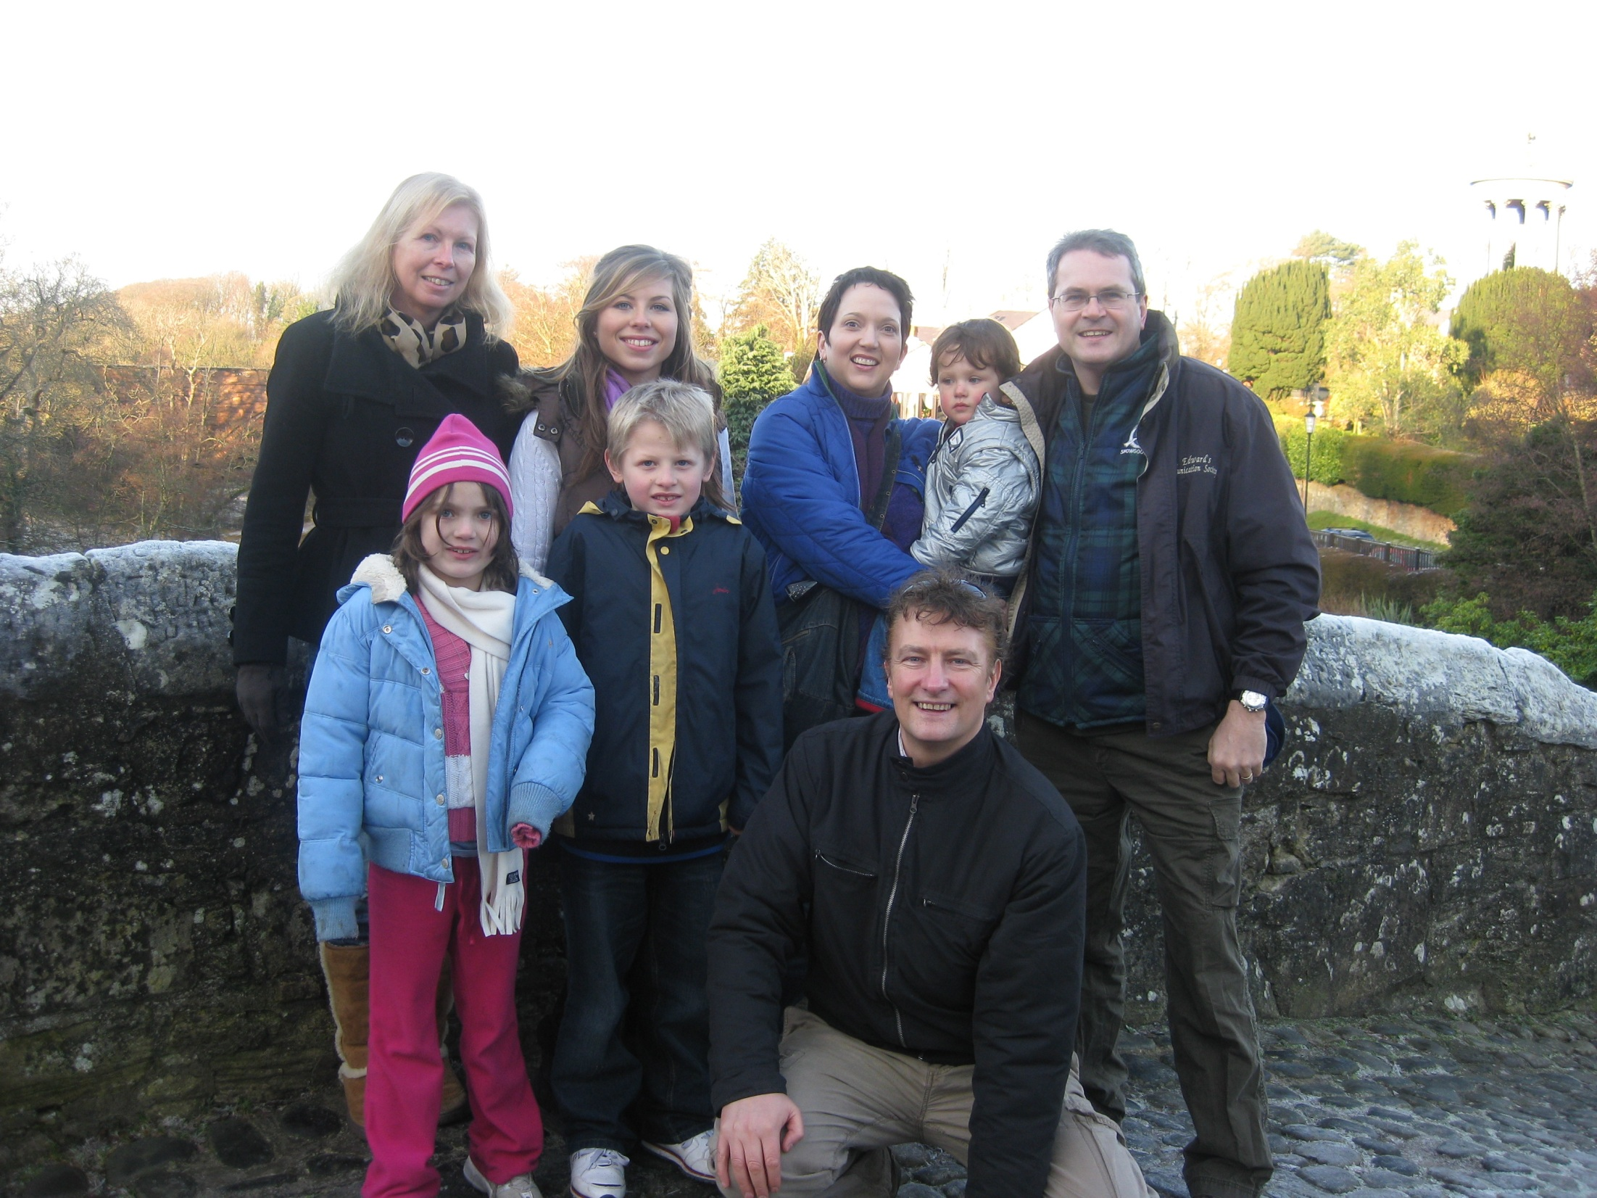
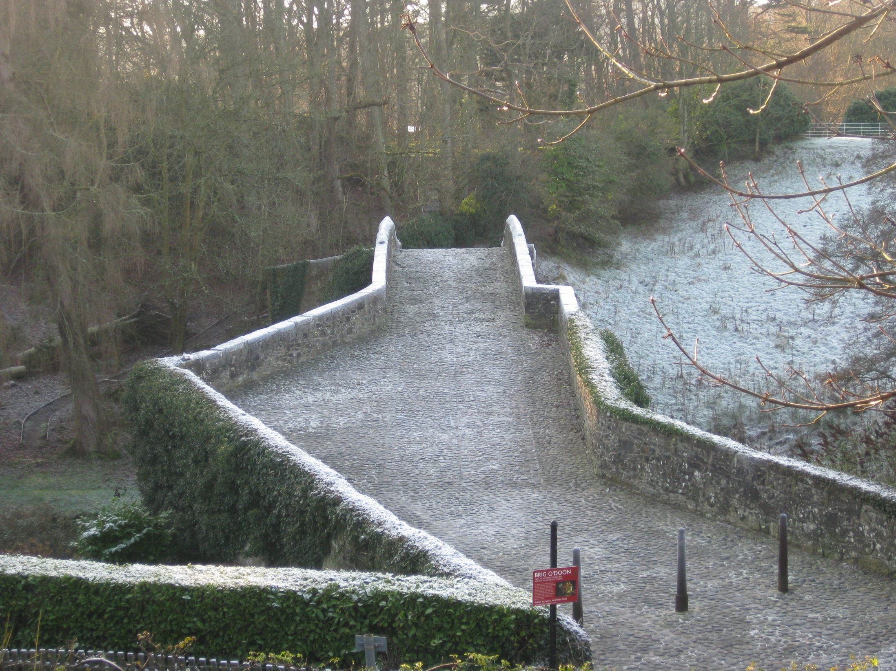
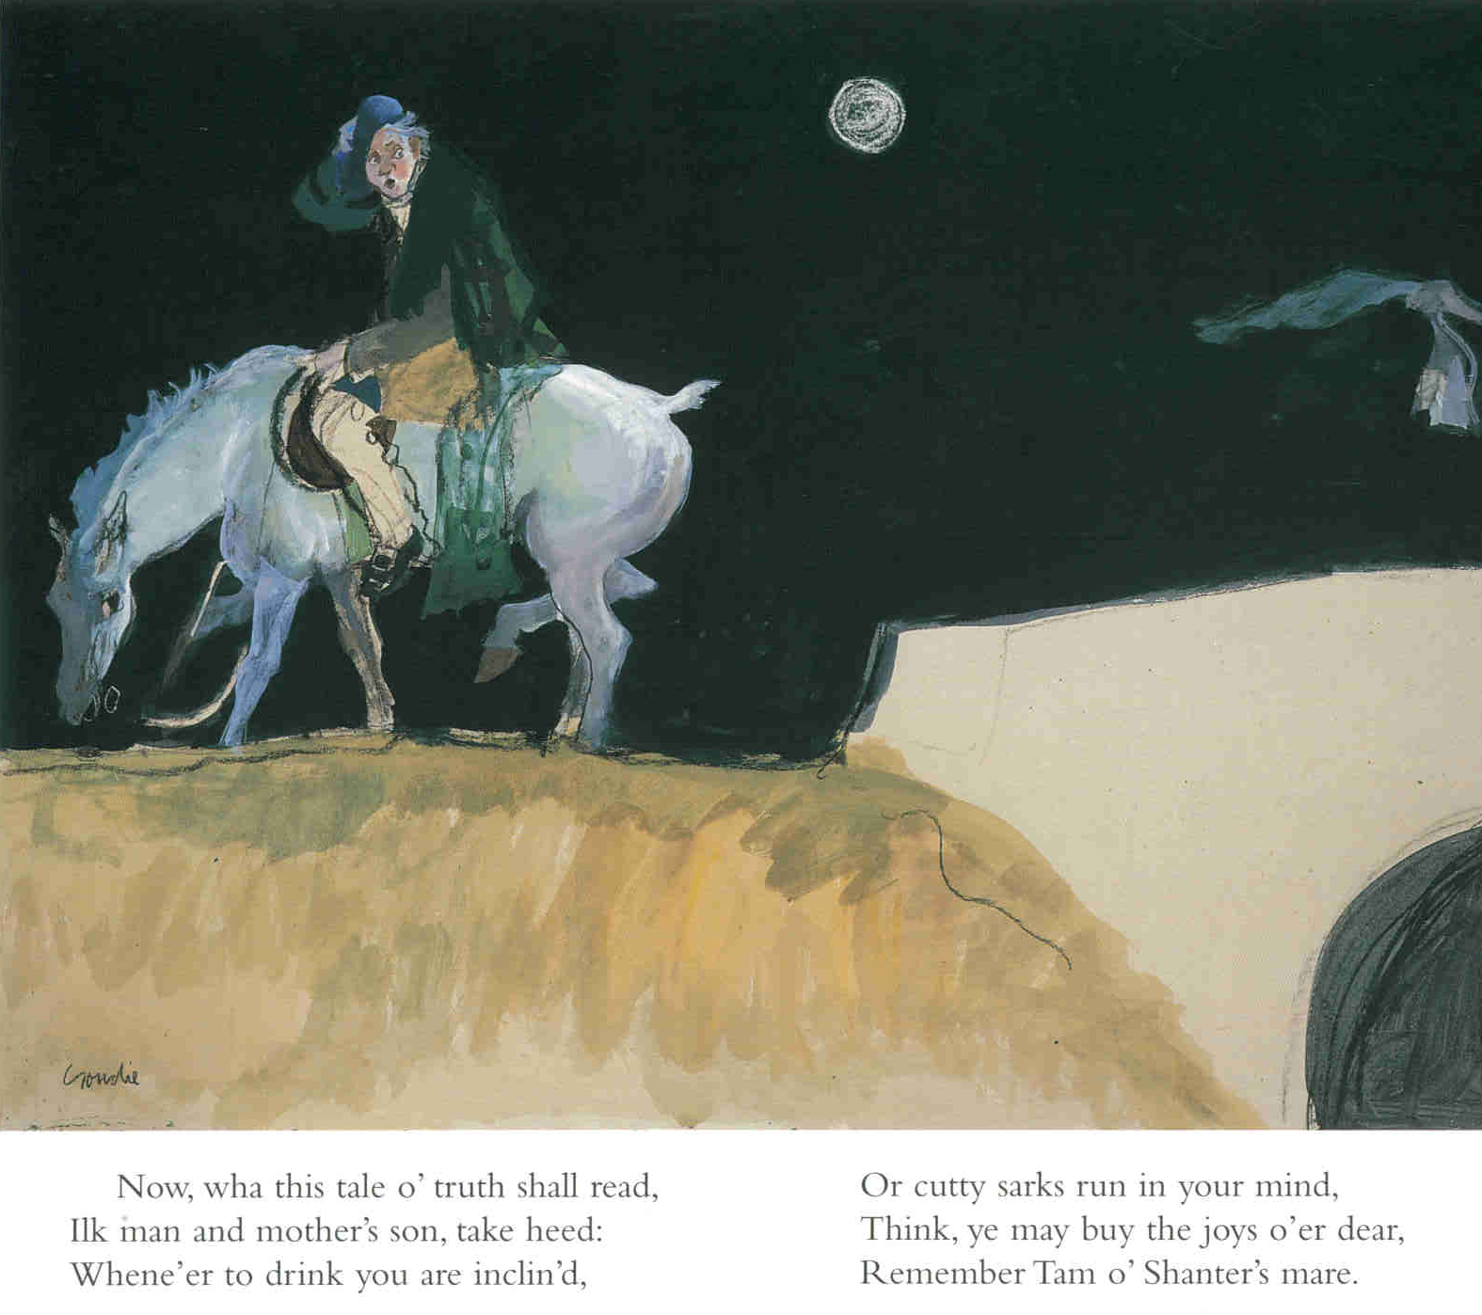
Visit Scotland 2012

Slide 17
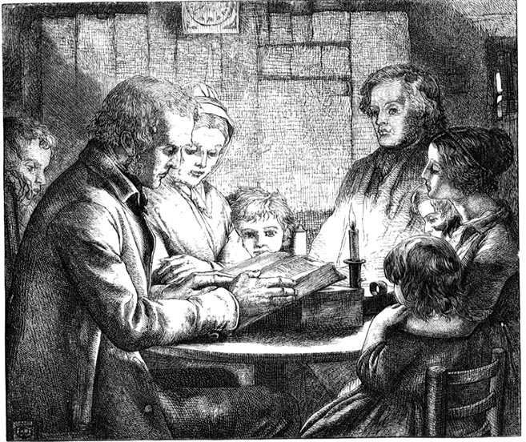

Slide 18
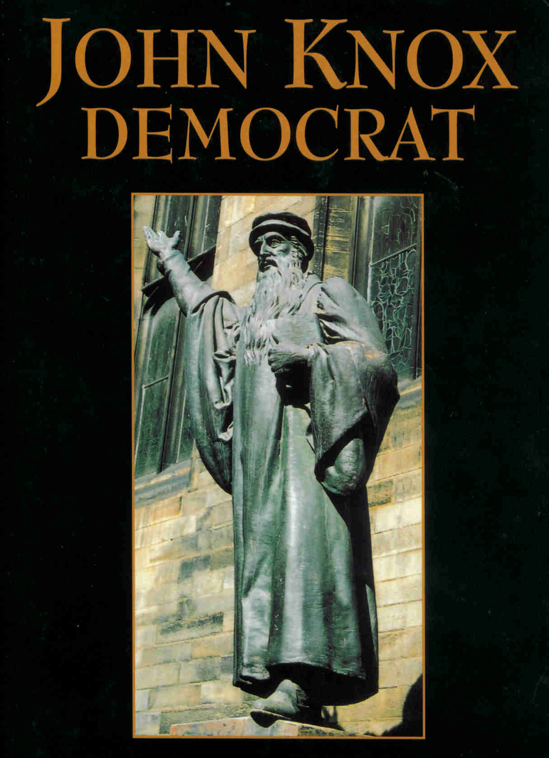
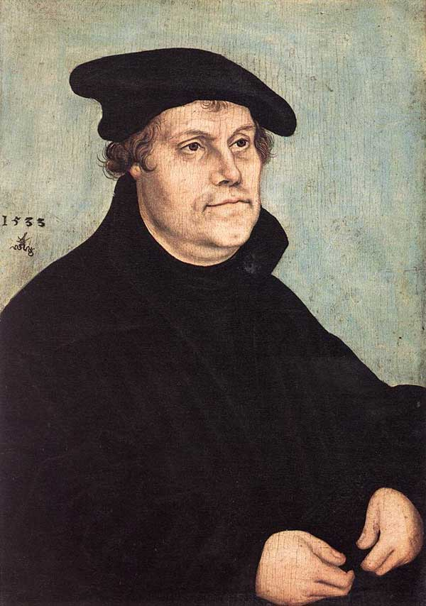
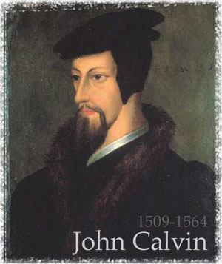
Martin Luther

Slide 19
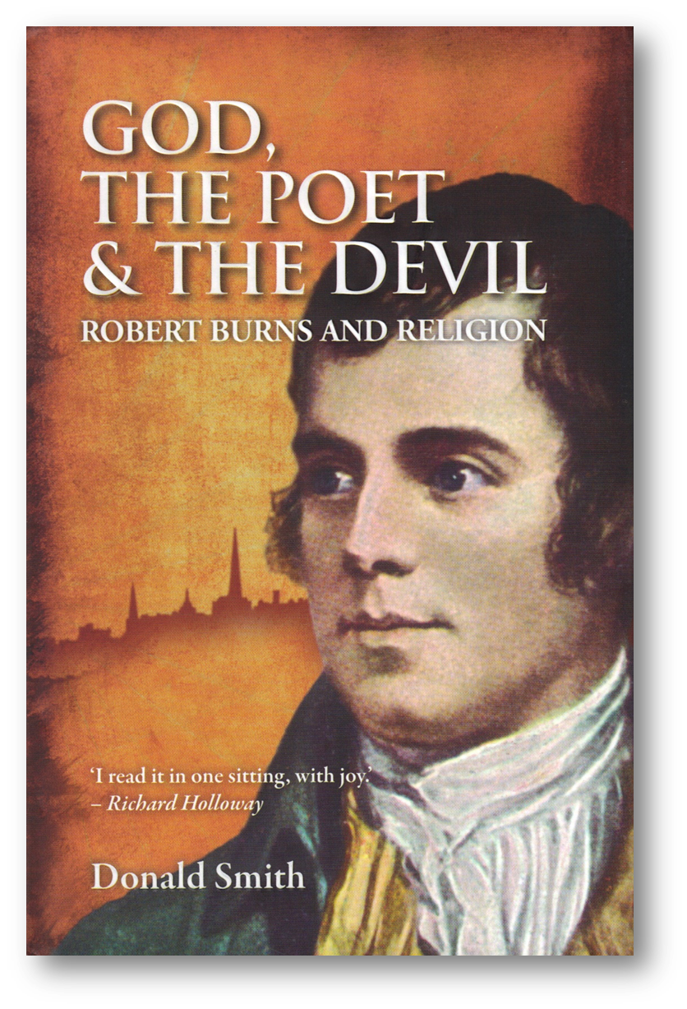
Formative years (Ayrshire)
Bible reading—literacy
Father Christian
Early poems “saturated with biblical references”
Well versed in folk religion that continued inside & outside “Kirk”

Slide 20
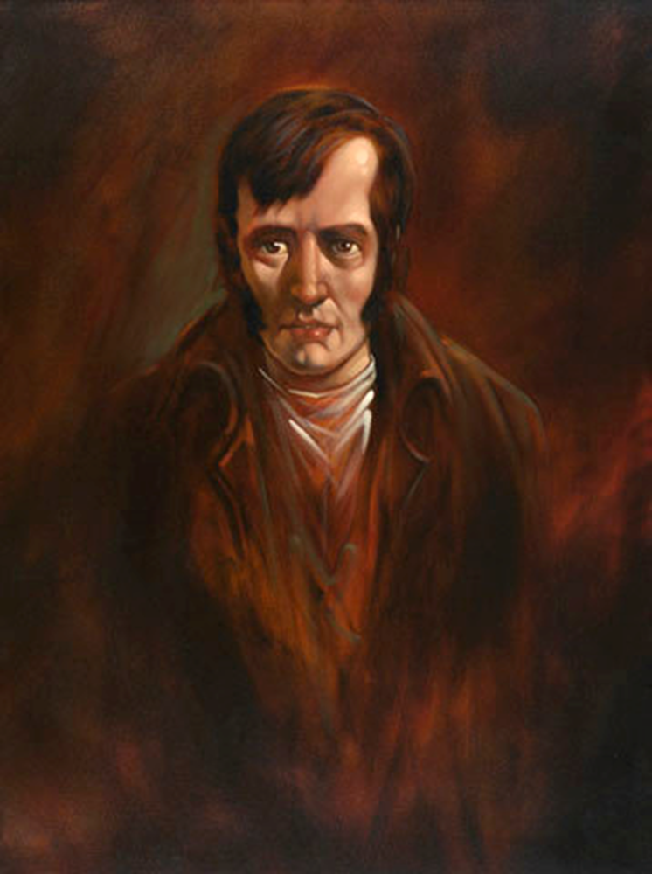
Later years …
French Revolution
Poems more satirical & critical towards religion
“A religion of reason and conscience without need of Church & State”

Slide 21
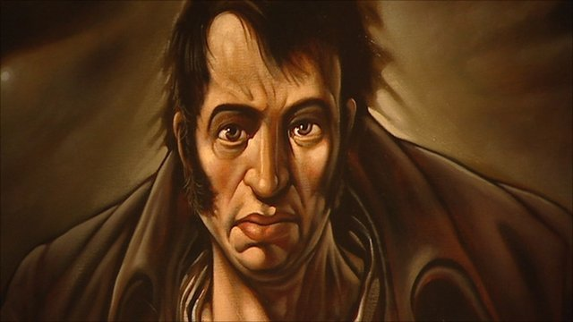
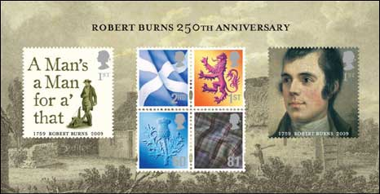

Slide 23
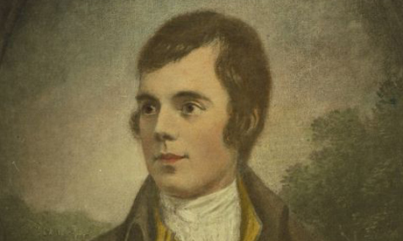
“There is no such uncertainty as a sure thing” — Robert Burns, Scottish poet (1759-1796)

Slide 24
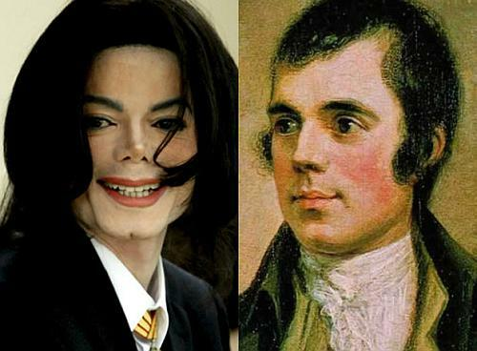
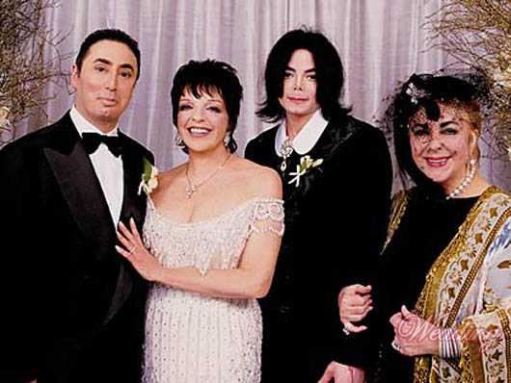

Slide 25
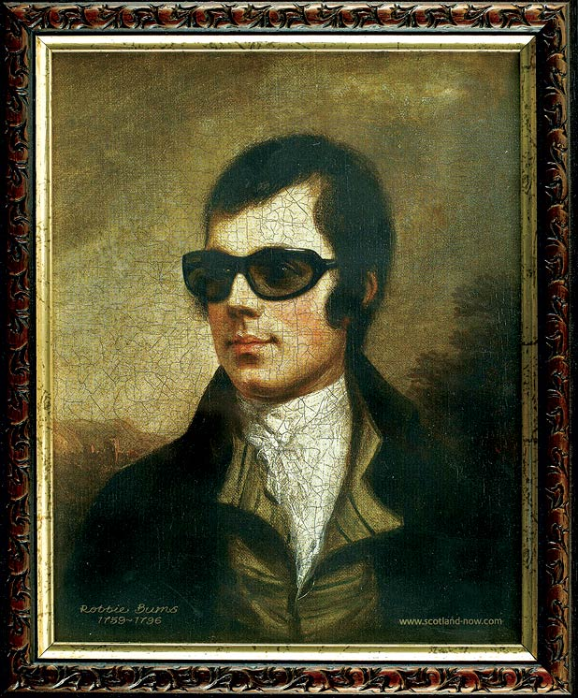

Slide 30
Apostasy

Slide 32
A wind of secularity is blowing across North America
Number of Americans leaving religion = “one of the most important trends on the American religious scene”

Slide 34
Demographic shifts
Best selling books
Growth in Atheist Groups
Millennials—only 53% believe in god

Slide 35
The “real story” underlying the growth of secularity in North America is “the growth in apostasy”

Slide 36
Apostasy = defection or revolt
Not only loss of faith
Rejection of religious community as basis of self-identification

Slide 38
Intellectual
Just don’t believe anymore

Slide 39
Social
Social bonds disintegrate

Slide 40
Emotional
Psychological reactions

Slide 41
Early
Most people knew by 22

Slide 42
Late
Rare—reject religion adopted as adult
USA Today

Slide 44
Shallow vs. Deep
Not totally secular—ex-Catholic, ex-Mormon
Jesus = moral teacher worthy of respect & reverence
Not comfortable with “Atheist” label
Culturally linked to religious tradition

Slide 46
52% nonreligious former Catholics

Slide 47
Intro

Slide 48
Mild vs. Transformative
Barker
clergyproject

Slide 49
Personal revolution
Life-altering transformation
Often entails:
Loss of close friendships
Alienation from strong community
Rejection by one’s family

Slide 50
The Call, The Fall, The Fallout

Slide 51
The Call
15 “Called to Ministry”
Teacher James Edwards
Ministry—music & message
Missionary Mexico
National Christian songwriter

Slide 52
The Call
Behind the visible world was a very real spiritual world inhabited by angels, demons, spirits and saints all fighting to win my soul

Slide 53
The Fall
Tolerance of Liberal Christians
Reading science magazines, philosophy, psychology
End Times—not arrived
Faith & Reason began a war within me

Slide 54
The Fall
Lost faith in Faith
Bible not accurate source of truth
Enjoying the scary feeling of “growing up” and learning
A private, independent process of freethinking

Slide 55
The Fall
The whole sermon / worship set up is a huge drama we are all acting out … all playing along with the illusory meaningfulness of it all

Slide 56
The Fallout
As much as we wanted to be friends, their religion considers me the enemy
Demoted from respected authority to problem child
Christian marriage did not last

Slide 59
More likely among men than women
More likely among left-leaning politically
More likely among better educated
“Education appears to have a corrosive effect on religiosity in general”

Slide 60
Most people are uncertain & susceptible vulnerable to someone else’s confidence & certainty

Slide 61
Religious Authority
Failure to obey = loss of paradise
Abraham willing to kill son because God ordered it, without explanation

Slide 62
Most people conform,
Most of the time

Slide 63
Most people accept and adopt the religious worldview of their parents, community, culture

Slide 64
St. Margaret's

Slide 68
Product of Cultural Background
Cultural Relativism of Religion

Slide 69
“I loved being Catholic”
You knelt in obedience and submission
Like you lived in a castle
Close-knit, safe feeling

Slide 70
“What We Believe”
Hated that Mulan was taking what I said as absolute truth
Our job is to socialize our kids, they have evolved to look to us for answers

Slide 71
“What We Believe”
It’s expedient to pressure children to conform
It encourages community

Slide 72
Obedience
Conforming to dictates of authority figures had advantages
Parents, teachers knew more than we did
Following their advice was beneficial
Their positions speak of greater access to information and power

Slide 73
“I have to say it Because it’s nice”

Slide 74
Social Proof
We view a behavior as correct in a given situation to the degree we see others performing it
A convenient shortcut for determining the way to behave

Slide 76
Evangelical preachers seed their audience with ringers
“By the time Billy Graham arrives in town and makes his alter call, an army of 6,000 wait with instructions on when to come forth at varying intervals to create the impression of spontaneous mass outpouring”

Slide 77
Jonestown 1978
Jim Jones relocated The People’s Temple from San Francisco to the jungles of Guyana, South America
Followers convinced suicide was the correct conduct—social proof

Slide 78
“Learned” from watching others that patient turn taking was the correct behavior

Slide 79
Cult of Personality
Anthony Romero

Slide 80
The more the leader comes to embody the group:
The more loyalty or obedience he enjoys
Focusing on personality and welfare of leader
Lose sight of where his interests end and group interests begin

Slide 81
Conformity Drawback
Groupthink—reaching consensus overrides willingness to disagree

Slide 82
The illusion of invulnerability
Belief in the inherent group morality
Rationalization of group views
Stereotyping of out-groups
Self-censorship
Direct pressure on dissenters
Self-appointed mindguards
The illusion of unanimity

Slide 83
American as Apple Pie

Slide 84
Apostasy = importance of individuality, variability, human agency

Slide 85
Apostate Personality = good, kind, honest, happy, self-assured, courageous, freethinkers, life-lovers

Slide 87
Part 1
Part 3

Slide 89
Intro

Slide 95
The Demon-Haunted World, subtitled Science as a Candle in the Dark, was a passionate defense of science against pseudoscience and irrationality

